Slide 1


Slide 2
This is only made possible by God’s faithfulness to His gracious covenants.

Slide 3
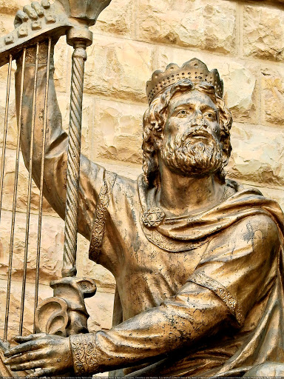

Slide 4
“Your house and your kingdom shall endure before Me forever; your throne
shall be established forever”
(II Sam. 7:16; NASB 95).

Slide 5
“I have made a covenant with My chosen;
I have sworn to David My servant, I will establish your seed forever and build up
your throne to all generations. . . .
My lovingkindness I will keep for him forever, and My covenant shall be confirmed to him. So I will establish his descendants forever and his throne as the days of heaven” (Ps. 89:3-4, 28-29; NASB 95).

Slide 6
“He will be great and will be called the
Son of the Most High; and the Lord God
will give Him the throne of His father David; and He will reign over the house of Jacob forever, and His kingdom will have no end”
(Lk. 1:32-33; NASB 95).

Slide 7

The Davidic Covenant’s gracious provisions are God’s promises that David’s seed, kingdom, and throne would be established forever, all of which are
fulfilled in David’s ultimate descendant,
the Lord Jesus Christ.

Slide 8
The Sequence of Books 1 and 2

Slide 9
The Sequence of Books 1 and 2
Book 1 (1-41) David preserved

Slide 10
The Sequence of Books 1 and 2
Book 1 (1-41) David preserved
Psalm 3
A psalm of David,
when he fled from Absalom his son.

Slide 11
The Sequence of Books 1 and 2
Book 1 (1-41) David preserved
Book 2 (42-72) David’s dynasty preserved

Slide 12
The Sequence of Books 1 and 2
Book 1 (1-41) David preserved
Book 2 (42-72) David’s dynasty preserved
Psalms 42-44
The sons of Korah in the Exile

Slide 13
Book 2 (42-72) David’s dynasty preserved

Slide 14
Book 2 (42-72) David’s dynasty preserved
Reassurance

Slide 15
Book 2 (42-72) David’s dynasty preserved
I. These Psalms are by Various Authors.

Slide 16
Book 2 (42-72) David’s dynasty preserved
I. These Psalms are by Various Authors.
42-49 Sons of Korah
50 Asaph

Slide 17
Book 2 (42-72) David’s dynasty preserved
I. These Psalms are by Various Authors.
42-49 Sons of Korah
50 Asaph
51-65 David
66-67 Anonymous
68-70 David
71 An old man
72 Solomon

Slide 18
Book 2 (42-72) David’s dynasty preserved
I. These Psalms are by Various Authors.
(In Book 1, 37 are ascribed to David.
There are no other named authors.)

Slide 19
Book 2 (42-72) David’s dynasty preserved
I. These Psalms are by Various Authors.
What are they doing?

Slide 20
Book 2 (42-72) David’s dynasty preserved
I. These Psalms are by Various Authors.
What are they doing?
Lamenting and reflecting,
progressing to hope, and
providing answers.

Slide 21
Book 2 (42-72) David’s dynasty preserved
These Psalms are by Various Authors.
Many of David’s Psalms are His
Responses to Events He is Experiencing.

Slide 22
Book 2 (42-72) David’s dynasty preserved
These Psalms are by Various Authors.
Many of David’s Psalms are His
Responses to Events He is Experiencing.
Book 1 4 out of 37 are his responses to named
events.

Slide 23
Book 2 (42-72) David’s dynasty preserved
These Psalms are by Various Authors.
Many of David’s Psalms are His
Responses to Events He is Experiencing.
Book 1 4 out of 37 are his responses to named
events.
Book 2 8 out of 18 are his responses to named
events.

Slide 24
II. Many of David’s Psalms are His
Responses to Events He is Experiencing.
Psalm 51 David’s own sin

Slide 25
II. Many of David’s Psalms are His
Responses to Events He is Experiencing.
Psalm 51 David’s own sin
Psalms 52-64 David’s enemies

Slide 26
II. Many of David’s Psalms are His
Responses to Events He is Experiencing.
Psalm 51 David’s own sin
Psalms 52-64 David’s enemies
52 Doeg, the Edomite
54 the Ziphites
56 the Philistines
57 Saul
59 Saul’s murderous assassins
60 Gentile nations
63 the waterless wilderness

Slide 27
II. Many of David’s Psalms are His
Responses to Events He is Experiencing.
Psalm 51 David’s own sin
Psalms 52-64 David’s enemies
53 Atheists
55 a nameless close friend
58 the wicked
61 the false

Slide 28
II. Many of David’s Psalms are His
Responses to Events He is Experiencing.
Psalm 51 David’s own sin
Psalms 52-64 David’s enemies
All of these threatened the Covenant

Slide 29
Book 2 (42-72) David’s dynasty preserved
These Psalms are by Various Authors.
Many of David’s Psalms are His
Responses to Events He is Experiencing.

Slide 30
Book 2 (42-72) David’s dynasty preserved
These Psalms are by Various Authors.
Many of David’s Psalms are His
Responses to Events He is Experiencing.
III. These Psalms are for the Encouragement
of the Righteous . . .

Slide 31
Book 2 (42-72) David’s dynasty preserved
These Psalms are by Various Authors.
Many of David’s Psalms are His
Responses to Events He is Experiencing.
III. These Psalms are for the Encouragement
of the Righteous . . . when the covenant
seemed most threatened.

Slide 32
“Remember Jesus Christ, risen from the dead, descendant of David, according
to my gospel” (II Timothy 2:8; NASB 95).

Slide 33
“I, Jesus, have sent My angel to testify
to you these things for the churches.
I am the root and the descendant
of David, the bright morning star”
(Revelation 22:16; NASB 95).

