Slide 1
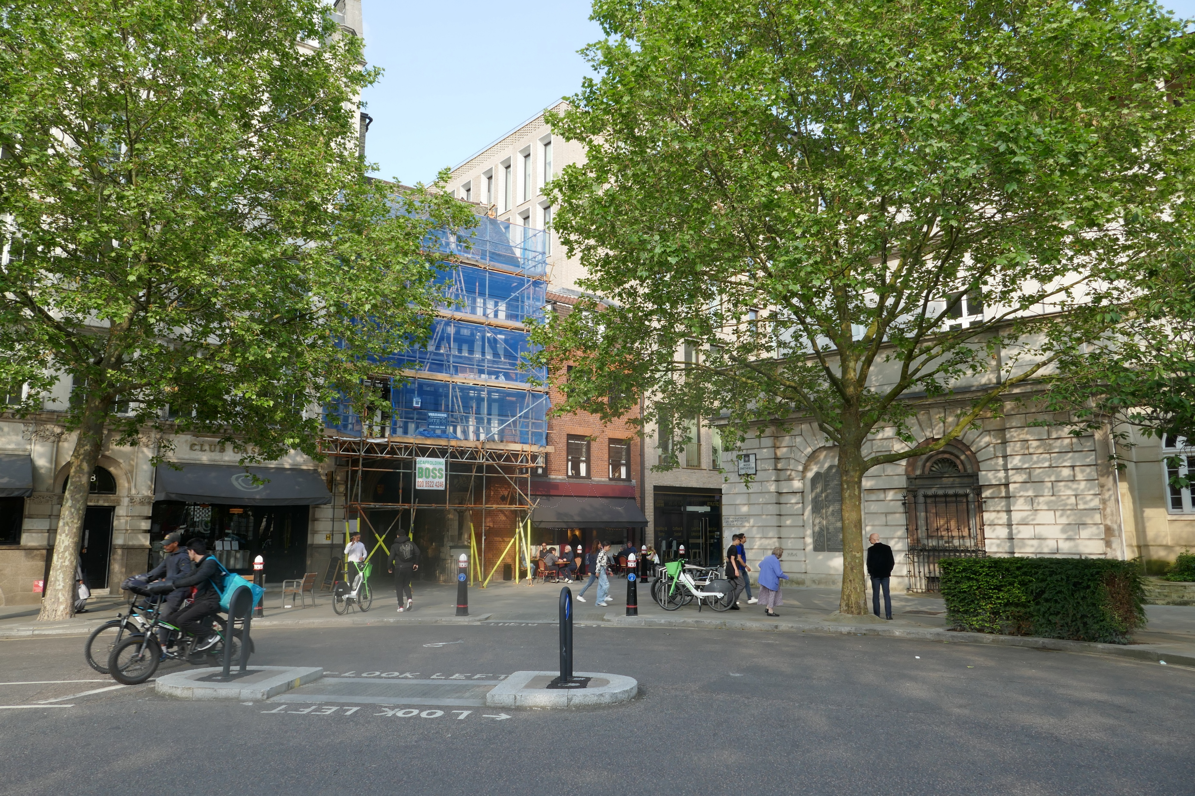

Slide 2
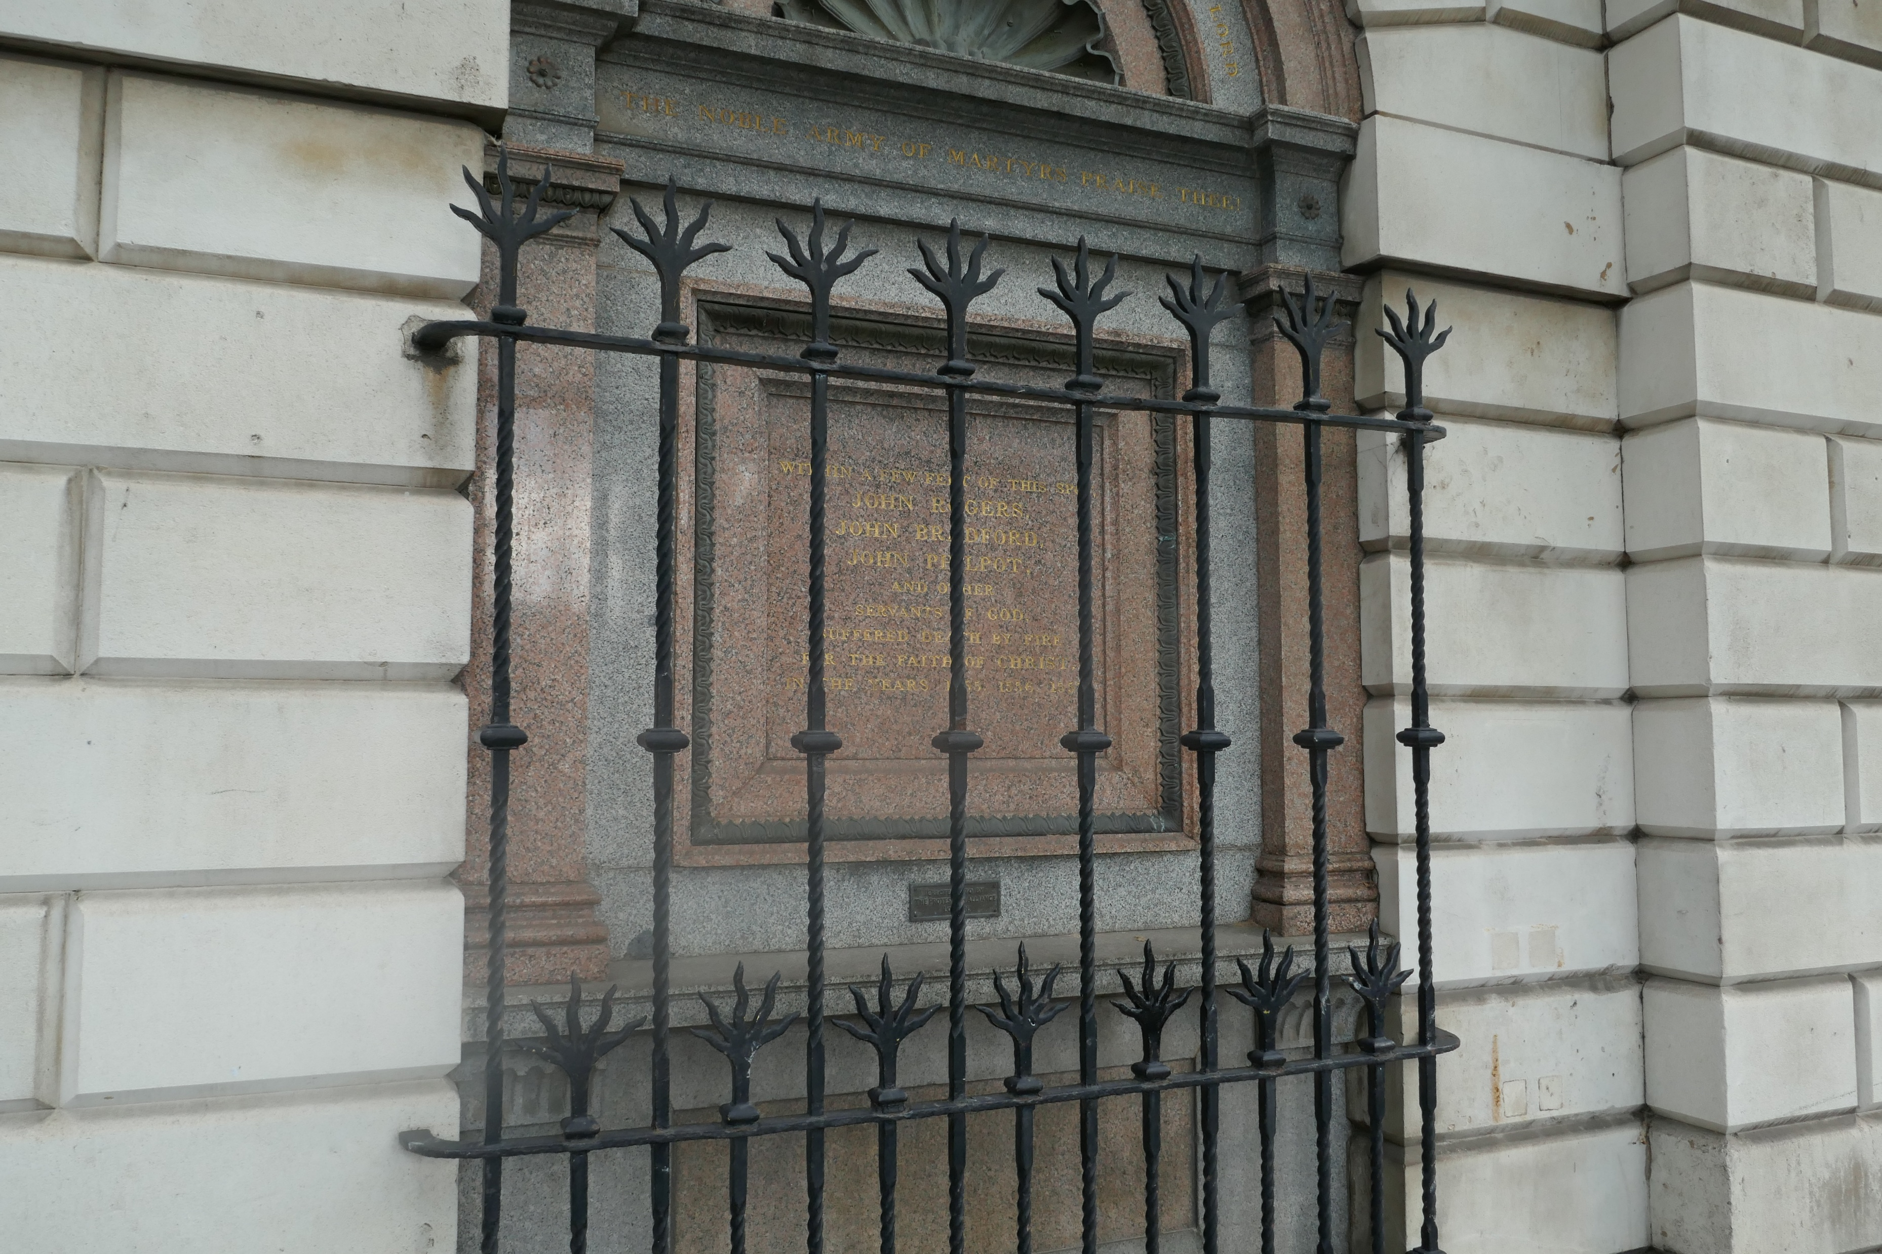

Slide 3
JOHN ROGERS
1550-1555
From Rome to Smithfield
From Priest to Martyr

Slide 4
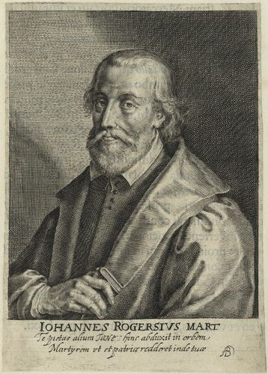
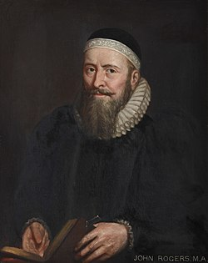
John Rogers
1505-1555
Willem de Passe (ca. 1598 – ca. 1637),
Portrait by Gustavus Ellinthorpe Sintzenich (c.1821–1892)

Slide 5
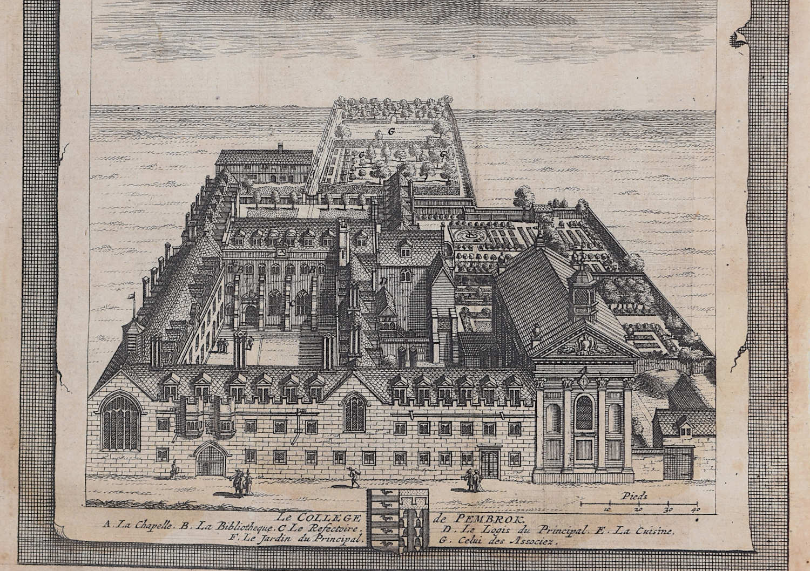

Slide 6
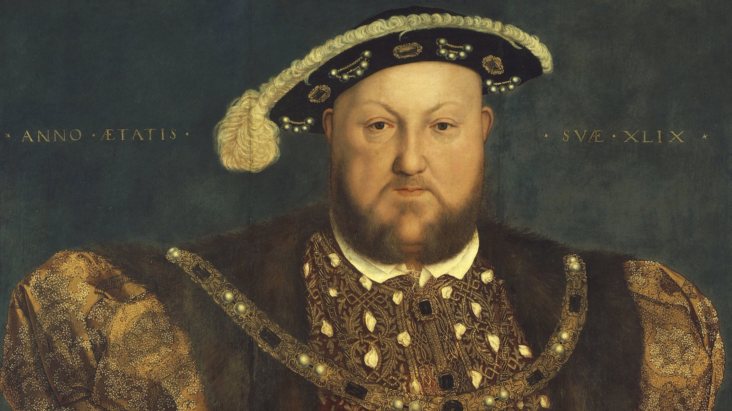

Slide 7
Moves to Antwerp 1534

Slide 8
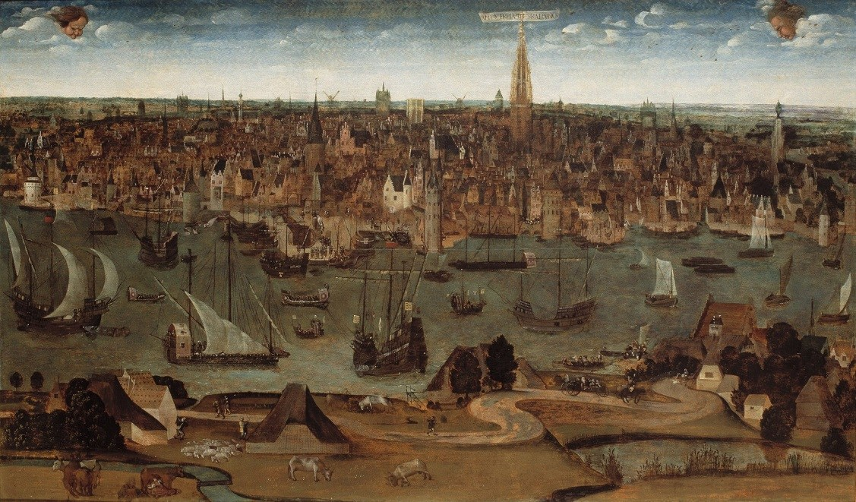
In its 16th-century pomp, Antwerp was at the hub of the known world. It was a cauldron of emperors, heretics, spies and killer bankers, all stirring religious, sexual and intellectual scandals.

Slide 9
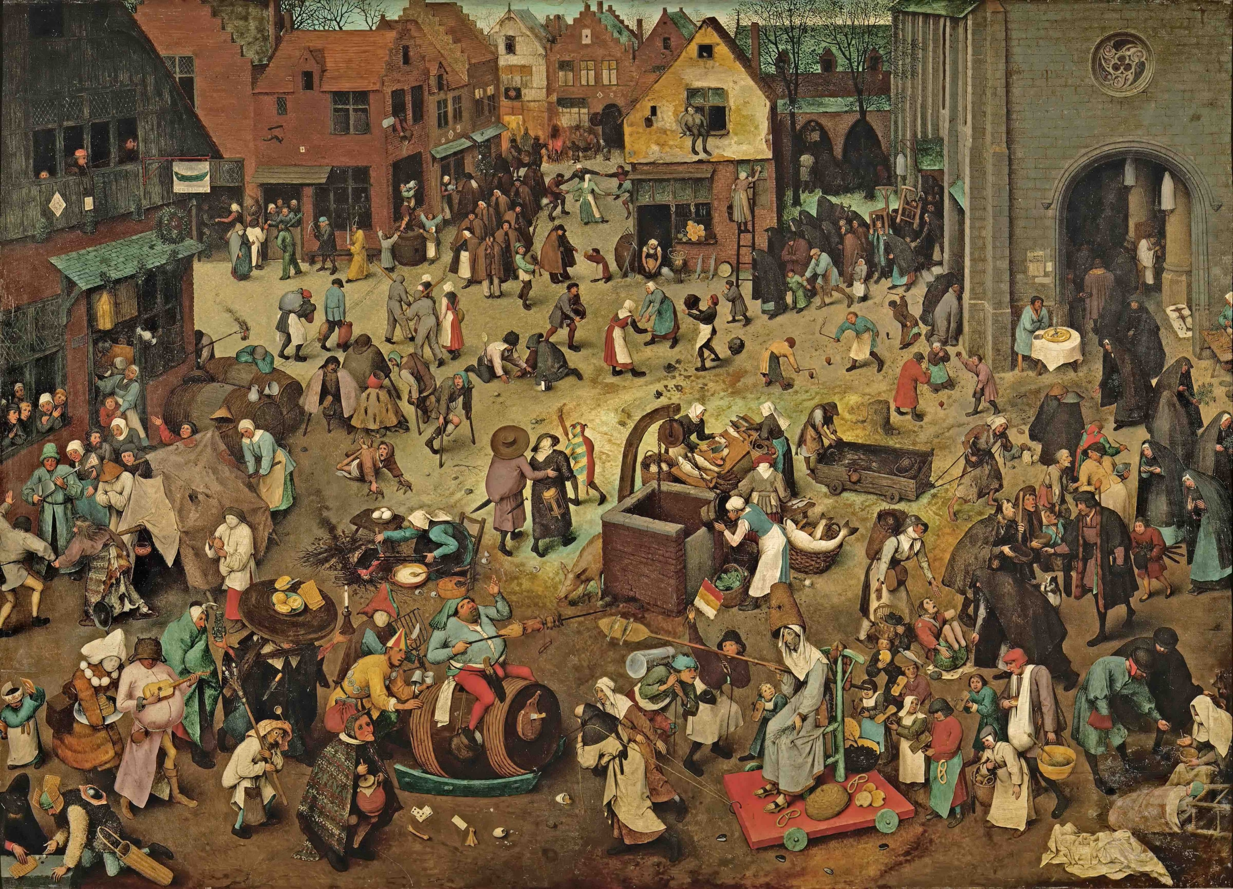
The Fight Between Carnival and Lent' by Pieter Bruegel the Elder, an oil painting from 1559, shows the late-medieval dynamic Wendy Wauters evokes in 'The Smells of the Cathedral'.

Slide 10
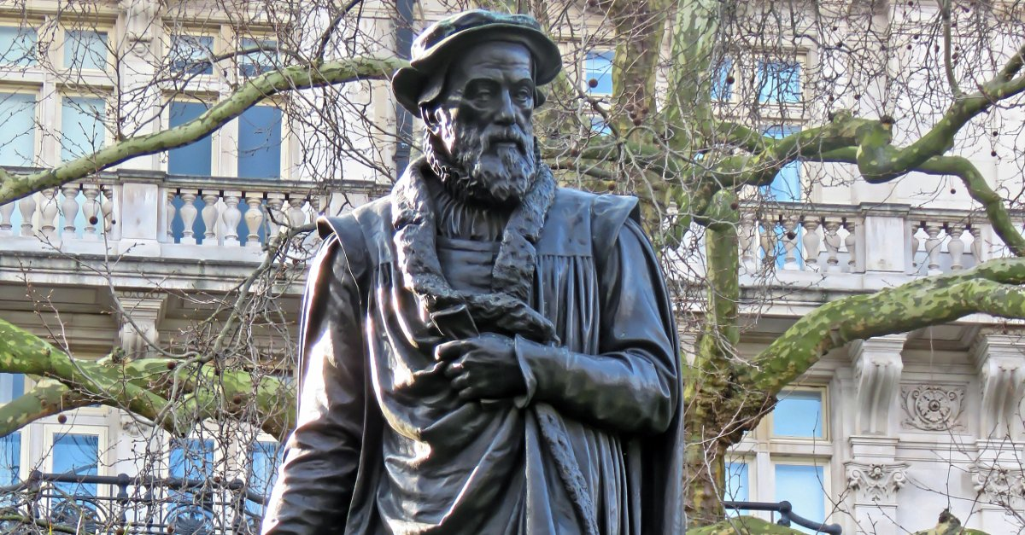

Slide 11
Antwerp 1534
Meets Tyndale and is converted ??

Slide 12
Antwerp 1534
Meets Tyndale and is converted ??
Tyndale arrested May, 1535

Slide 13
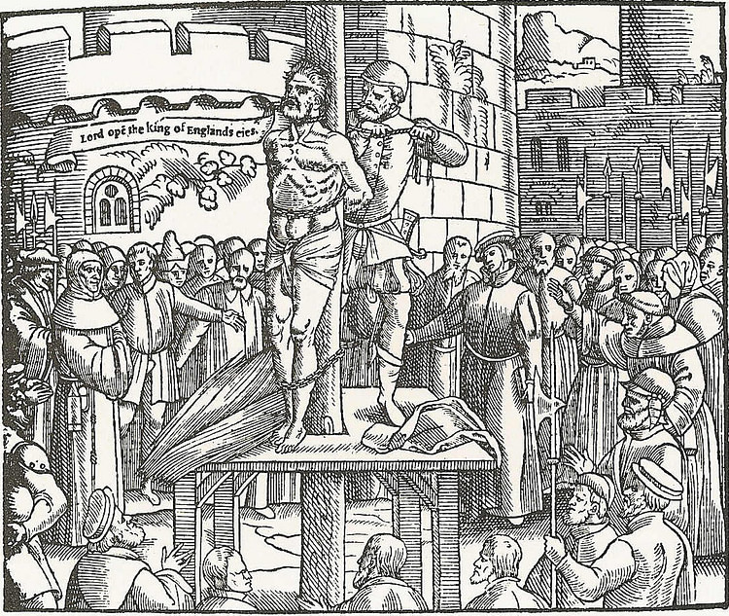
October 6, 1536

Slide 14
Antwerp 1534
Meets Tyndale and is converted ??
Tyndale arrested May, 1535
Marries Adriana de Weyden 1537

Slide 15
Antwerp 1534
Meets Tyndale and is converted ??
Tyndale arrested May, 1535
Marries Adriana de Weyden 1537
Prints the “Matthew” Bible July, 1537

Slide 16
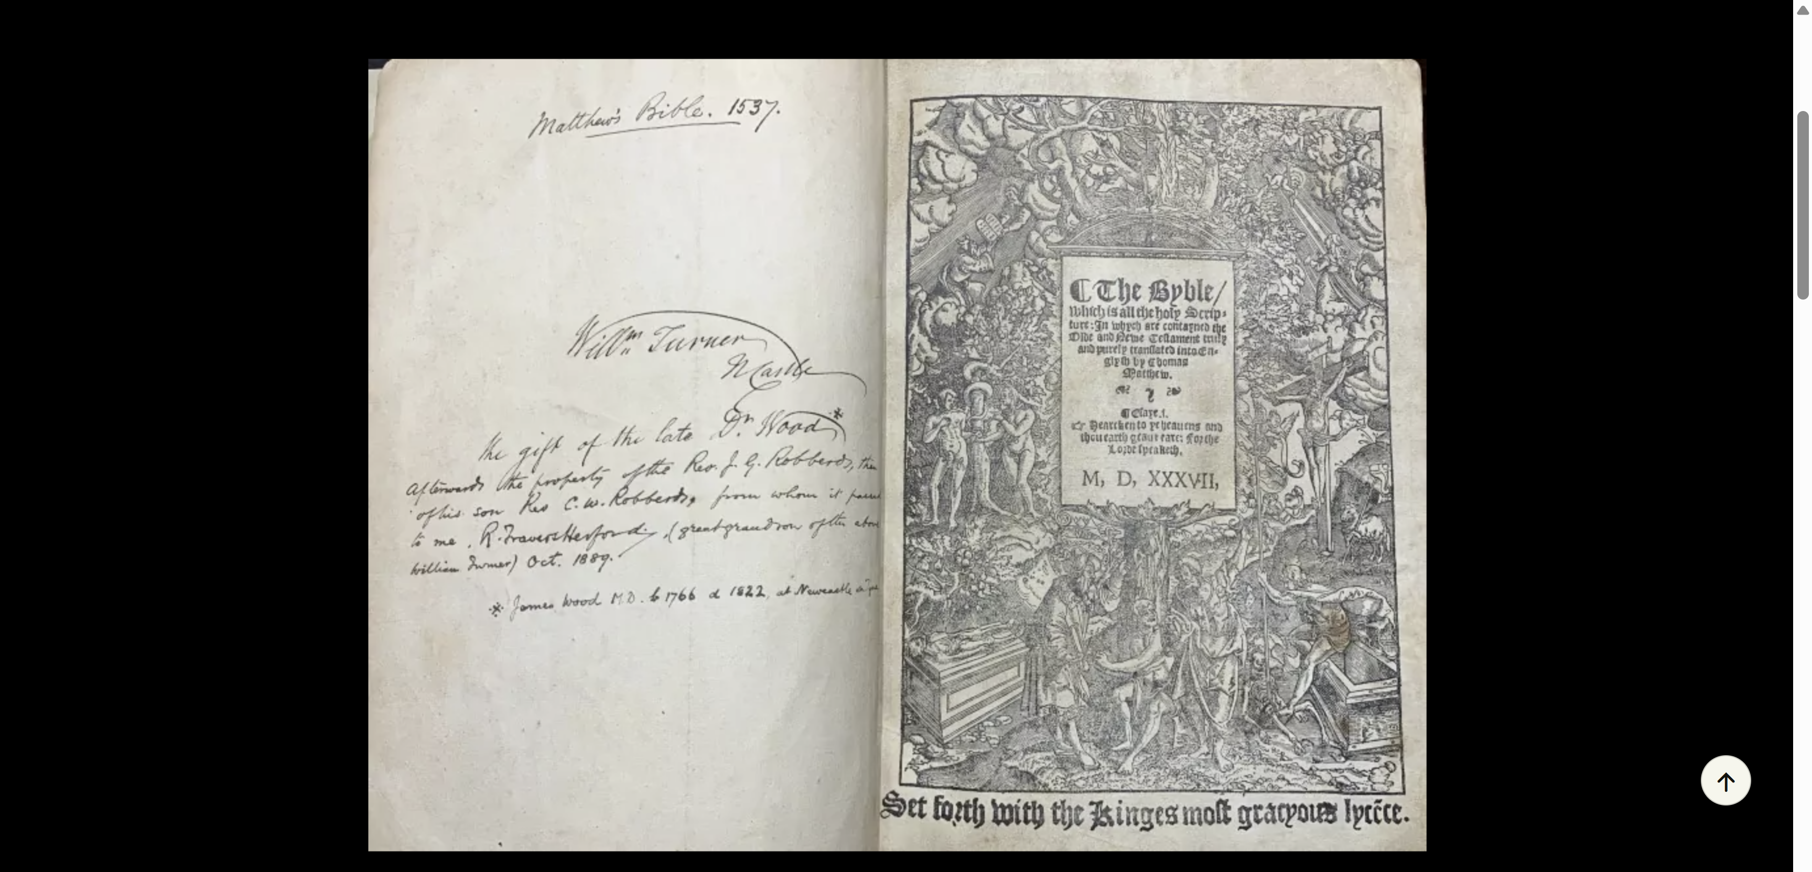

Slide 17
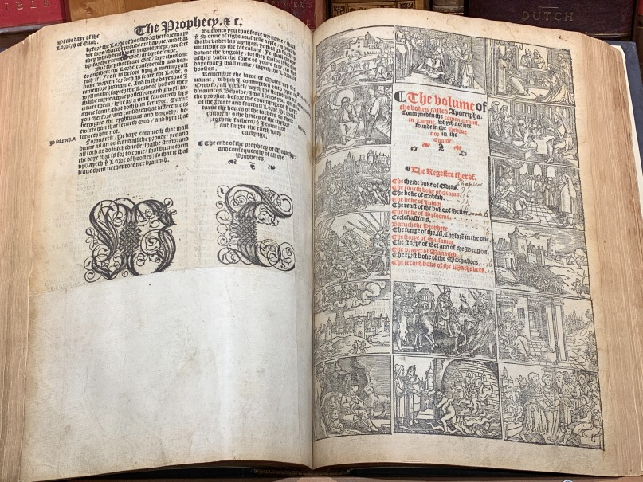

Slide 18
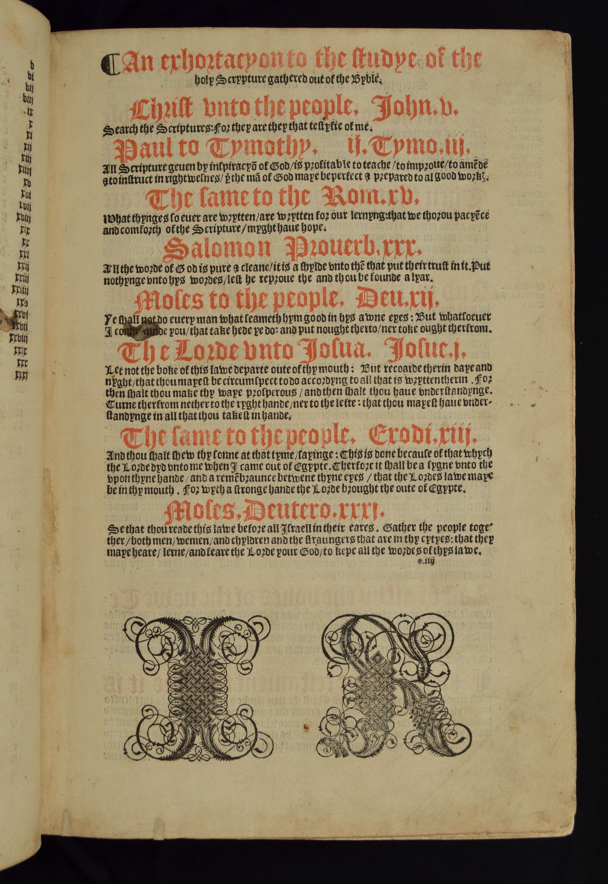

Slide 19
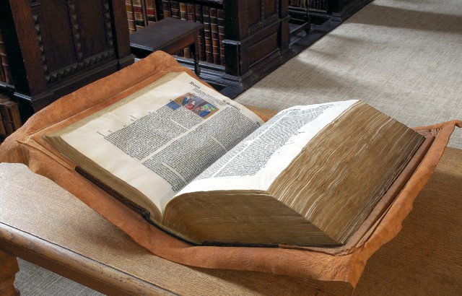
Analysis of Henry VIII's personal Bible sheds new light on Britain's past - Queen Mary University of London

Slide 20
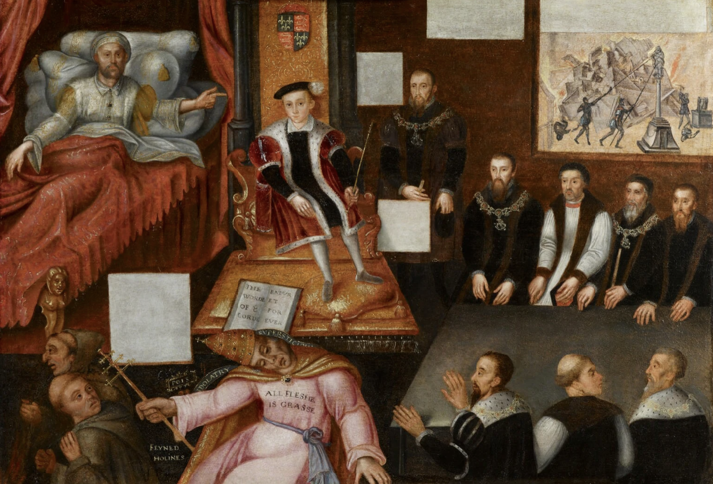

Slide 21
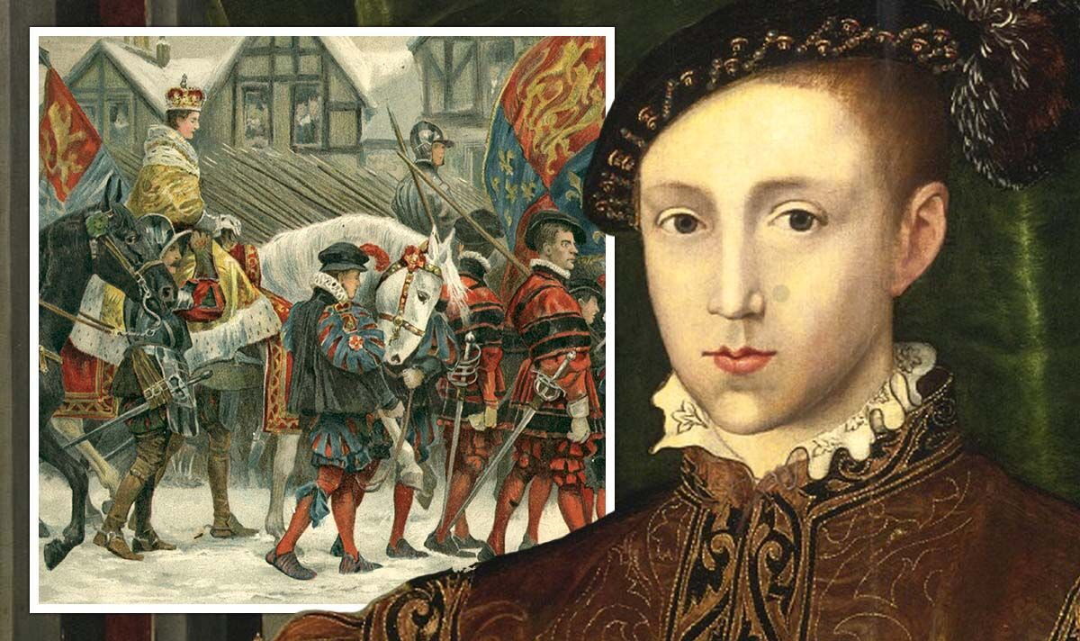

Slide 22
Antwerp 1534
Meets Tyndale and is converted ??
Tyndale arrested May, 1535
Marries Adriana de Weyden 1537
Prints the “Matthew” Bible July, 1537
Returns to England 1548

Slide 23
Antwerp 1534
Meets Tyndale and is converted ??
Tyndale arrested May, 1535
Marries Adriana de Weyden 1537
Prints the “Matthew” Bible July, 1537
Returns to England 1548
Appointed to St. Sepulchre 1550

Slide 24
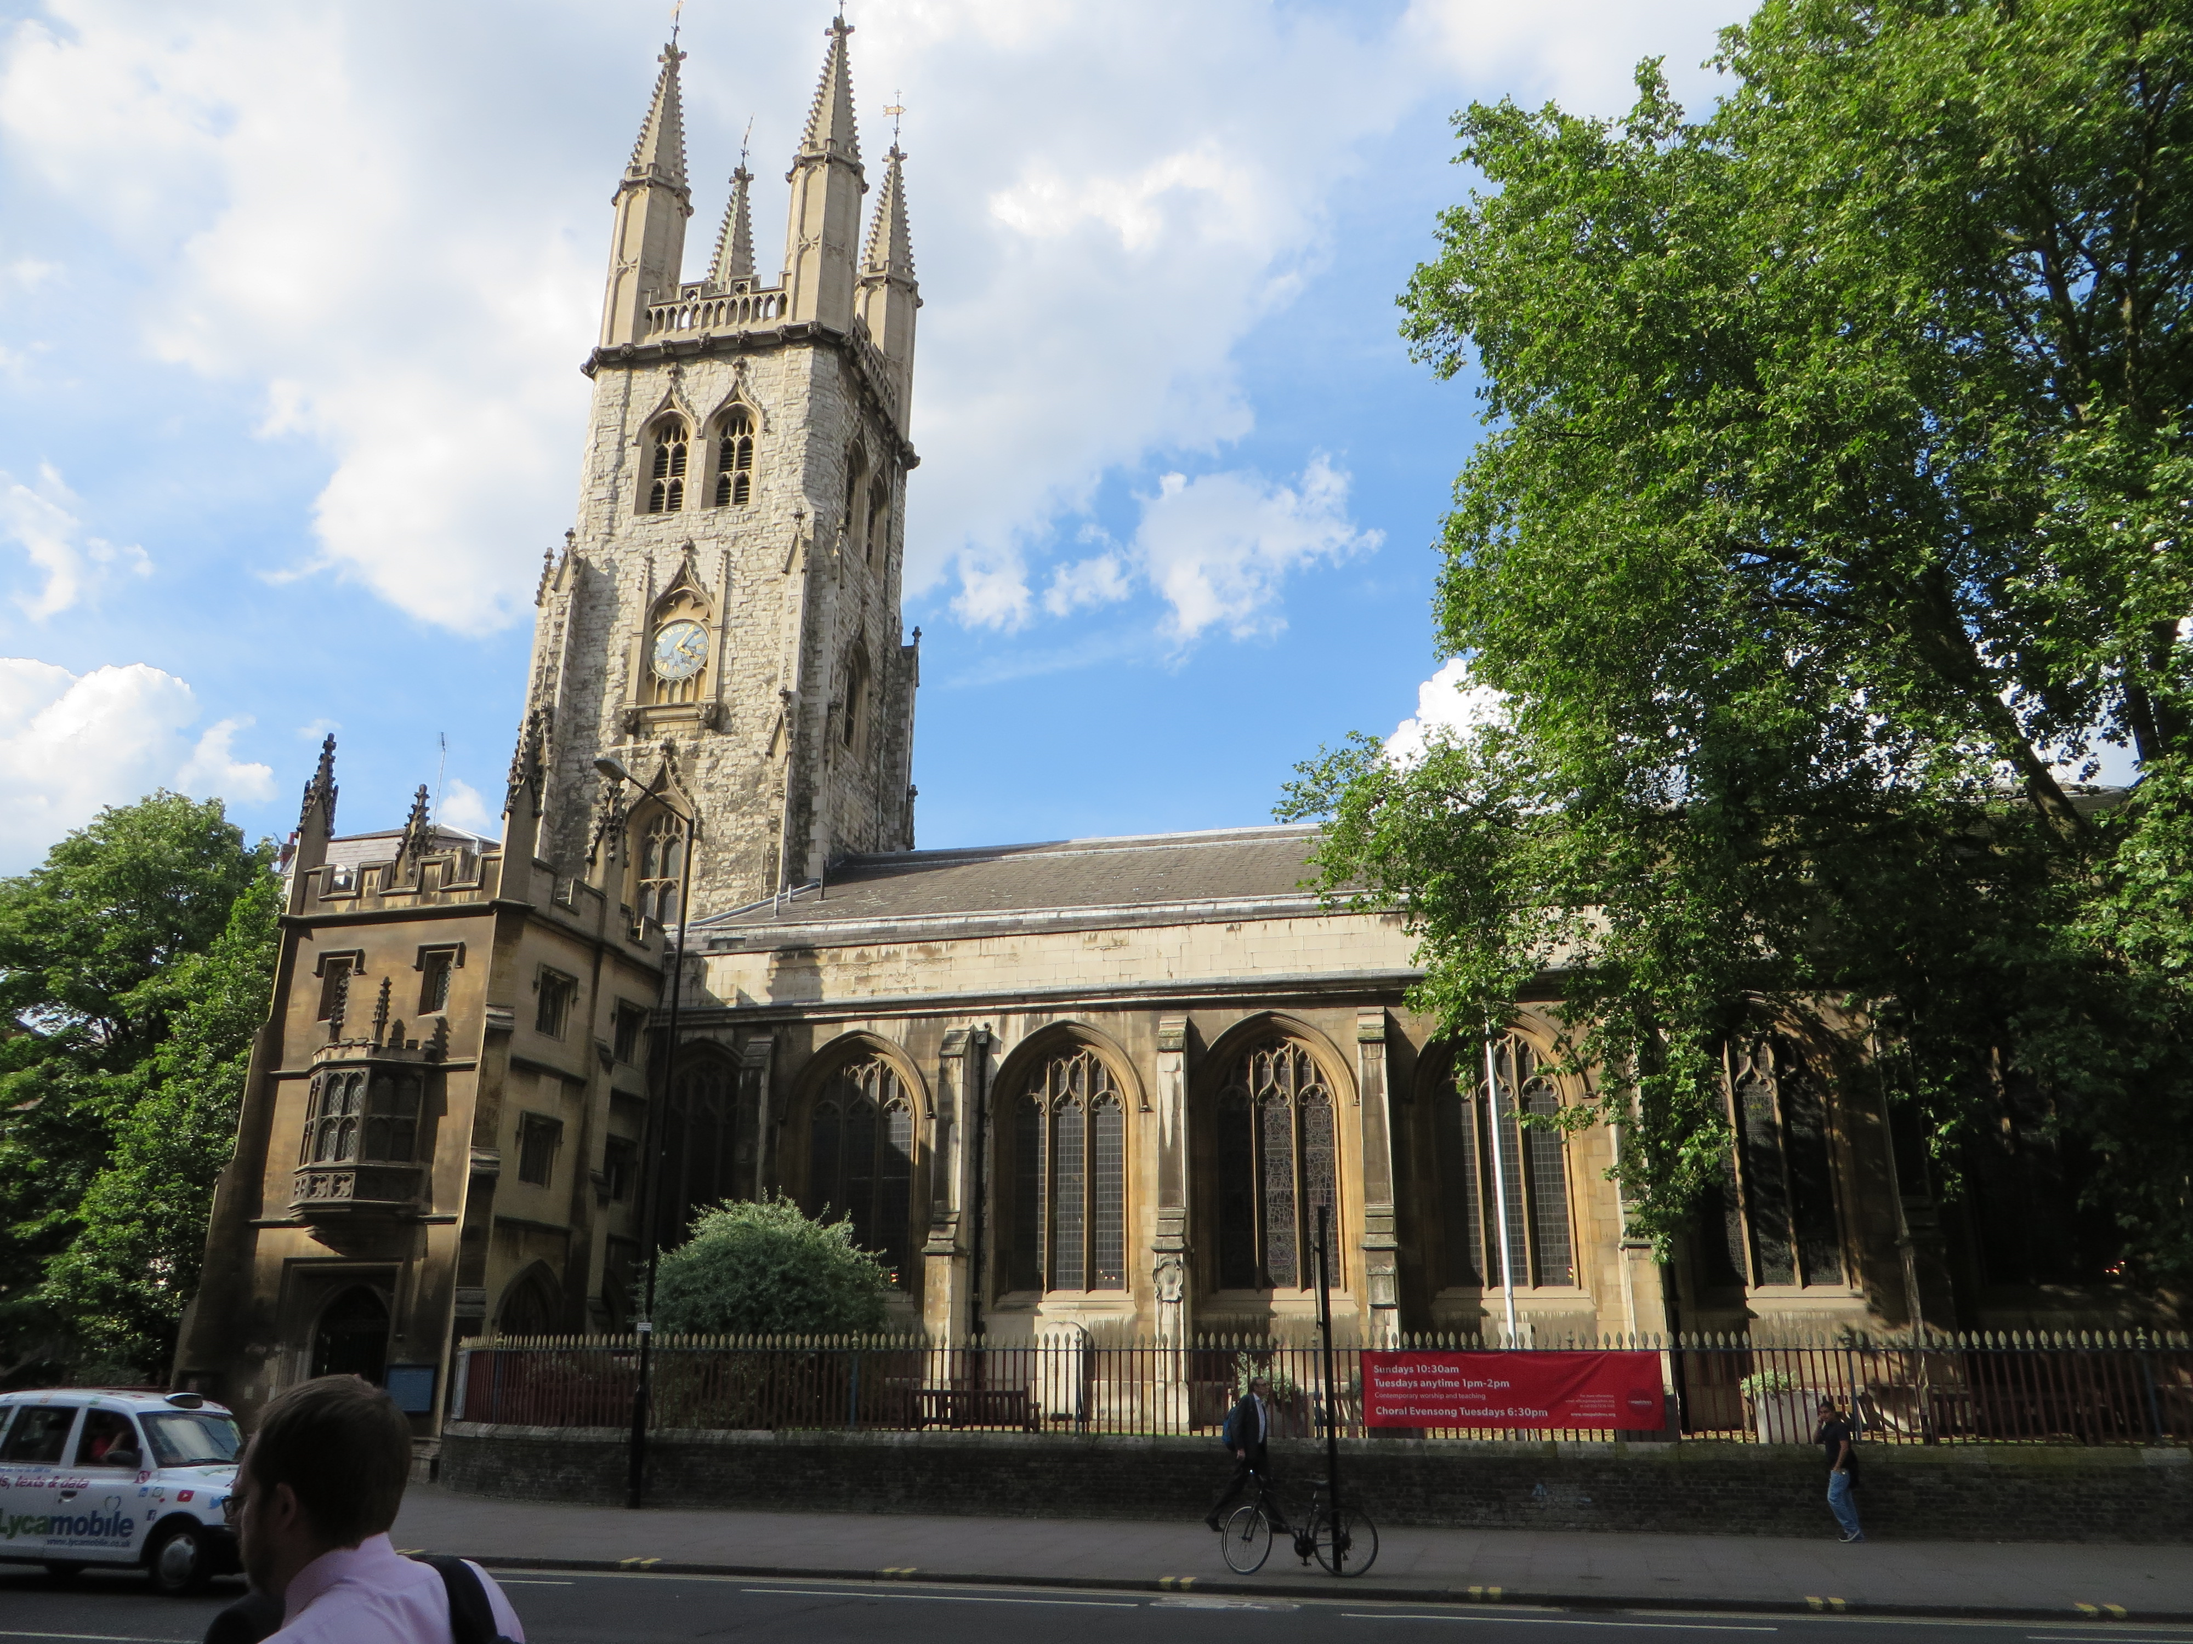

Slide 25
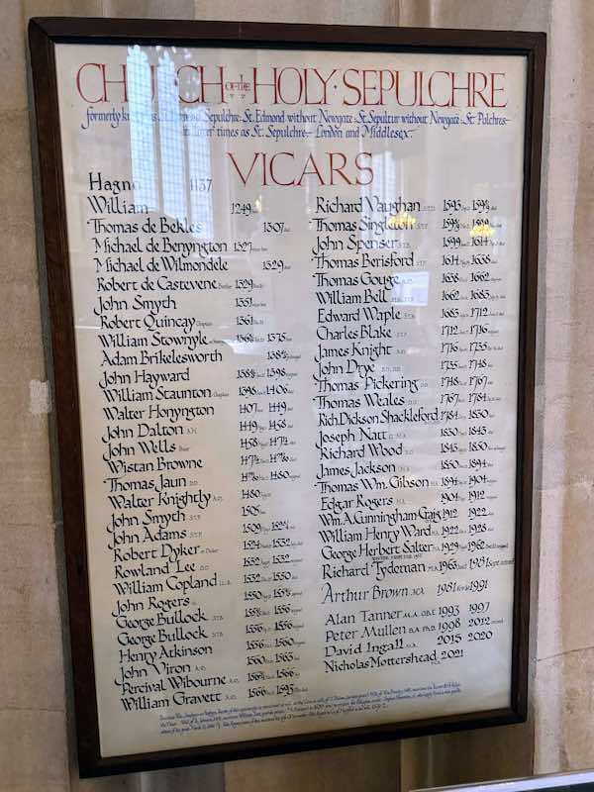

Slide 26
Antwerp 1534
Meets Tyndale and is converted ??
Tyndale arrested May, 1535
Marries Adriana de Weyden 1537
Prints the “Matthew” Bible July, 1537
Returns to England 1548
Appointed to St. Sepulchre 1550
Edward VI dies July 6, 1553

Slide 27
Antwerp 1534
Meets Tyndale and is converted ??
Tyndale arrested May, 1535
Marries Adriana de Weyden 1537
Prints the “Matthew” Bible July, 1537
Returns to England 1548
Appointed to St. Sepulchre 1550
Edward VI dies July 6, 1553
Preaches at St. Paul’s Cross July 16

Slide 28
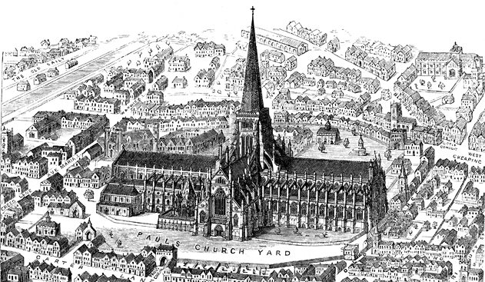

Slide 29
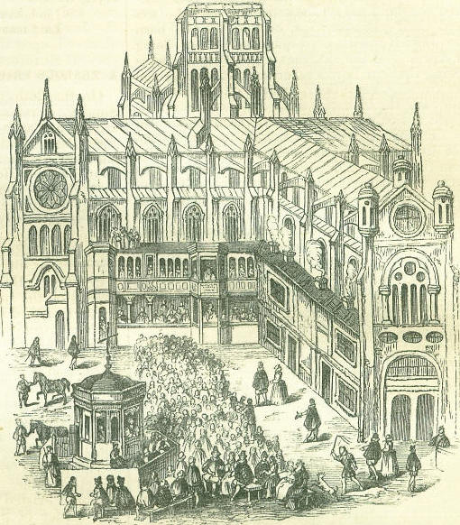
St. Paul’s Cross
In 1612 keen to get support for the restoration of the old St Paul’s, London one Henry Farley made petitions to powerful officers of state to get bills through parliament and in 1616 in another promotion had three pictures painted on panels, one of which shows ‘personages’ processing which includes the Royal Family seated at an outside sermon by St. Paul’s Cross.(1)
Farley’s concern to get the King to agree to the restoration of the cathedral was at a time when it had lain in a dilapidated state since a fire of 1561.
Though largely thwarted one of the painted panels Farley had produced shows the Royal Family Today 26th March 1620 on Mid-Lent Sunday.(see below)
The picture shows, ‘a curious antique structure preaching cross’, which for centuries existed in the vacant space at the north-east corner of the churchyard against the choir of the church. It had compartments containing King James (I)(VI), Queen, Prince of Wales and the Lord Mayor who came to hear the sermon.

Slide 30
“All the Reformation was
accomplished from the Cross.”
In 1612 keen to get support for the restoration of the old St Paul’s, London one Henry Farley made petitions to powerful officers of state to get bills through parliament and in 1616 in another promotion had three pictures painted on panels, one of which shows ‘personages’ processing which includes the Royal Family seated at an outside sermon by St. Paul’s Cross.(1)
Farley’s concern to get the King to agree to the restoration of the cathedral was at a time when it had lain in a dilapidated state since a fire of 1561.
Though largely thwarted one of the painted panels Farley had produced shows the Royal Family Today 26th March 1620 on Mid-Lent Sunday.(see below)
The picture shows, ‘a curious antique structure preaching cross’, which for centuries existed in the vacant space at the north-east corner of the churchyard against the choir of the church. It had compartments containing King James (I)(VI), Queen, Prince of Wales and the Lord Mayor who came to hear the sermon.

Slide 31
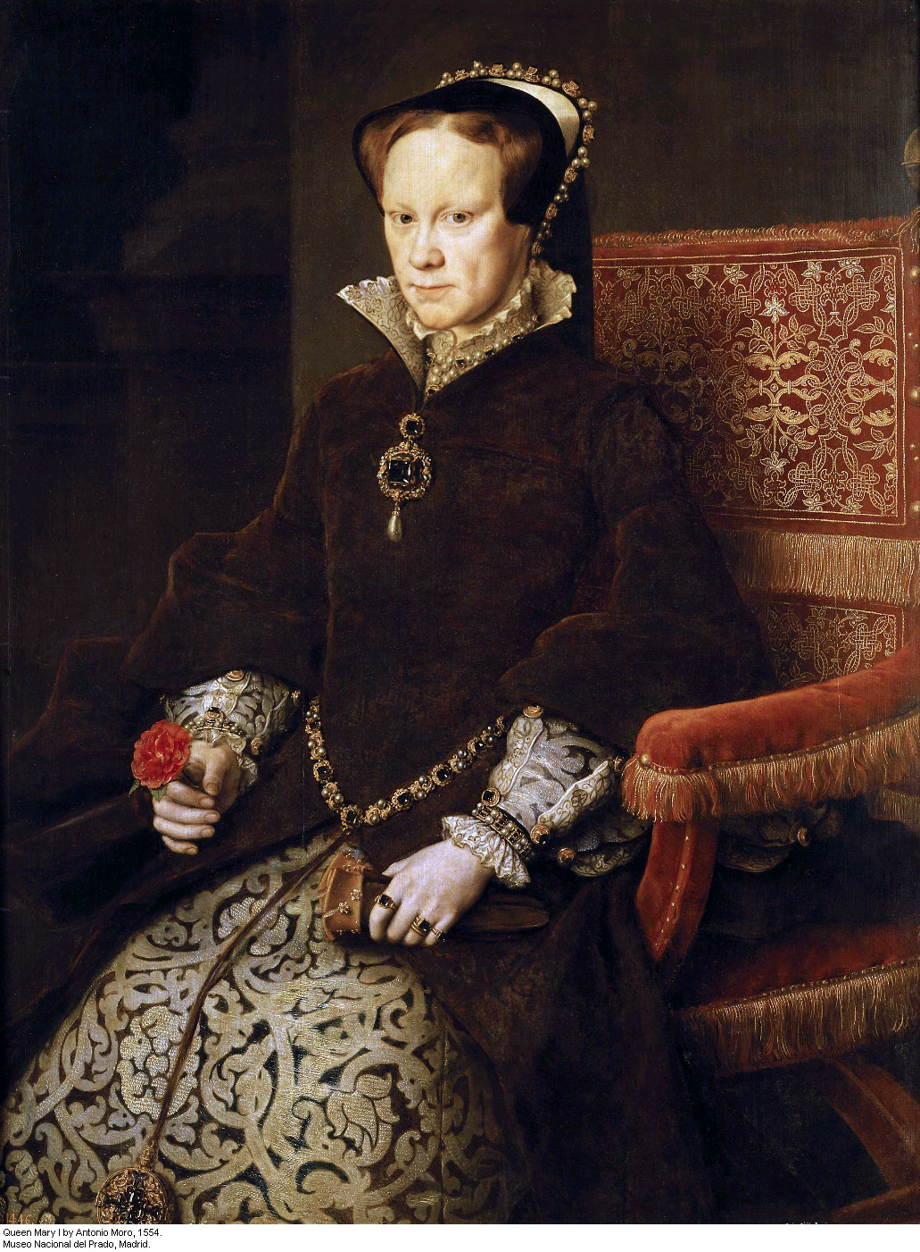
August 3

Slide 32
Antwerp 1534
Meets Tyndale and is converted ??
Tyndale arrested May, 1535
Marries Adriana de Weyden 1537
Prints the “Matthew” Bible July, 1537
Returns to England 1548
Appointed to St. Sepulchre 1550
Edward VI dies July 6, 1553
Preaches at St. Paul’s Cross July 16
Preaches at St. Paul’s Cross August 6

Slide 33
. . . made a godly and vehement sermon at Paul's Cross, confirming such true doctrine as he and others had there taught in King Edward's days, exhorting the people constantly to remain in the same, and to beware of all pestilent popery, idolatry, and superstition.
--John Foxe
In 1612 keen to get support for the restoration of the old St Paul’s, London one Henry Farley made petitions to powerful officers of state to get bills through parliament and in 1616 in another promotion had three pictures painted on panels, one of which shows ‘personages’ processing which includes the Royal Family seated at an outside sermon by St. Paul’s Cross.(1)
Farley’s concern to get the King to agree to the restoration of the cathedral was at a time when it had lain in a dilapidated state since a fire of 1561.
Though largely thwarted one of the painted panels Farley had produced shows the Royal Family Today 26th March 1620 on Mid-Lent Sunday.(see below)
The picture shows, ‘a curious antique structure preaching cross’, which for centuries existed in the vacant space at the north-east corner of the churchyard against the choir of the church. It had compartments containing King James (I)(VI), Queen, Prince of Wales and the Lord Mayor who came to hear the sermon.

Slide 34
Antwerp 1534
Meets Tyndale and is converted ??
Tyndale arrested May, 1535
Marries Adriana de Weyden 1537
Prints the “Matthew” Bible July, 1537
Returns to England 1548
Appointed to St. Sepulchre 1550
Edward VI dies July 6, 1553
Preaches at St. Paul’s Cross July 16
Preaches at St. Paul’s Cross August 6
Arrested August 16

Slide 35
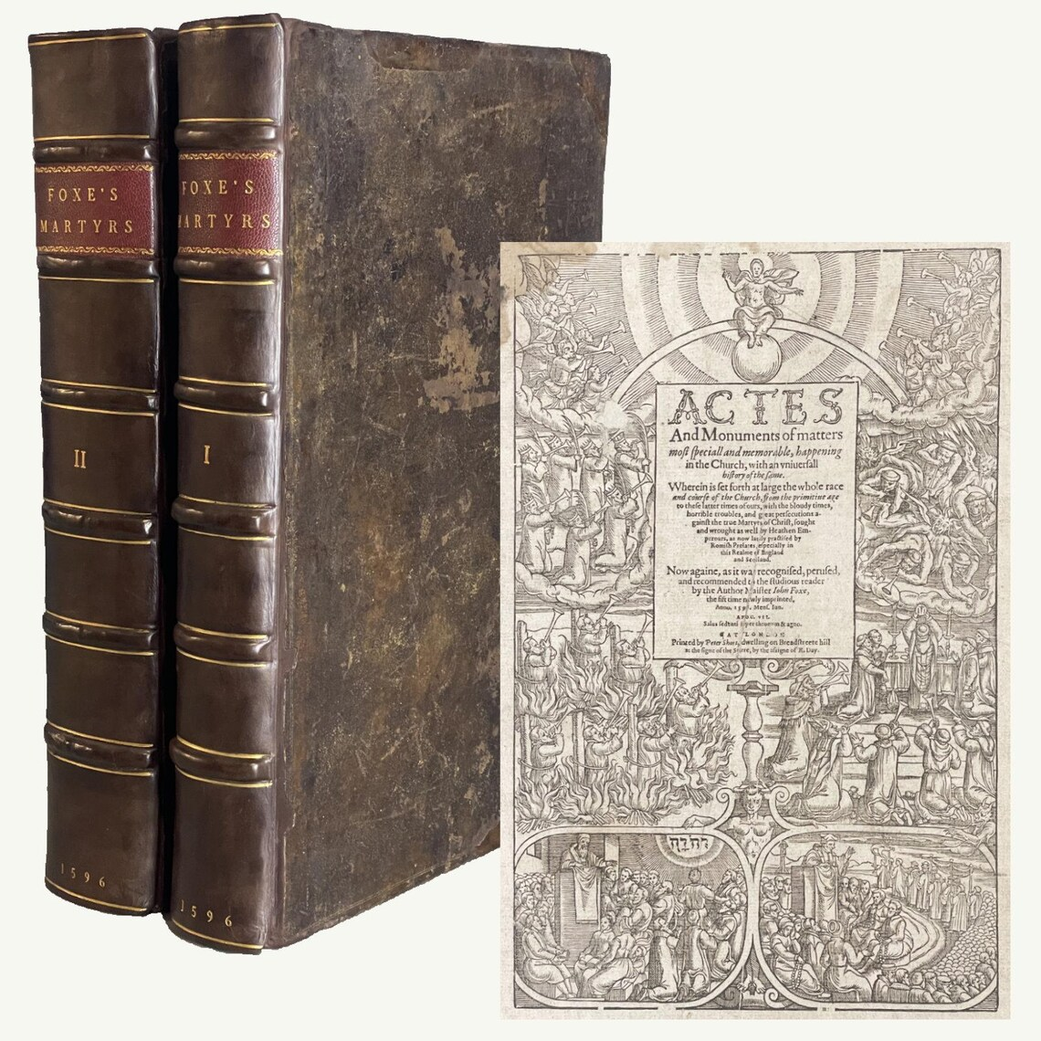
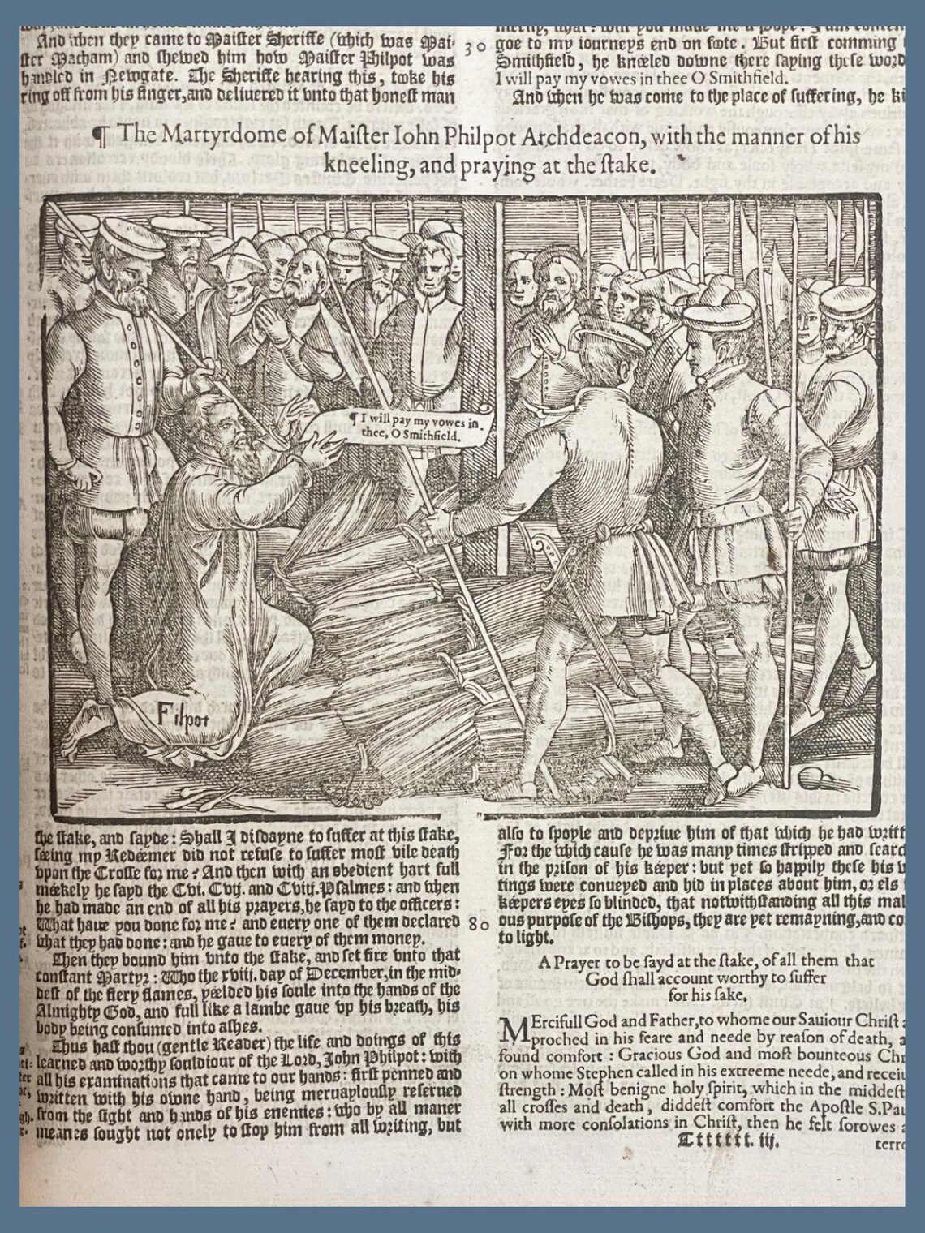
1596
Printing
Rare find
Price:$14,000.00
1596 Book of Martyrs by John Foxe – Acts and Monuments - Complete with over 100 woodcuts and one foldout
DungenessBooks
5 out of 5 stars This was May 28, 2025

Slide 36
John Rogers, alias Matthew, a seditious preacher, ordered by the lords of the Council to keep himself as prisoner in his house at Paul’s, without conference of any person other than such as are daily with him in his household, until such time as he has contrary commandment.
(Lords of the Council)

Slide 37
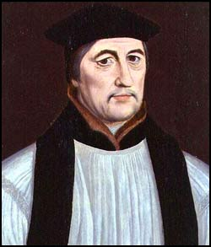
Stephen Gardiner
Bishop of Winchester
Lord Chancelor 1553-1555

Slide 38
Stephen Gardiner
Bishop of Winchester
Lord Chancelor 1553-1555
1st Trial (Jan. 22, 1555)

Slide 39
Rogers: I will find it first in the Scripture, and see it tried thereby, before I receive him to be supreme head. I find not the Bishop of Rome in the Creed, for the word “Catholic” there signifieth not the Romish Church; it signifieth the consent of all true teaching Churches of all times and all ages. But how should the Bishop of Rome’s Church be one of them, which teacheth so many doctrines that are plainly and directly against the Word of God? Can that bishop be the true head of the Catholic Church that doth so? That is not possible.

Slide 40
Gardner: Show me one of them—one! Let me hear one!

Slide 41
Rogers: The Bishop of Rome and his Church say, read, and sing all that they do in their congregations in Latin, which is directly and plainly against the first of Corinthians and the fourteenth chapter, to ‘speak with tongues’ is to speak with a strange tongue, as Latin or Greek, etc; and so to speak is not to speak unto men, but to God. But ye speak in Latin, which is a strange tongue: wherefore ye speak not unto men, but unto yourselves and God only.

Slide 42
Stephen Gardiner
Bishop of Winchester
Lord Chancelor 1553-1555
2nd Trial (Jan. 28-29, 1555)

Slide 43
Rogers: Even as the most part of your doctrine in other points is false, and the defense thereof only by force and cruelty; so in this matter I think it to be as false as the rest. For I cannot understand the words “really” and “substantially” to signify otherwise than corporally; but corporally Christ is only in heaven, and so Christ cannot be corporally also in your sacrament.

Slide 44
Gardiner: Well then, is our church false and antichristian?
Rogers: Yes!
Gardiner: And what is the doctrine of the sacrament?
Rogers: False!

Slide 45
Stephen Gardiner
Bishop of Winchester
Lord Chancelor 1553-1555
Sentence of Condemnation

Slide 46
. . . we do find that thou hast taught, holden, and affirmed, and obstinately defended, divers errors, heresies, and damnable opinions, contrary to the doctrine and determination of the holy church, as namely these: That the catholic Church of Rome is the church of antichrist: item, that in the sacrament of the altar there is not substantially nor really the natural body and blood of Christ: the which aforesaid heresies and damnable opinions, being contrary to the law of God, and determination of the universal and apostolical church, thou hast arrogantly, stubbornly, and wittingly maintained, held, and affirmed, and also defended before us, as well in this judgment, as also otherwise; and with the like obstinacy, stubbornness, malice, and blindness of heart, both wittingly and willingly hast affirmed, that thou wilt believe, maintain and hold, affirm and declare, the same:

Slide 47
"'Well my Lord,' quoth I, 'here I stand before God and you, and all this honourable audicnce, and take him to witness, that I never wittingly or willingly taught any false doctrine; and therefore have I a good conscience before God and all good men. I am sure that you and I shall come before a Judge that is righteous, before whom I shall be as good a man as you: and I nothing doubt but that I shall be found there a true member of the true catholic church of Christ, and everlastingly saved. And as for your false church, ye need not to excommunicate me forth of it. I have not been in it these twenty years, the Lord be thanked there-for.

Slide 48
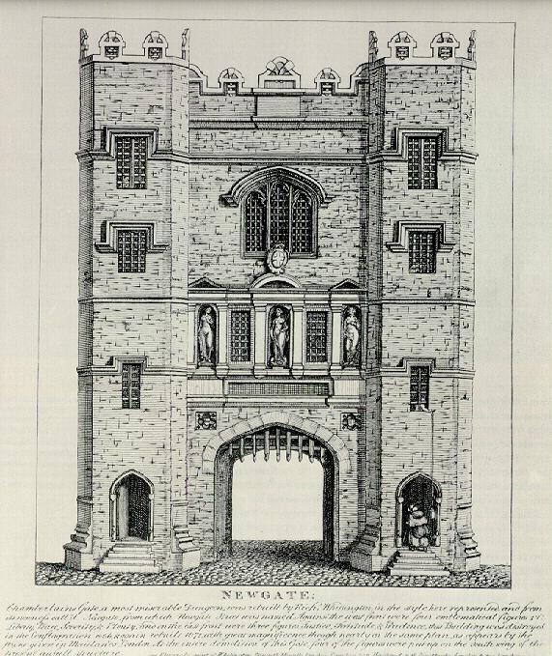
Newgate Prison
February 4, 1555

Slide 49
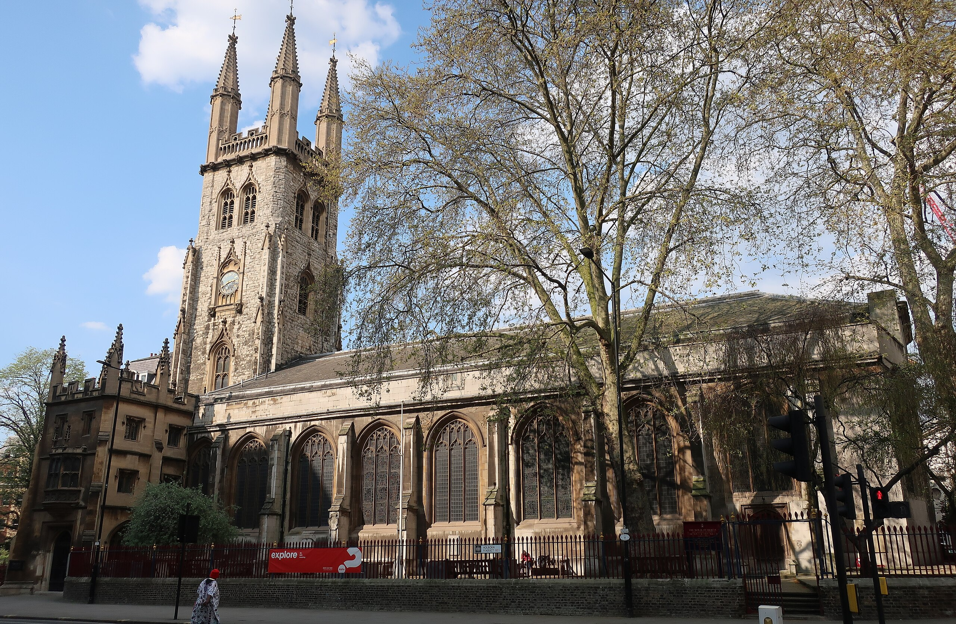

Slide 50
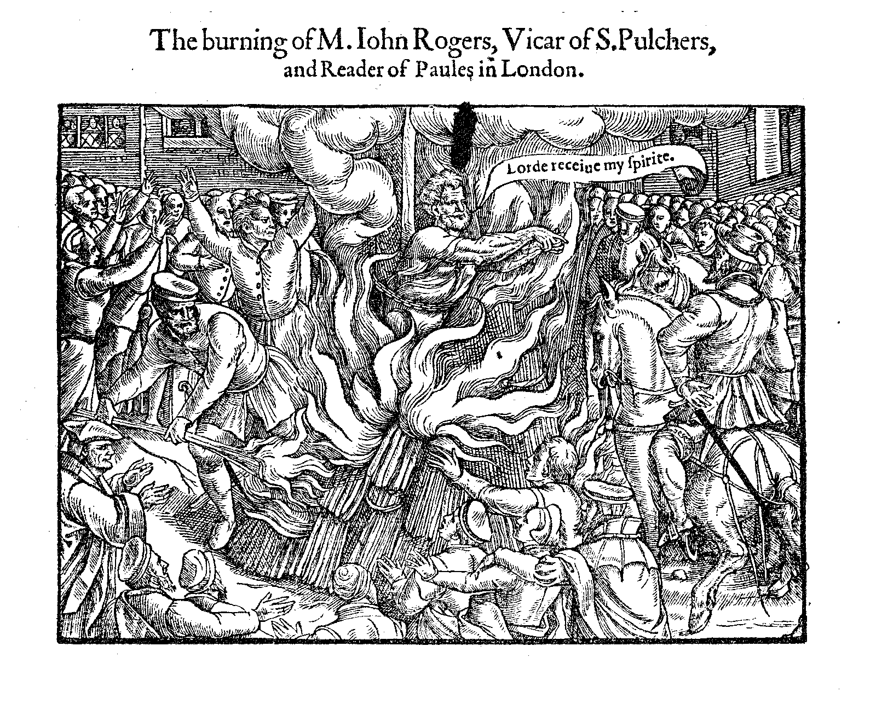

Slide 51
This day was performed the confirmation of the alliance between the Pope and this kingdom, by a public and solemn sacrifice of a preaching doctor named Rogers, who has been burned alive for being a Lutheran; but he died persisting in his opinion. At this conduct, the greatest part of the people took such pleasure, that they were not afraid to make him many exclamations to strengthen his courage. Even his children assisted at it, comforting him in such a manner that it seemed as if he had been led to a wedding.
--Count Noailles, French ambassador

Slide 52
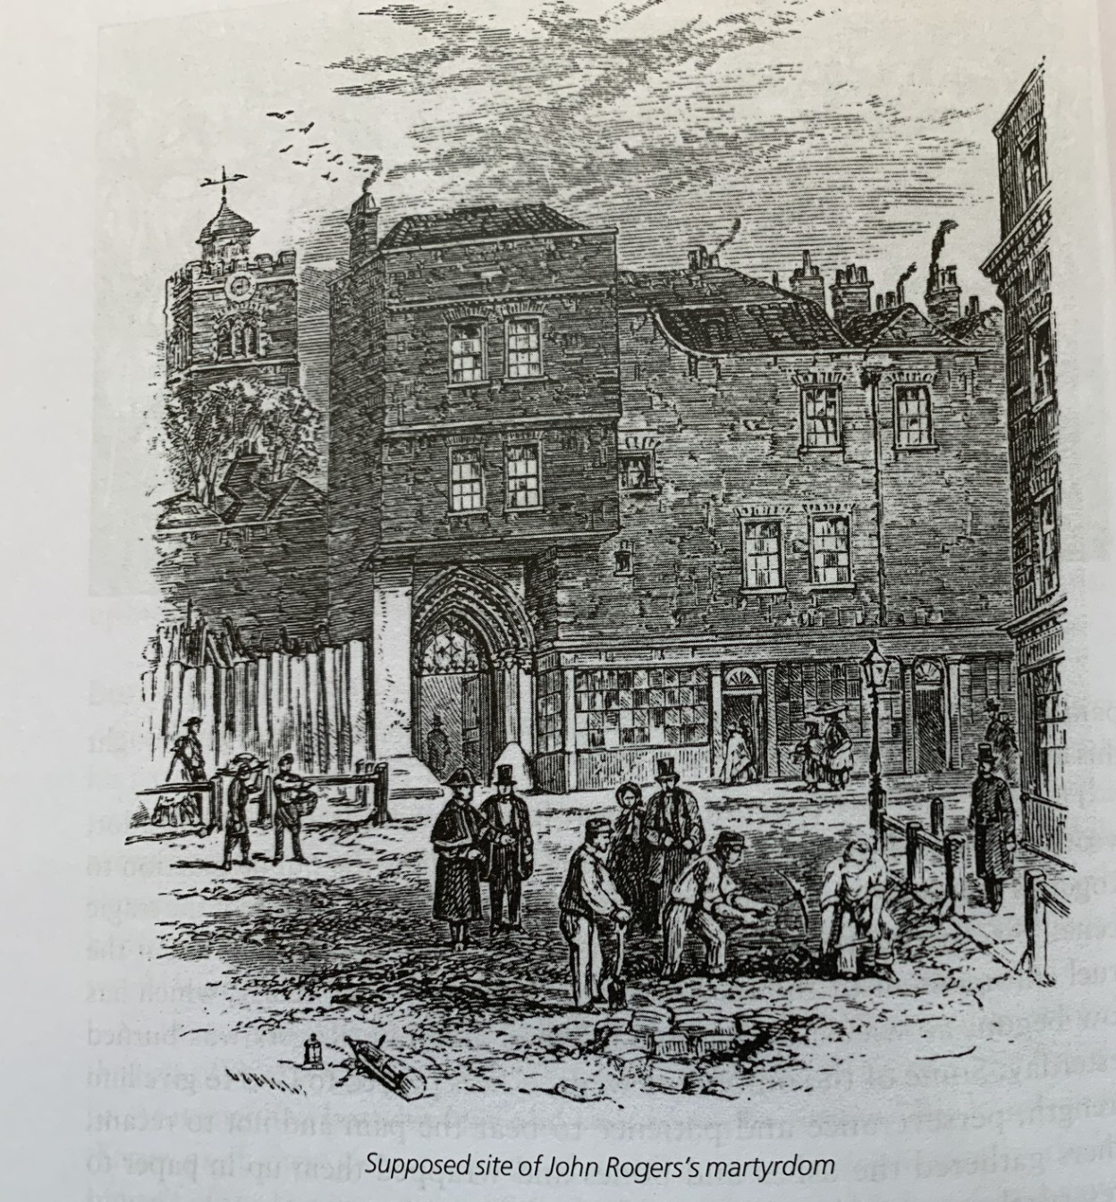

Slide 53
The Memorial Plaque Reads:
Blessed are the dead which die in the Lord, it says.
The noble army of martyrs praise Thee!
Within a few feet of this spot, John Rogers, John Bradford, John Philpot,
and other servants of God, suffered death by fire for the faith of Christ,
in the years 1555, 1556, 1557.

Slide 54
The Scripture Says:
And others experienced mockings
and scourgings, yes, also chains and
imprisonment.
They were stoned, they were sawn in two,
they were tempted, they were put to death with the sword;
they went about in sheepskins, in goatskins, being destitute,
afflicted, ill treated.
of whom the world was not worthy.
--Hebrews 11:36-38a

