Slide 1
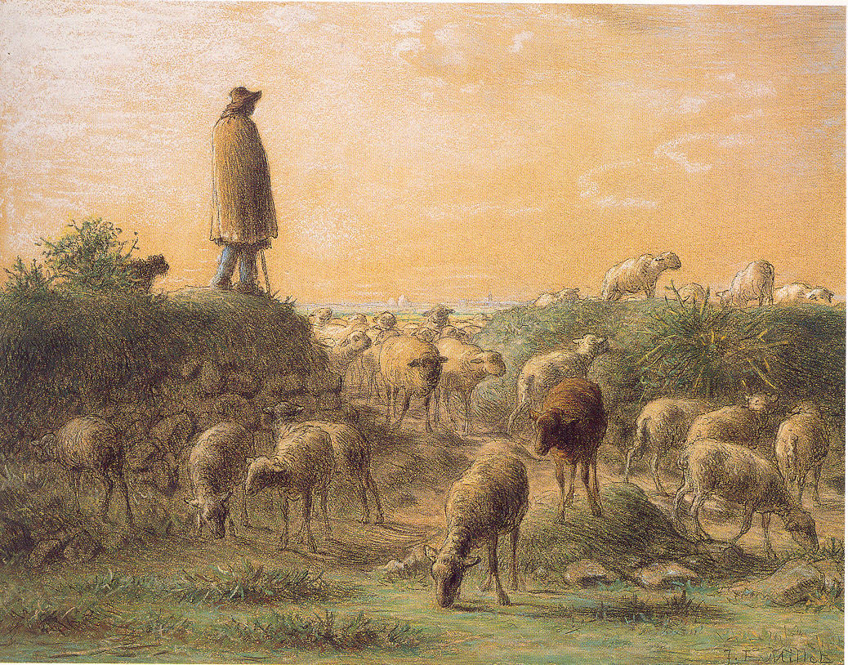
Leadership
Retreat
2022
Shepherding
in
Difficult Times
Jean-François Millet (French, 1814–1875). Shepherd Minding His Sheep, c. 1863-66. Pastel, conté crayon, and pen and ink on dark buff wove paper, 14 3/4 x 19 in. Frick Art & Historical Center, Pittsburgh, 1984.5.

Slide 2
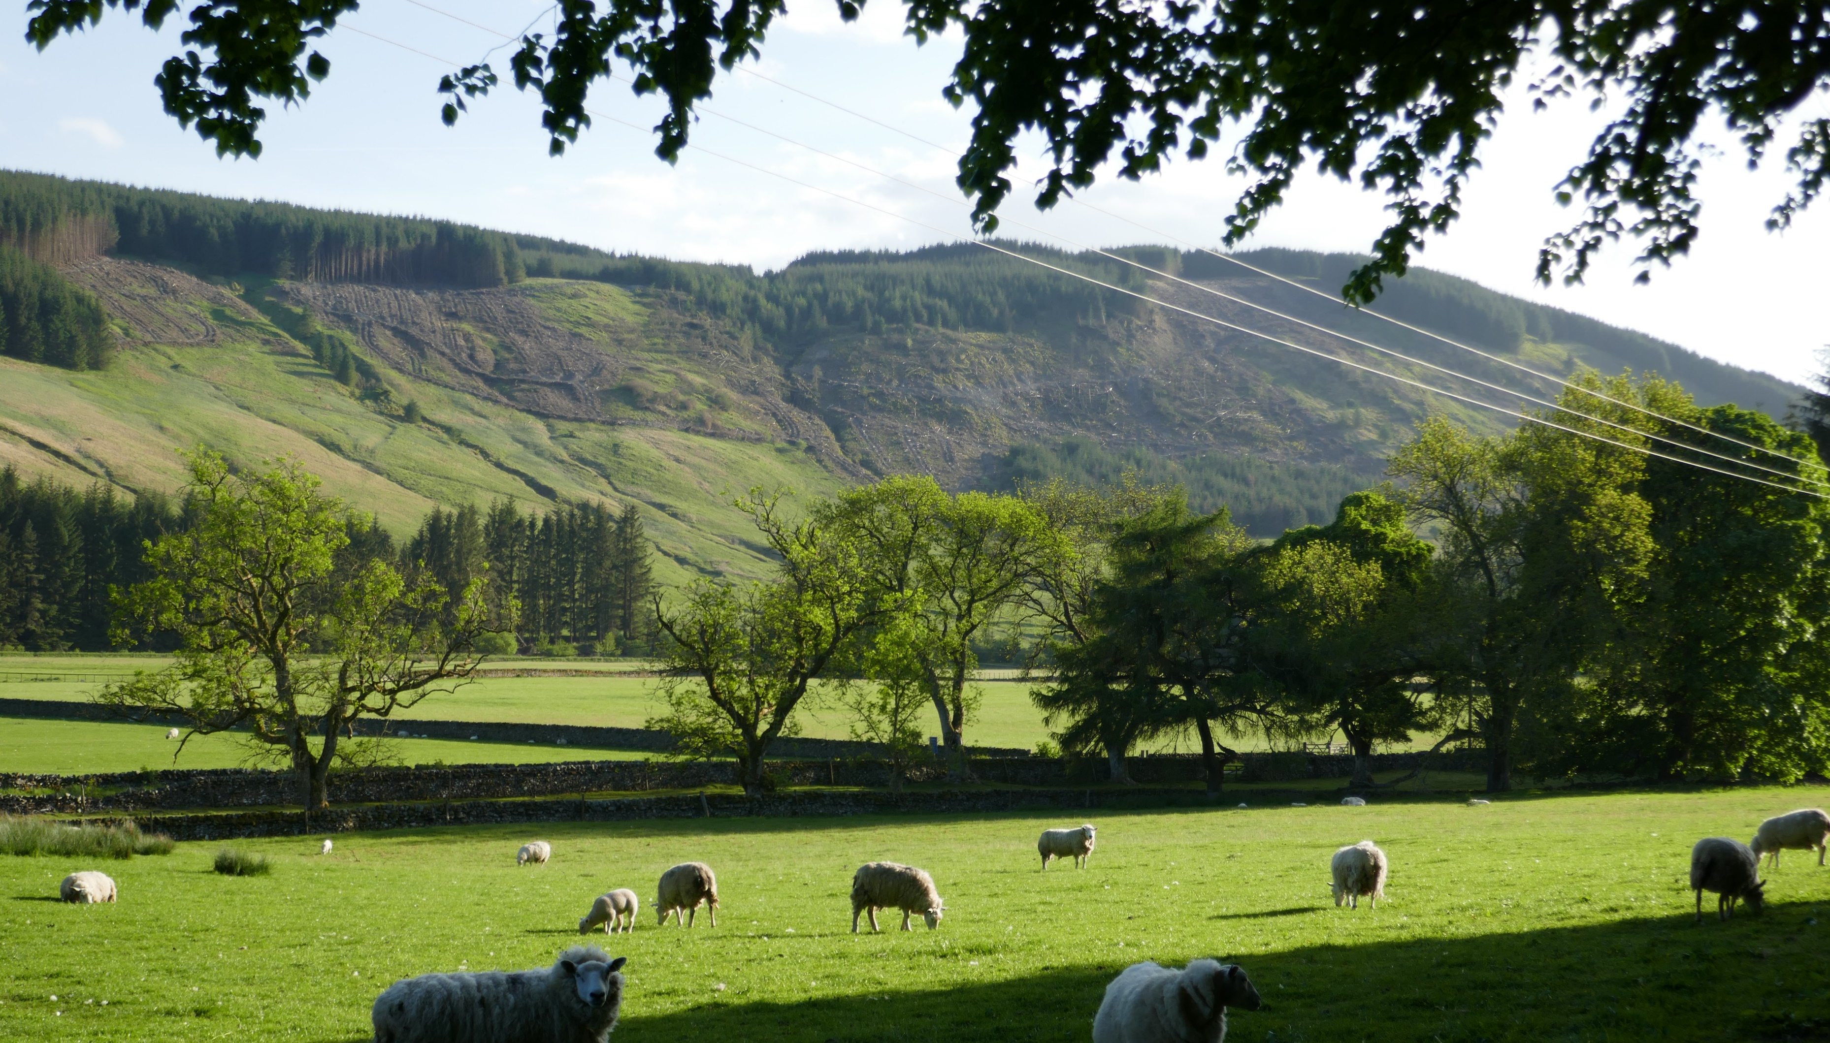

Leadership
Retreat 2024
Shepherding and Serving
under the
Chief
Shepherd

Slide 3
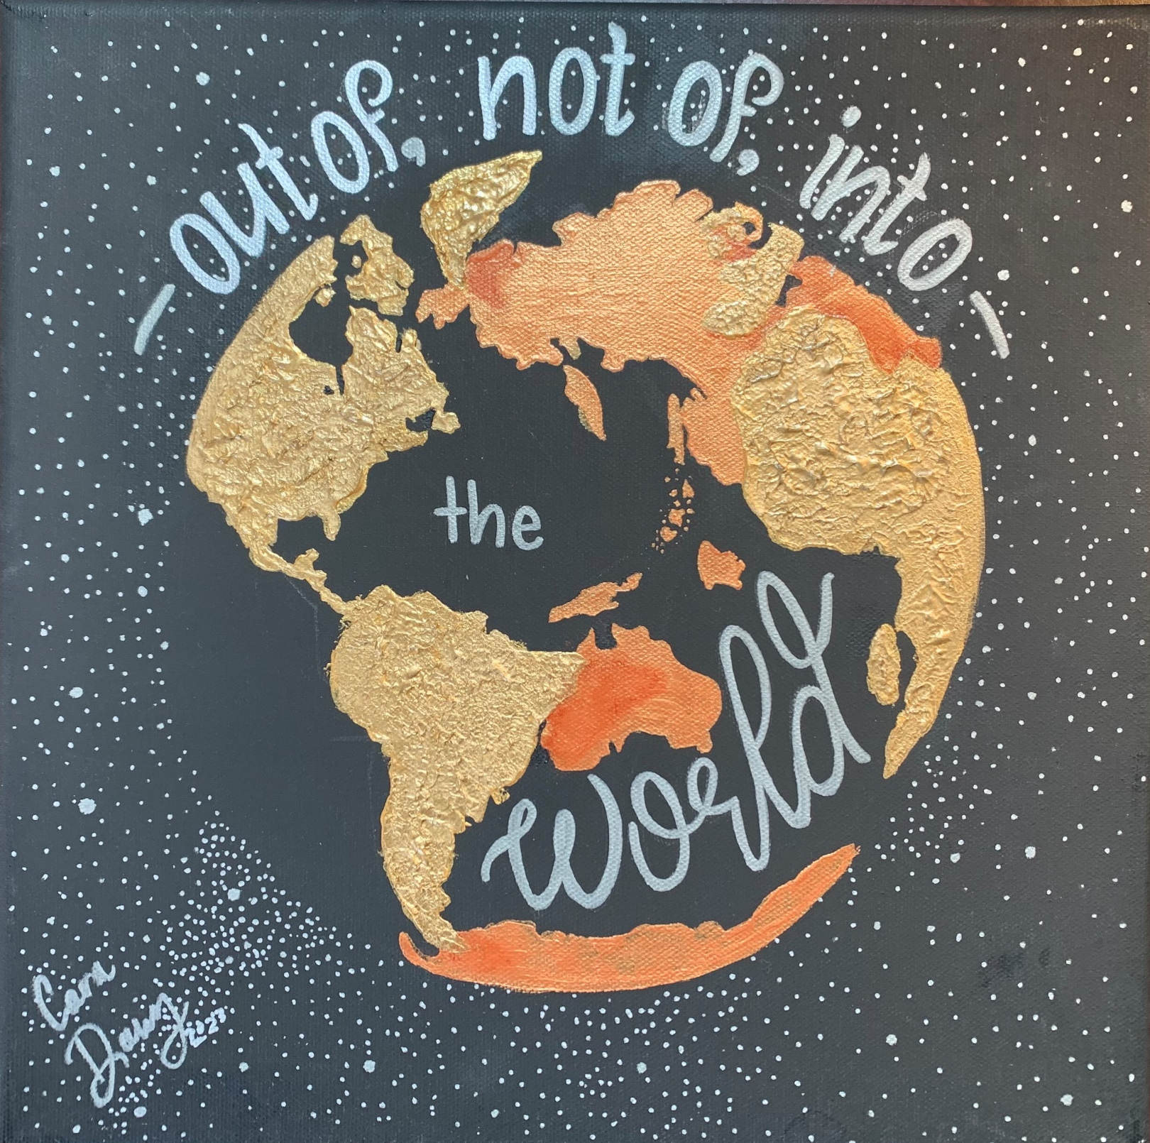
WHAT IS THE TRUE
CHRISTIAN’S RELATION
TO THE WORLD?

Slide 4



Slide 5
SENT TO BE SALT
Matthew 5:14
By our good works
With words of a certain character
In Their Content.
First: Gospel words

Slide 6
First: Gospel words
Mark 1:14-15

Slide 7
First: Gospel words
Mark 1:14-15
Matthew 28:18-20
Acts 1:3
Acts 2:36
Acts 8:12
Acts 17:
Acts 19:8; 20:25
Acts 28:23
Colossians 1:13

Slide 8
How beautiful upon the mountains
are the feet of those
who bring good news
who proclaim peace,
who bring good tidings,
who proclaim salvation,
who say to Zion,
Your God reigns!
--Romans 10:15 (Isaiah 52:7)

Slide 9
SENT TO BE SALT
Matthew 5:14
By our good works
With words of a certain character
In Their Content.
First: Gospel words

Slide 10
SENT TO BE SALT
Matthew 5:14
By our good works
With words of a certain character
In Their Content.
First: Gospel words
Second: John 7:7

Slide 11
SENT TO BE SALT
Matthew 5:14
By our good works
With words of a certain character
In Their Content.
First: Gospel words
Second: John 7:7; Ephesians 5:11

Slide 12
SENT TO BE SALT
Matthew 5:14
By our good works
With words of a certain character
In Their Content.
First: Gospel words
Second: Exposing words (John 7:7; Ephesians 5:11)

Slide 13
SENT TO BE SALT
Matthew 5:14
Second: Exposing words (John 7:7; Ephesians 5:11)
Ephesians 5:13

Slide 14
SENT TO BE SALT
Matthew 5:14
Second: Exposing words (John 7:7; Ephesians 5:11)
Ephesians 5:13
John 3:20

Slide 15
SENT TO BE SALT
Matthew 5:14
Second: Exposing words (John 7:7; Ephesians 5:11)
Ephesians 5:13
John 3:20
II Timothy 4:2

Slide 16
SENT TO BE SALT
Matthew 5:14
Second: Exposing words (John 7:7; Ephesians 5:11)
Ephesians 5:13
John 3:20
II Timothy 4:2
Titus 1:12-13

Slide 17
SENT TO BE SALT
Matthew 5:14
Second: Exposing words (John 7:7; Ephesians 5:11)
Ephesians 5:13
John 3:20
II Timothy 4:2
Titus 1:12-13
Titus 2:15

Slide 18
Salting has to bite. Although they criticize us as
biters, we know that this is how it has to be, and that Christ has commanded the salt to be sharp and continually caustic. . . If you want to preach the Gospel and help people, you must be sharp and rub salt into their wounds, showing the reverse side and denouncing what is not right. . .
--Martin Luther (The Sermon the Mount)

Slide 19


Slide 20
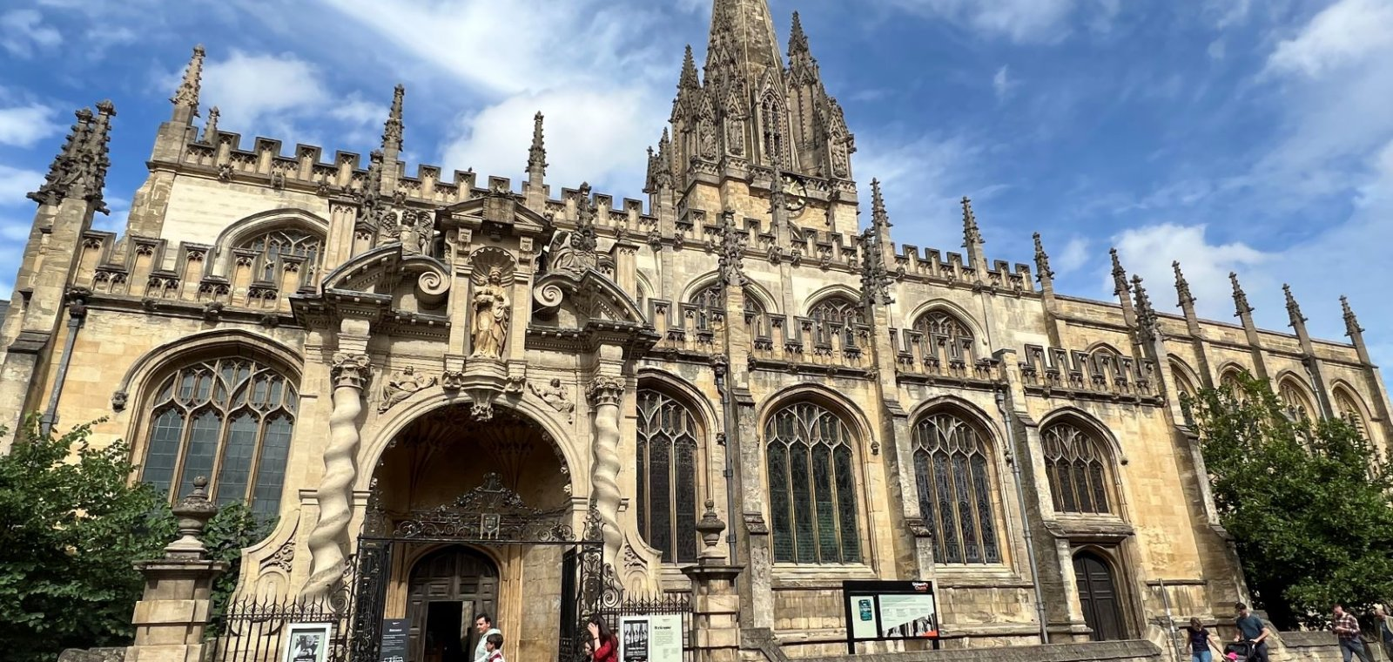

Slide 21
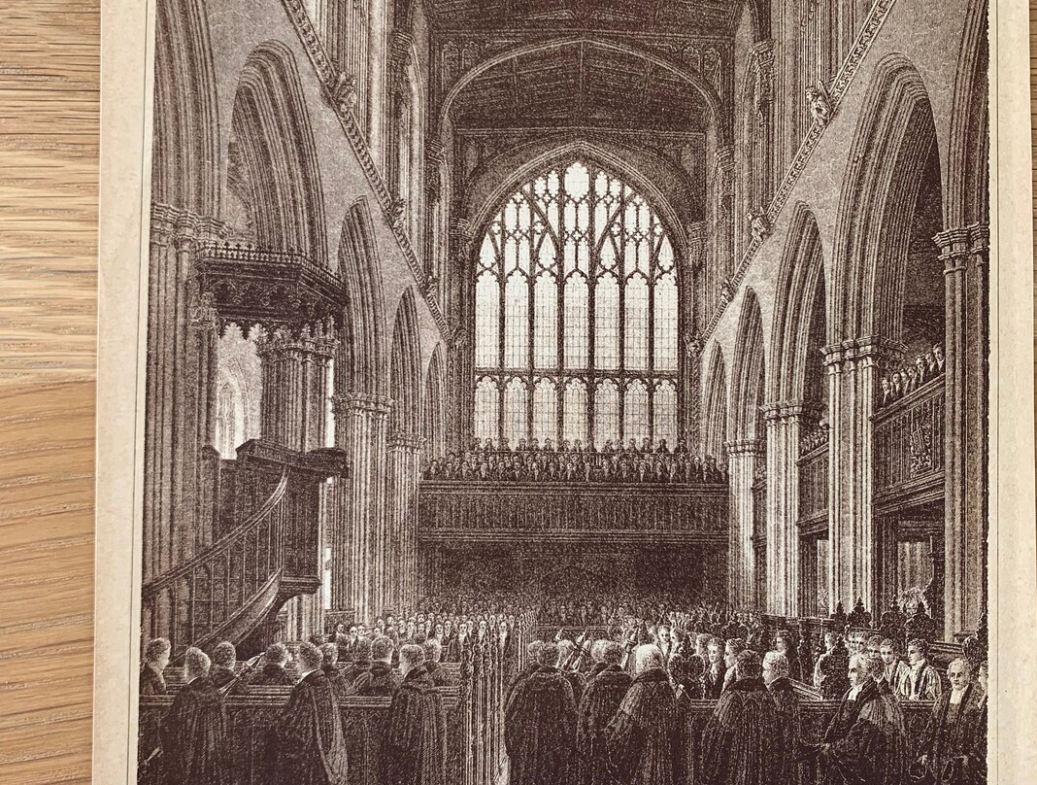
Scriptural Christianity (1744)

Slide 22
What is intended to offend nobody is apt also to affect no body. In studying to maintain moderation and avoid enthusiasm the prevailing theology lost much of its vivifying power. . .
--John Henry Overton, The Evangelical Revival

Slide 23
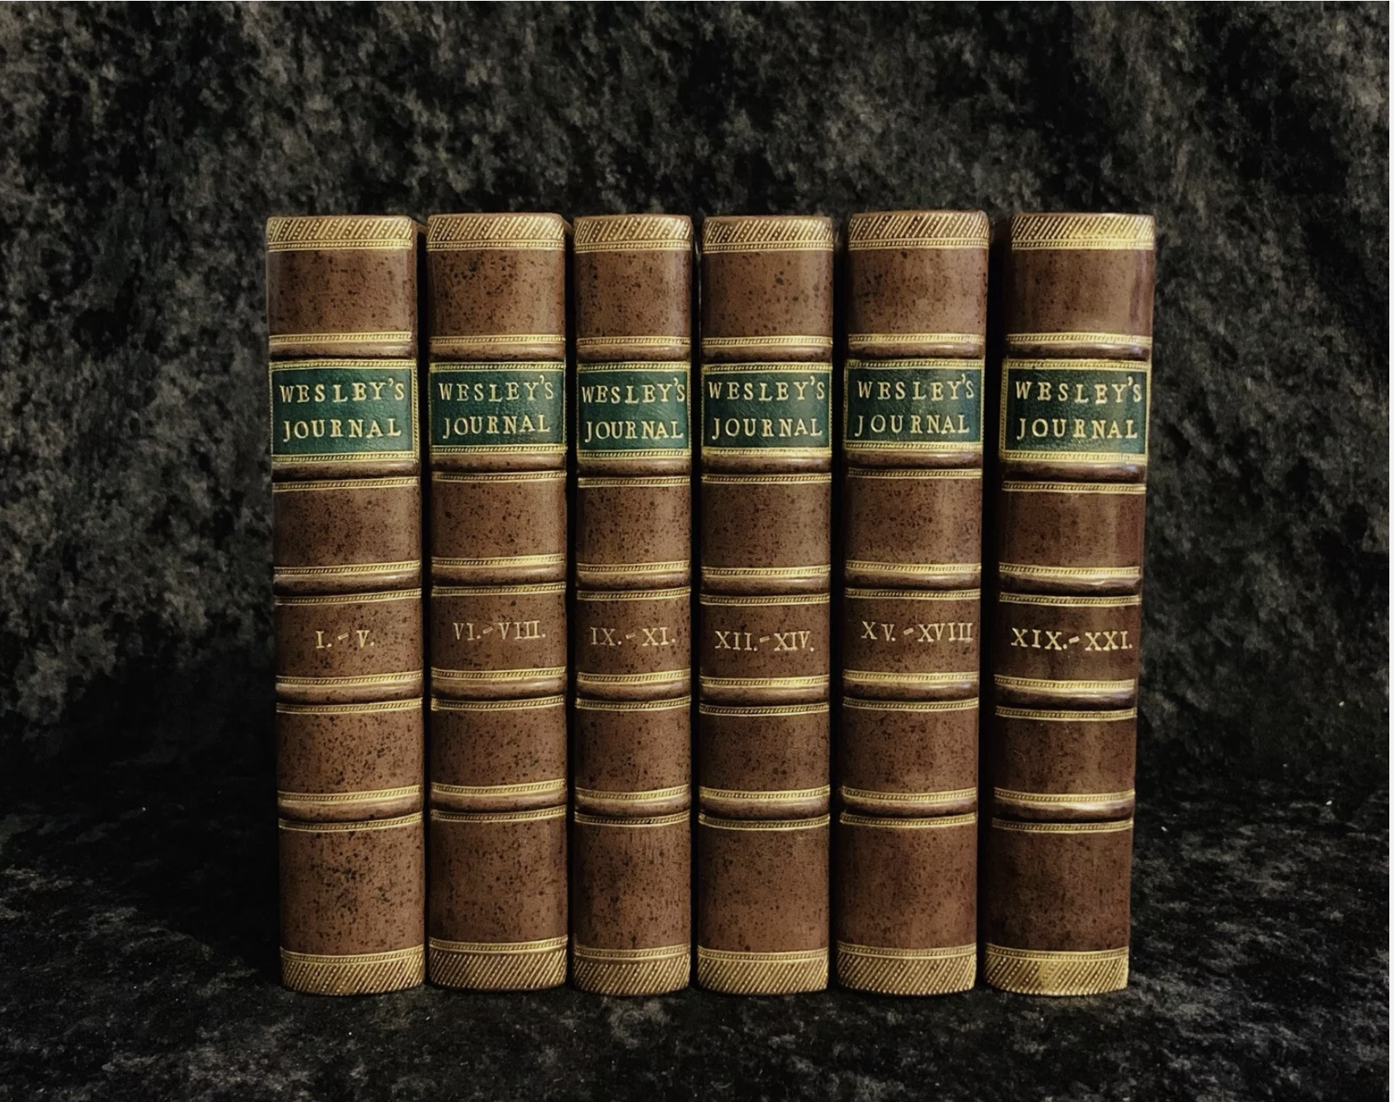

Slide 24
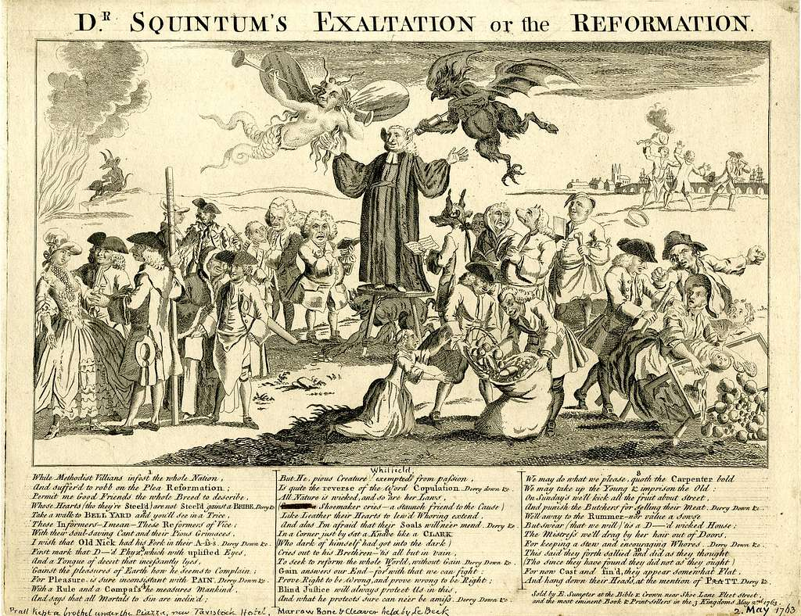

Slide 25
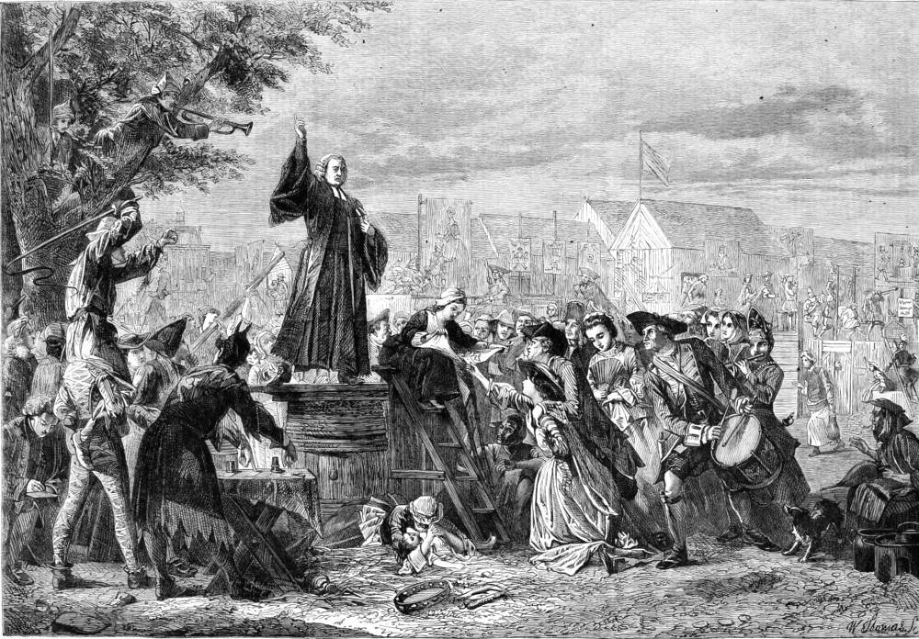

Slide 26
Their aim was to conquer, to compel men then and there to renounce sin and to seek pardon at the Cross of Christ.
--G. R. Balleine, A History of the Evangelical
Party in the Church of England (31)

Slide 27
Of the faith . . . which made the selfish man self-denying, the discontented happy, the worldling spiritually-minded, the drunkard sober, the sensual chaste, the liar truthful, the proud humble, the godless godly, the thriftless thrifty, we can only judge by the fruits which it bore. That such fruits were born is surely undeniable.
--John Henry Overton

Slide 28


Slide 29
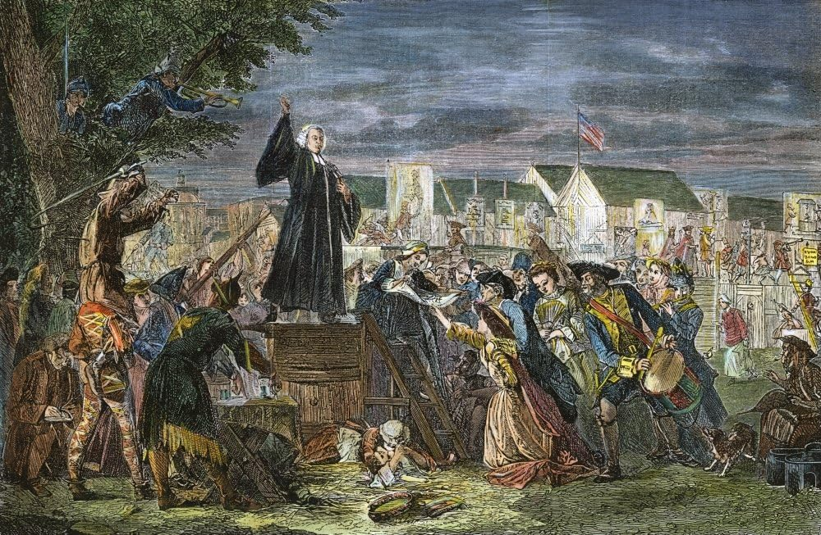
George Whitefield N(1714-1770) English Evangelist Preaching To The People In Moorfields London England 1742 Wood Engraving

Slide 30


Slide 31


Slide 32
Of the faith which enabled a man to abandon the cherished habits of a lifetime, and to go forth ready to spend and be spent in his Master’s service, which made the selfish man self-denying, the discontented happy, the worldling spiritually-minded, the drunkard sober, the sensual chaste, the liar truthful, the proud humble, the godless godly, the thriftless thrifty, we can only judge by the fruits which it bore. That such fruits were born is surely undeniable.
--John Henry Overton, quoted by G. R. Balleine, A History of the Evangelical Party.
Overton was minister at Epworth. A High Church Anglican and Church historian. Balleine is quoting from his, The Evangelical Revival.

