Slide 1




Slide 2
Psalm 37

Slide 3
Psalm 37
Repeated fundamentals:
Two subjects: the wicked (13 occ)
and the righteous (9 occ.)

Slide 4
Psalm 37
Repeated fundamentals:
Two subjects: the wicked (13 occ)
and the righteous (9 occ.)
Two truths: their ends

Slide 5
Psalm 37
Repeated fundamentals:
Two subjects: the wicked (13 occ)
and the righteous (9 occ.)
Two truths: their ends
One primary question: is Psalm 1 true?

Slide 6
Psalm 37
THE STATE OF THE PERSON COUNSELED (1, 7, 8).

Slide 7
Psalm 37
THE STATE OF THE PERSON COUNSELED (1, 7, 8).
THE CHIEF CONCERN (9, 11, 22, 29, 34).

Slide 8
Psalm 37
THE STATE OF THE PERSON COUNSELED (1, 7, 8).
THE CHIEF CONCERN (9, 11, 22, 29, 34).
THE EXPANSIONS OF 1:6B.

Slide 9
Psalm 37
THE STATE OF THE PERSON COUNSELED (1, 7, 8).
THE CHIEF CONCERN (9, 11, 22, 29, 34).
THE EXPANSIONS OF 1:6B.
A deceiving appearance (35).

Slide 10
Psalm 37
THE STATE OF THE PERSON COUNSELED (1, 7, 8).
THE CHIEF CONCERN (9, 11, 22, 29, 34).
THE EXPANSIONS OF 1:6B.
A deceiving appearance (35).
The unmasking to come (2, 9, 10).

Slide 11
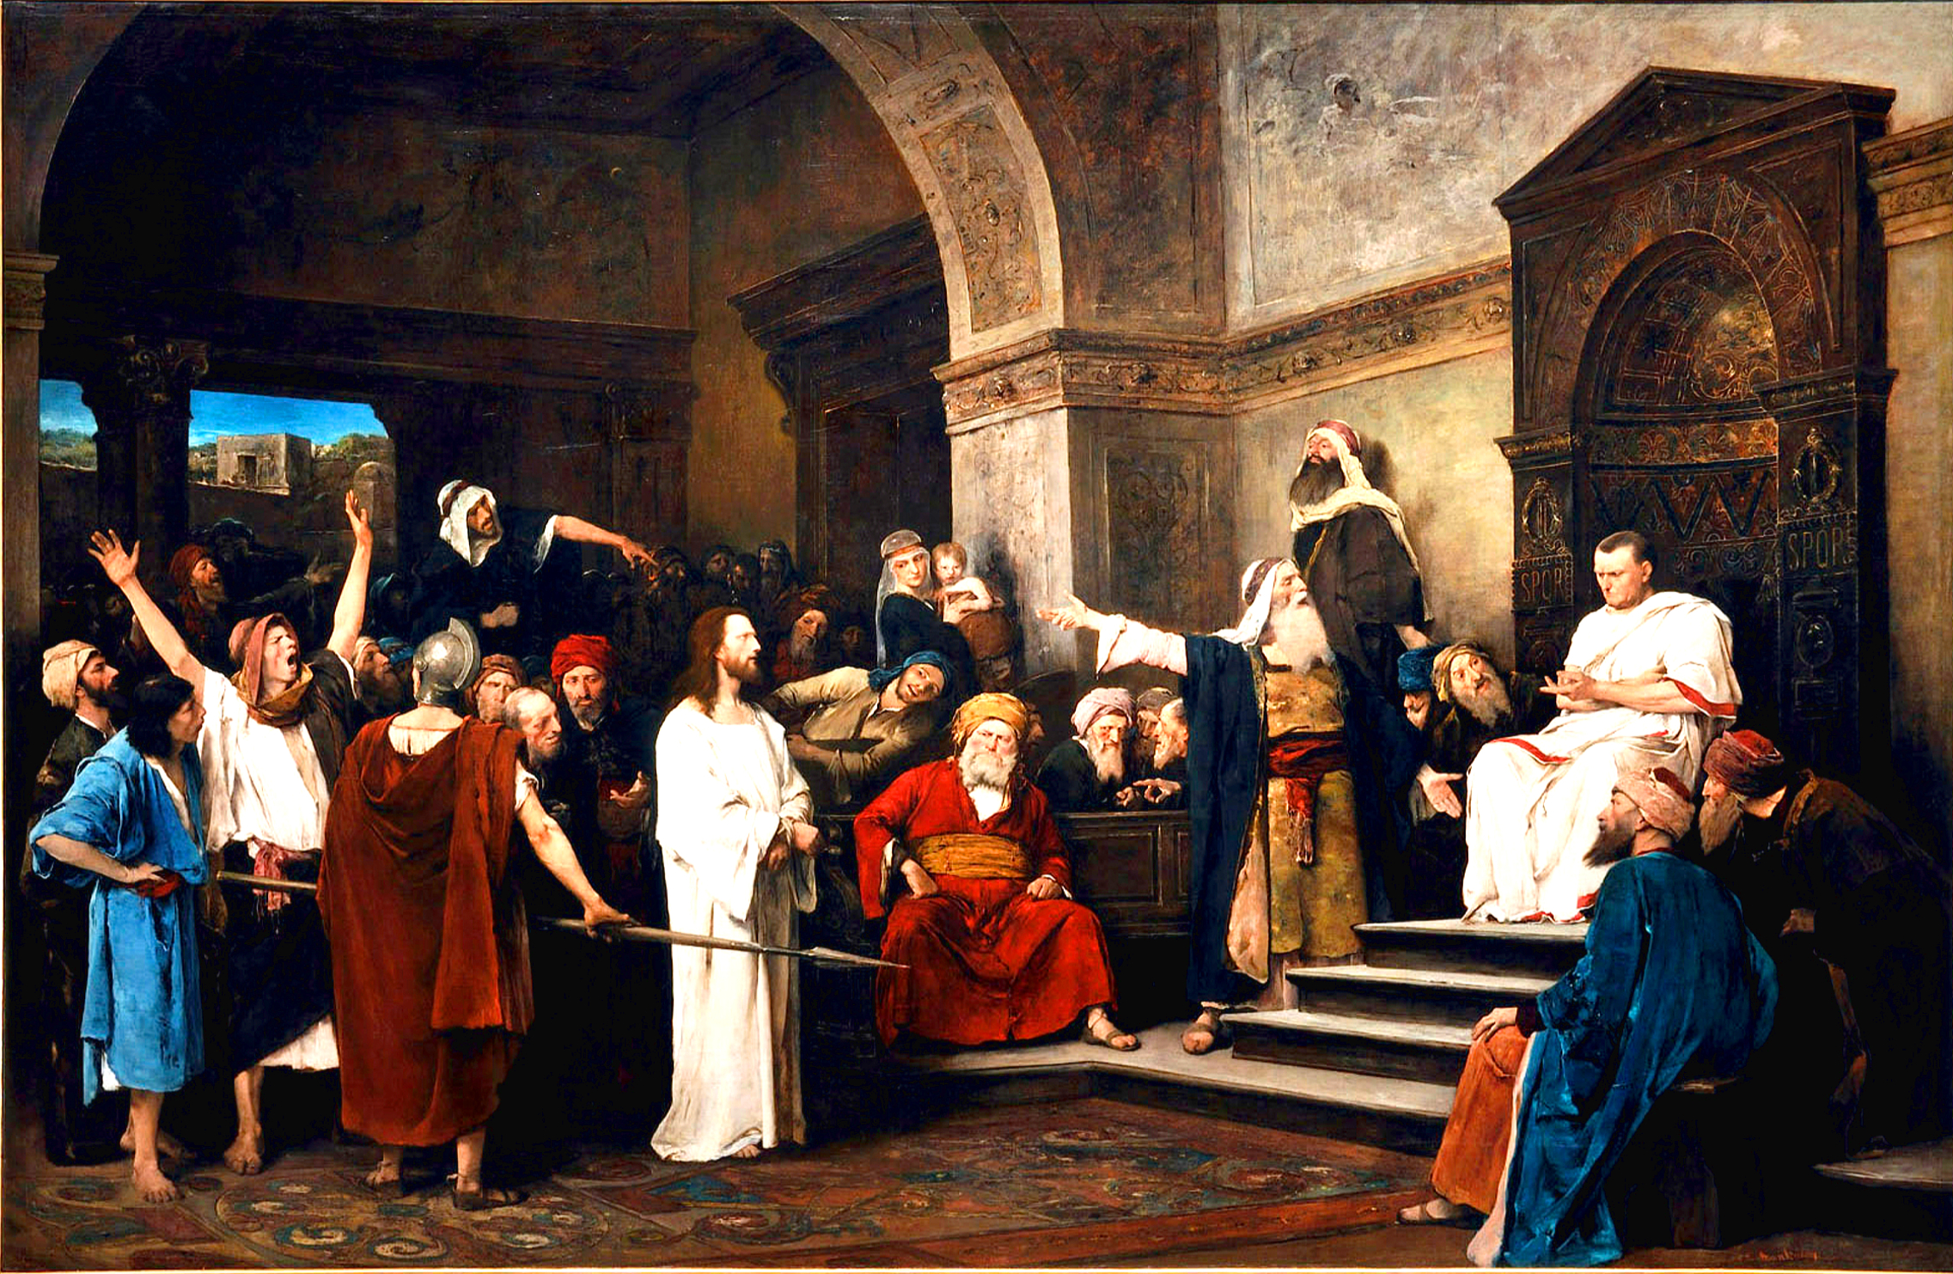

Slide 12
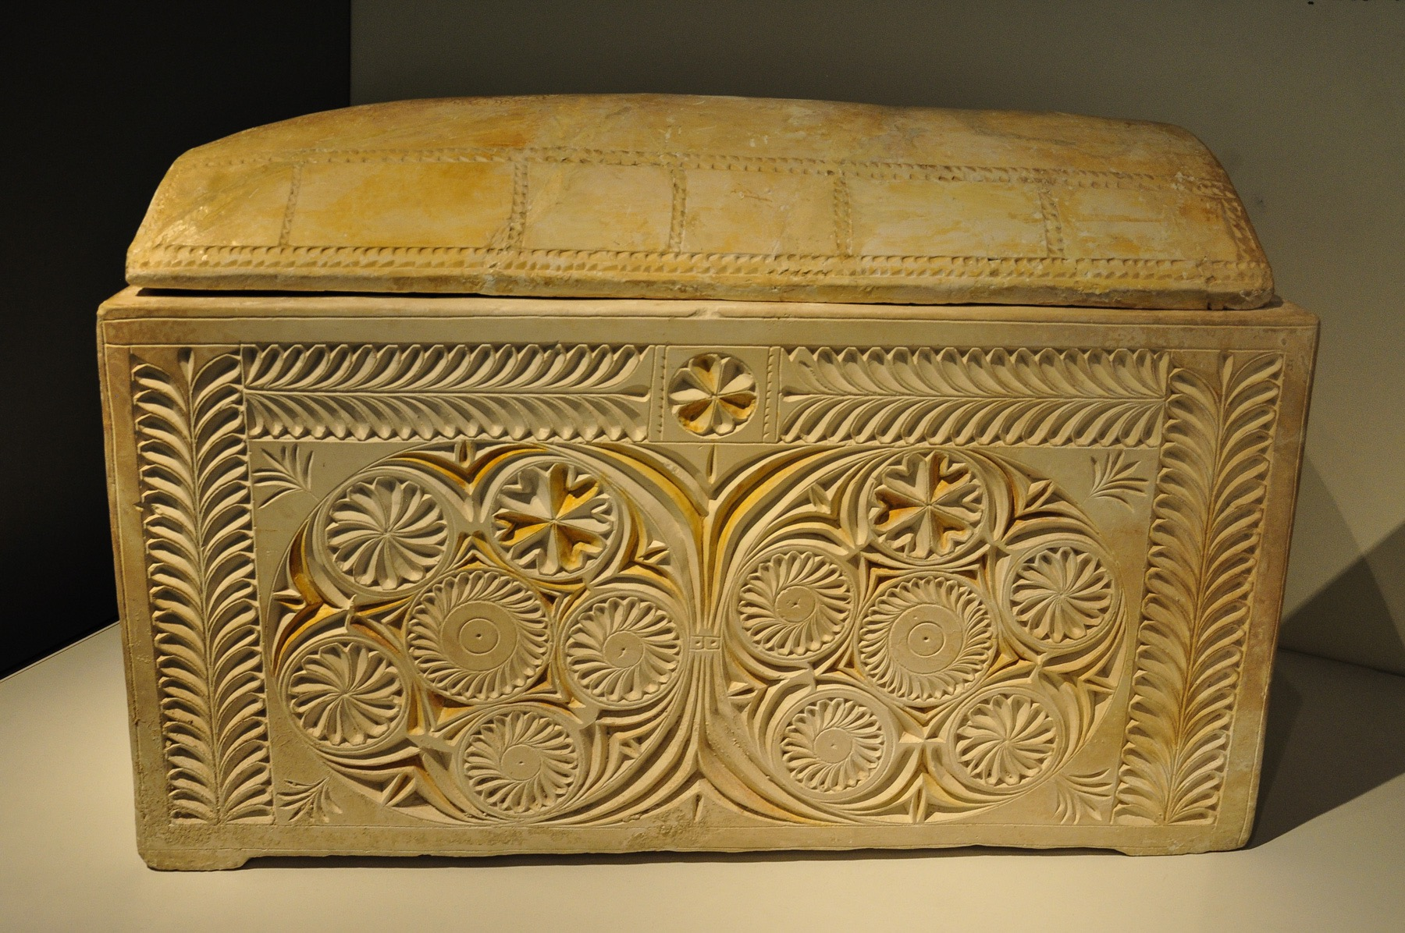

Slide 13
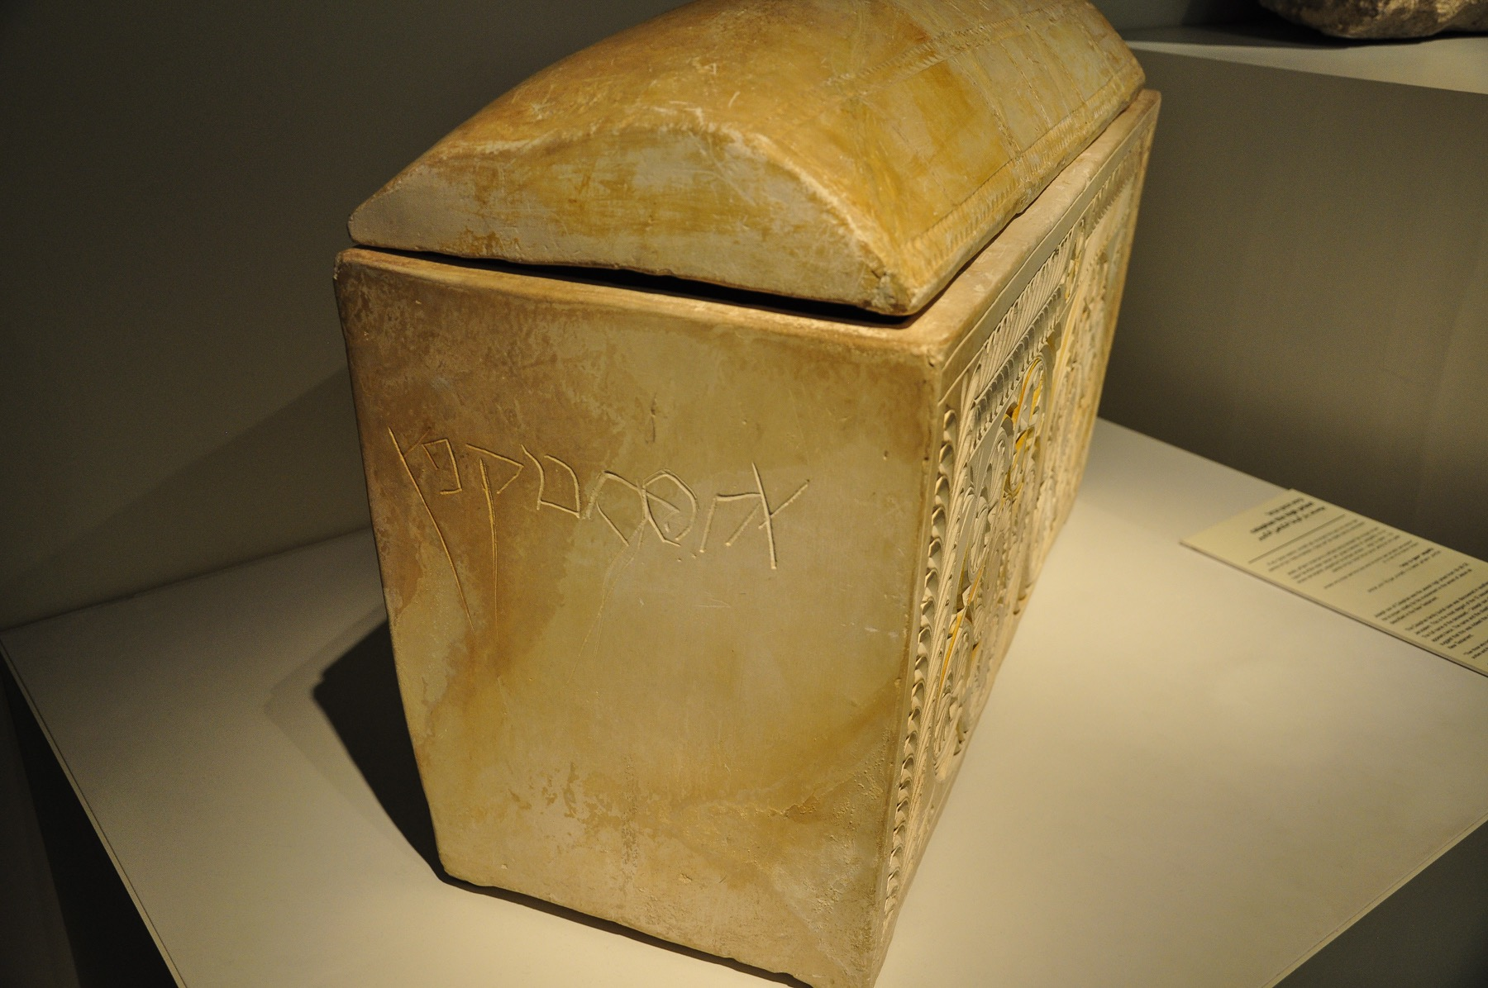

Slide 14
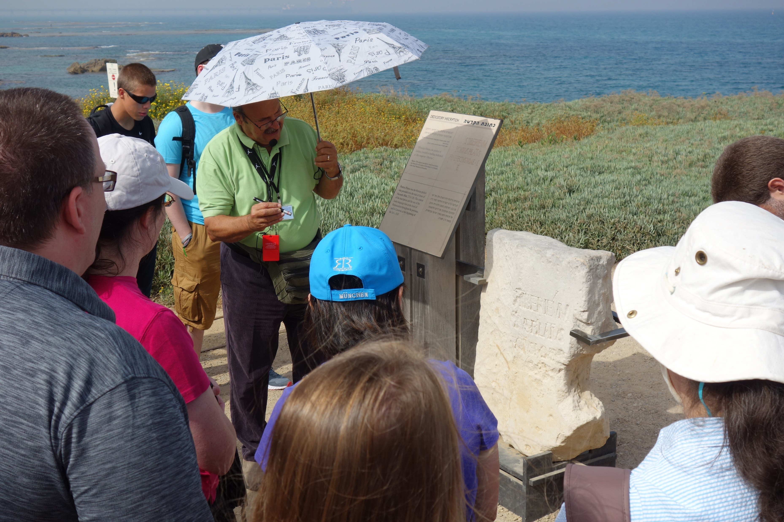

Slide 15
Psalm 37
THE STATE OF THE PERSON COUNSELED (1, 7, 8).
THE CHIEF CONCERN (9, 11, 22, 29, 34).
THE EXPANSIONS OF 1:6B.
A deceiving appearance (35).
The unmasking to come (2, 9, 10).
COUNSELS TO THE RIGHTEOUS.

Slide 16
Psalm 37
COUNSELS TO THE RIGHTEOUS.
Trust in the LORD (3, 5)
Delight in the LORD (4)
Commit your way to the LORD (5)
Rest in the LORD (7)
Wait patiently for the LORD (7)
Wait on the LORD (9)

Slide 17
Psalm 37
COUNSELS TO THE RIGHTEOUS.
Trust in the LORD (3, 5)
Delight in the LORD (4)
Commit your way to the LORD (5)
Rest in the LORD (7)
Wait patiently for the LORD (7)
Wait on the LORD (9)

Slide 18
Psalm 37
COUNSELS TO THE RIGHTEOUS.
Trust in the LORD (3, 5)
Delight in the LORD (4)
Commit your way to the LORD (5)
Rest in the LORD (7)
Wait patiently for the LORD (7)
Wait on the LORD (9)

Slide 19

These are the relationships to the LORD that
characterize the humble (v 11).

Slide 20
These are the relationships to the LORD that
characterize the humble (v 11); the meek (Mtt. 5:5).

Slide 21
These are the relationships to the LORD that
characterize the humble (v 11); the meek (Mtt. 5:5).
--our Savior was this (meek; Mtt. 11:29).

Slide 22
These are the relationships to the LORD that
characterize the humble (v 11); the meek (Mtt. 5:5).
--our Savior was this (meek; Mtt. 11:29).
--our Christlikeness will be this then.

Slide 23
These are the relationships to the LORD that
characterize the humble (v 11); the meek (Mtt. 5:5).
--our Savior was this (meek; Mtt. 11:29).
--our Christlikeness will be this then.
These relationships define meekness

Slide 24
These are the relationships to the LORD that
characterize the humble (v 11); the meek (Mtt. 5:5).
--our Savior was this (meek; Mtt. 11:29).
--our Christlikeness will be this then.
These relationships define meekness
These relationships display meekness

Slide 25
These are the relationships to the LORD that
characterize the humble (v 11); the meek (Mtt. 5:5).
--our Savior was this (meek; Mtt. 11:29).
--our Christlikeness will be this then.
These relationships define meekness
These relationships display meekness
These relationships develop meekness

Slide 26
Psalm 37
THE STATE OF THE PERSON COUNSELED (1, 7, 8).
THE CHIEF CONCERN (9, 11, 22, 29, 34).
THE EXPANSIONS OF 1:6B.
COUNSELS TO THE RIGHTEOUS.
THE PROGRESSION OF THE PSALM.

Slide 27


Slide 29

The Prosperity of the Wicked (1-11) (counsels regarding)

Slide 30
The Plotting of the Wicked (12-15) (Divine laughter)

Slide 31
The Provision for the Righteous (16-26) (more than sufficient)

Slide 32
The Preservation of the Righteous (27-34) (forever)

Slide 33
The Psalm 1 Ends (35-40)
(seen and foreseen)

Slide 34
Prosperity of the wicked (counsels regarding)
Plotting of the wicked (Divine laughter)
Provision for the righteous (more than sufficient)
Preservation of the righteous (forever)
The Psalm 1 ends (seen and foreseen)

Slide 35
Psalm 37
THE STATE OF THE PERSON COUNSELED (1, 7, 8).
THE CHIEF CONCERN (9, 11, 22, 29, 34).
THE EXPANSIONS OF 1:6B.
COUNSELS TO THE RIGHTEOUS.
THE PROGRESSION OF THE PSALM.

Slide 36
Psalm 37
THE STATE OF THE PERSON COUNSELED (1, 7, 8).
THE CHIEF CONCERN (9, 11, 22, 29, 34).
THE EXPANSIONS OF 1:6B.
COUNSELS TO THE RIGHTEOUS.
THE PROGRESSION OF THE PSALM.
AN EXPANSION OF 36:11-12.

Slide 37
Psalm 37
THE STATE OF THE PERSON COUNSELED (1, 7, 8).
THE CHIEF CONCERN (9, 11, 22, 29, 34).
THE EXPANSIONS OF 1:6B.
COUNSELS TO THE RIGHTEOUS.
THE PROGRESSION OF THE PSALM.
AN EXPANSION OF 36:11-12.
A SEASONED PERSONAL PERSPECTIVE (25, 35-36)

Slide 38
Psalm 37
COUNSELS TO THE RIGHTEOUS.
Trust in the LORD (3, 5)
Delight in the LORD (4)
Commit your way to the LORD (5)
Rest in the LORD (7)
Wait patiently for the LORD (7)
Wait on the LORD (9)

