Slide 1




Slide 2
Book 1: The King Preserved
1-2 The Gateway to the Psalter
3-5 The the Worst Possible Day
6 The Deepest Possible Anxiety
7-9 Taking Refuge in the Righteous Judge
10-14 Lamenting the Ways of the Wicked
15-18 Longing and Love for the LORD
19 Responding to Revelation
20-24 Concerning the King’s Victory!
25-31 Let Me Never be Ashamed
32-34 Singing of Deliverance
35-41 The King Smitten, Even by His Friends

Slide 3

35 Imprecatory Petitions for Righteous Vindication

Slide 4
35 Imprecatory Petitions for Righteous Vindication
37 Don’t Fret Over Evildoers

Slide 5
35 Imprecatory Petitions for Righteous Vindication
36
37 Don’t Fret Over Evildoers

Slide 6

35 Imprecatory Petitions for Righteous Vindication
36
37 Don’t Fret Over Evildoers

Slide 7
35 Imprecatory Petitions. . . Agitated distress
36
37 Don’t Fret Over Evildoers

Slide 8
35 Imprecatory Petitions. . . Agitated distress
36
37 Don’t Fret Over Evildoers Calm confidence

Slide 9
1-4 Revelation Concerning the Transg. of the Ungodly

Slide 10
1-4 Revelation Concerning the Transg. of the Ungodly
--The Fundamental Absence: no fear of God 1b

Slide 11
1-4 Revelation Concerning the Transg. of the Ungodly
--The Fundamental Absence: no fear of God 1b
--The Flattering Presumption 2

Slide 12
1-4 Revelation Concerning the Transg. of the Ungodly
--The Fundamental Absence: no fear of God 1b
--The Flattering Presumption 2
--The Descent into Determination to be Evil 3-4

Slide 13
1-4 Revelation Concerning the Transg. of the Ungodly
--The Fundamental Absence: no fear of God 1b
--The Flattering Presumption 2
--The Descent into Determination to be Evil 3-4
3 His speech

Slide 14
1-4 Revelation Concerning the Transg. of the Ungodly
--The Fundamental Absence: no fear of God 1b
--The Flattering Presumption 2
--The Descent into Determination to be Evil 3-4
3 His speech
3 His understanding

Slide 15
1-4 Revelation Concerning the Transg. of the Ungodly
--The Fundamental Absence: no fear of God 1b
--The Flattering Presumption 2
--The Descent into Determination to be Evil 3-4
3 His speech
3 His understanding
Ceased to act prudently so as to do good.

Slide 16
1-4 Revelation Concerning the Transg. of the Ungodly
--The Fundamental Absence: no fear of God 1b
--The Flattering Presumption 2
--The Descent into Determination to be Evil 3-4
3 His speech
3 His understanding

Slide 17
1-4 Revelation Concerning the Transg. of the Ungodly
--The Fundamental Absence: no fear of God 1b
--The Flattering Presumption 2
--The Descent into Determination to be Evil 3-4
3 His speech
3 His understanding
4 His calculating and plotting

Slide 18
1-4 Revelation Concerning the Transg. of the Ungodly
--The Fundamental Absence: no fear of God 1b
--The Flattering Presumption 2
--The Descent into Determination to be Evil 3-4
3 His speech
3 His understanding
4 His calculating and plotting
4 His deliberate choice of path

Slide 19
1-4 Revelation Concerning the Transg. of the Ungodly
--The Fundamental Absence: no fear of God 1b
--The Flattering Presumption 2
--The Descent into Determination to be Evil 3-4
3 His speech
3 His understanding
4 His calculating and plotting
4 His deliberate choice of path
4 His ease/complacency about evil

Slide 20
I am more and more convinced that man is a dangerous creature, and that power whether vested in many or few is ever grasping.
--Abigail Adams (1775)

Slide 21
I am more and more convinced that man is a dangerous creature, and that power whether vested in many or few is ever grasping.
--Abigail Adams (1775)
. . . grow avaricious. . . exempt itself from burdens. . . become ambitious and after some time vote itself perpetual. --John Adams (1776)

Slide 22
1-4 Revelation Concerning the Transg. of the Ungodly
5-6 Four Perfections of the LORD

Slide 23
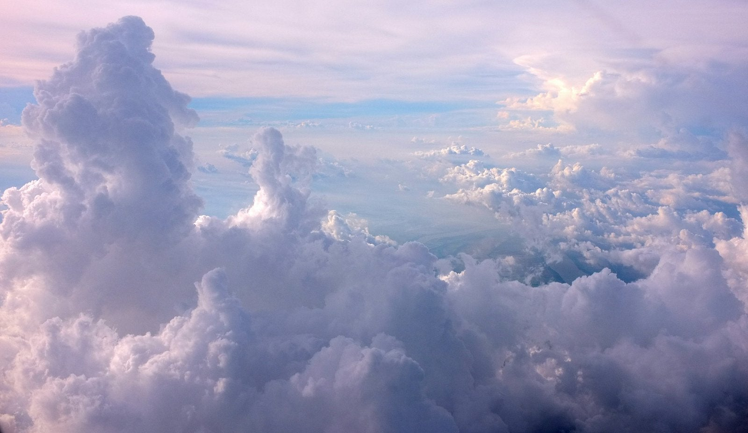

Slide 24


Slide 25


Slide 26


Slide 27
1-4 Revelation Concerning the Transg. of the Ungodly
5-6 Four Perfections of the LORD

Slide 28
1-4 Revelation Concerning the Transg. of the Ungodly
5-6 Four Unassailable Perfections of the LORD

Slide 29
1-4 Revelation Concerning the Transg. of the Ungodly
5-6 Four Unassailable Perfections of the LORD

Slide 30
1-4 Revelation Concerning the Transg. of the Ungodly
5-6 Four Unassailable Perfections of the LORD
These are what ensure the unfailing preservation
of all living things (6c).
Genesis 20:6

Slide 31
1-4 Revelation Concerning the Transg. of the Ungodly
5-6 Four Unassailable Perfections of the LORD
These are what ensure the unfailing preservation
of all living things (6c).
7-9 His Lovingkindness is Particularly Precious.

Slide 32
1-4 Revelation Concerning the Transg. of the Ungodly
5-6 Four Unassailable Perfections of the LORD
These are what ensure the unfailing preservation
of all living things (6c).
7-9 His Lovingkindness is Particularly Precious.
Psalm 107:43
Psalm 136

Slide 33
1-4 Revelation Concerning the Transg. of the Ungodly
5-6 Four Unassailable Perfections of the LORD
These are what ensure the unfailing preservation
of all living things (6c).
7-9 His Lovingkindness is Particularly Precious.
10-11 Petitions for the Continuations

Slide 34
1-4 Revelation Concerning the Transg. of the Ungodly
5-6 Four Unassailable Perfections of the LORD
These are what ensure the unfailing preservation
of all living things (6c).
7-9 His Lovingkindness is Particularly Precious.
10-11 Petitions for the Continuations
12 The Certainty of the Ruin of the Wicked

Slide 35
35 Imprecatory Petitions for Righteous Vindication
36
37 Don’t Fret Over Evildoers

Slide 36
35 Imprecatory Petitions for Righteous Vindication
36 Lovingly Preserved from the Transg. of the
Ungodly.
37 Don’t Fret Over Evildoers

