Slide 1


Slide 2
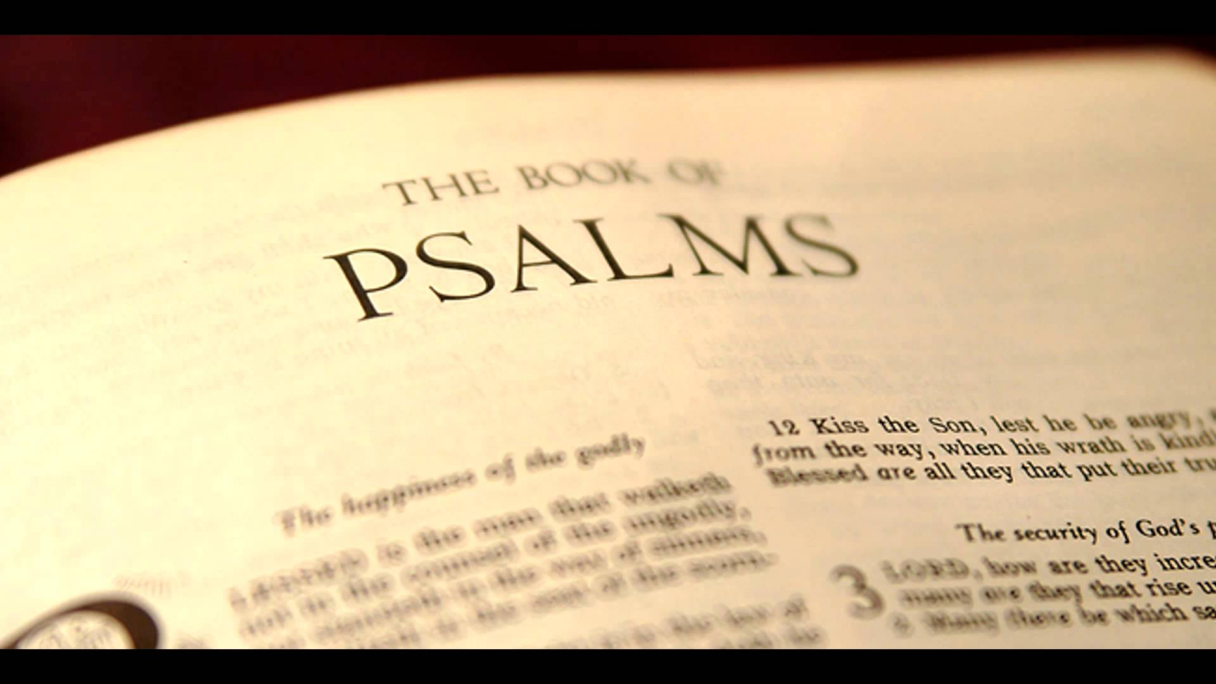

Slide 3
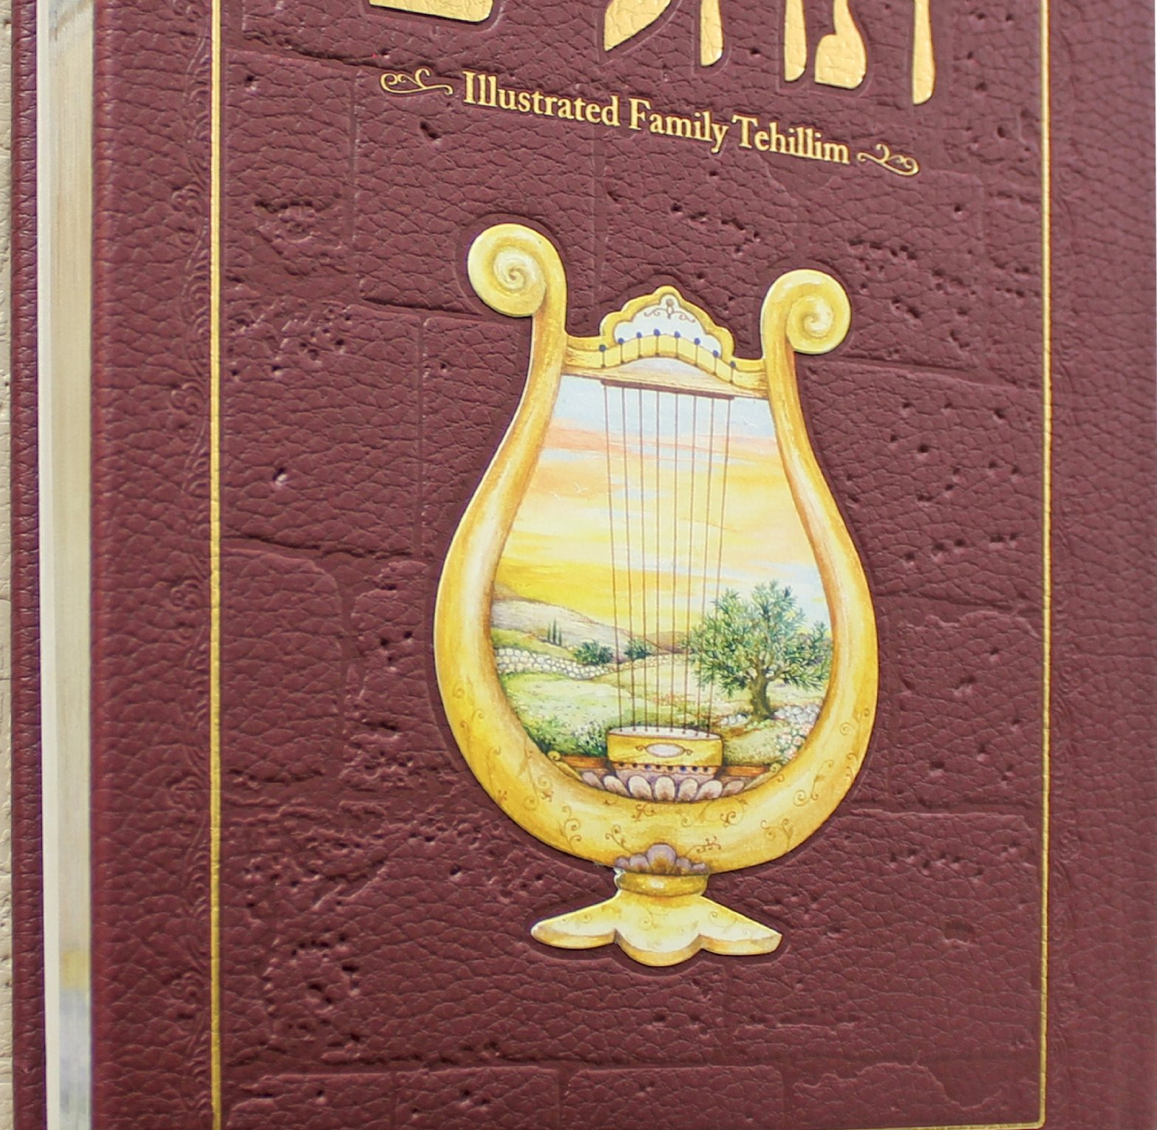
Tehillim Praises

Slide 4

Be filled with the Spirit, speaking to yourselves in psalms and hymns and spiritual songs, singing and making melody in your heart to the Lord.
Ephesians 5:18b-19

Slide 5
Let the word of Christ dwell in you richly in all wisdom; teaching and admonishing one another in psalms and hymns and spiritual songs, singing with grace in your hearts to the Lord.
Colossians 3:16

Slide 7




Slide 8

What hope has God given that it is possible for us to be redeemed from our state of sin and misery?
But the lovingkindness of the LORD is from everlasting to everlasting on those who fear Him, and His righteousness to children’s children, to those who keep His covenant and remember His precepts to do them (NASB; Ps. 103:17-18).
. . . Israelites, to whom belongs the adoption as sons, and the glory and the covenants . . . (NASB; Rom. 9:4).
Remember that formerly you, the Gentiles, . . . were at that time separate from Christ, excluded from the commonwealth of Israel, and strangers to the covenants of promise, having no hope and without God in the world. But now in Christ Jesus, you who formerly were far off have been brought near by the blood of Christ (NASB; Eph. 2:11a, 12-13).
29

Slide 9

The hope that God has given that it is possible for us to be redeemed from our state of sin and misery consists in the gracious provisions of His covenants.

Slide 11
What hope has God given that it is possible for us to be redeemed from our state of sin and misery?
But the lovingkindness of the LORD is from everlasting to everlasting on those who fear Him, and His righteousness to children’s children, to those who keep His covenant and remember His precepts to do them (NASB; Ps. 103:17-18).
. . . Israelites, to whom belongs the adoption as sons, and the glory and the covenants . . . (NASB; Rom. 9:4).
Remember that formerly you, the Gentiles, . . . were at that time separate from Christ, excluded from the commonwealth of Israel, and strangers to the covenants of promise, having no hope and without God in the world. But now in Christ Jesus, you who formerly were far off have been brought near by the blood of Christ (NASB; Eph. 2:11a, 12-13).
29

Slide 12
The hope that God has given that it is possible for us to be redeemed from our state of sin and misery consists in the gracious provisions of His covenants.

Slide 13
What are the Davidic Covenant’s gracious provisions?
“Your house and your kingdom shall endure before Me forever; your throne shall be established forever” (NASB; II Sam. 7:16).
“I have made a covenant with My chosen; I have sworn to David My servant, I will establish your seed forever and build up your throne to all generations. . . . My lovingkindness I will keep for him forever, and My covenant shall be confirmed to him. So I will establish his descendants forever and his throne as the days of heaven” (NASB; Ps. 89:3-4, 28-29).
“He will be great and will be called the Son of the Most High; and the Lord God will give Him the throne of His father David; and He will reign over the house of Jacob forever, and His kingdom will have no end”
(NASB; Lk. 1:32-33).
34

Slide 14
The Davidic Covenant’s gracious provisions are God’s promises that David’s seed, kingdom, and throne would be established forever, all of which are fulfilled in David’s ultimate descendant, the Lord Jesus Christ.

Slide 15


Slide 16
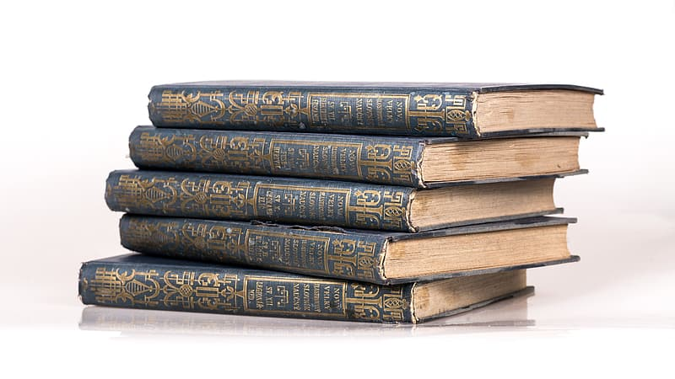

Slide 17
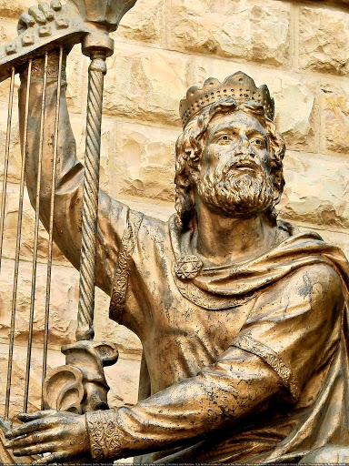

Slide 18
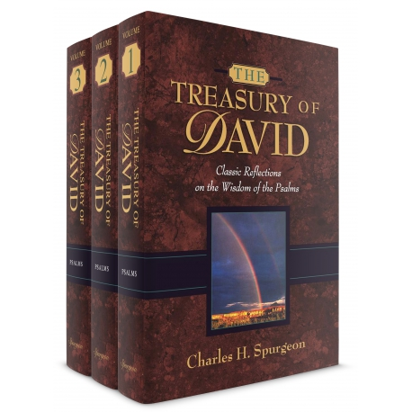

Slide 19
Book 1: The King Preserved

Slide 20
Book 1: The King Preserved
1-2 The Gateway to the Psalter
3-5 The the Worst Possible Day
6 The Deepest Possible Anxiety
7-9 Taking Refuge in the Righteous Judge
10-14 Lamenting the Ways of the Wicked
15-18 Longing and Love for the LORD
19 Responding to Revelation
20-24 Concerning the King’s Victory!
25-31 Let Me Never be Ashamed
32-34 Singing of Deliverance

Slide 21
Book 1: The King Preserved
35-41

Slide 22
Book 1: The King Preserved
35-41 These psalms. . .
Bracket a particular experience
in the life of the King(35:19; 41:9).

Slide 23
Book 1: The King Preserved
35-41 These psalms. . .
The King Smitten, Even by His Friends (35:19; 41:9).

Slide 24
Book 1: The King Preserved
35-41 These psalms. . .
The King Smitten, Even by His Friends (35:19; 41:9).
Contain the King’s pre-incarnate
commitment to this very experience
(40:6-8).

