Slide 1
Session 1: Music is a form of communication
Three-part series on music in worship
MUSIC CAN MAKE YOU CHRISTLIKE
Douglas Bachorik, Bob Jones Memorial Bible College (GFA), 2021

Slide 2
In public worship, we must use music as a tool for personal expression and motivational instruction as we communicate to and through our emotions.

Slide 3
What the Bible clearly teaches about the nature and use of music must be the foundation of our thinking and application.

Slide 4
Music is music. Music is not a language or symbols or drama, or anything else. We must take music on its own terms. Comparisons and analogies are generally helpful, but not equivalent to what music is.

Slide 5
Music is utterly simple and irreducibly complex. Our experiences with music are always immediate and multilayered.

Slide 6
Thinking, discernment, and choices in music are always, ultimately, theological.

Slide 7

Session 1
The nature of music: a form of communication

Slide 8
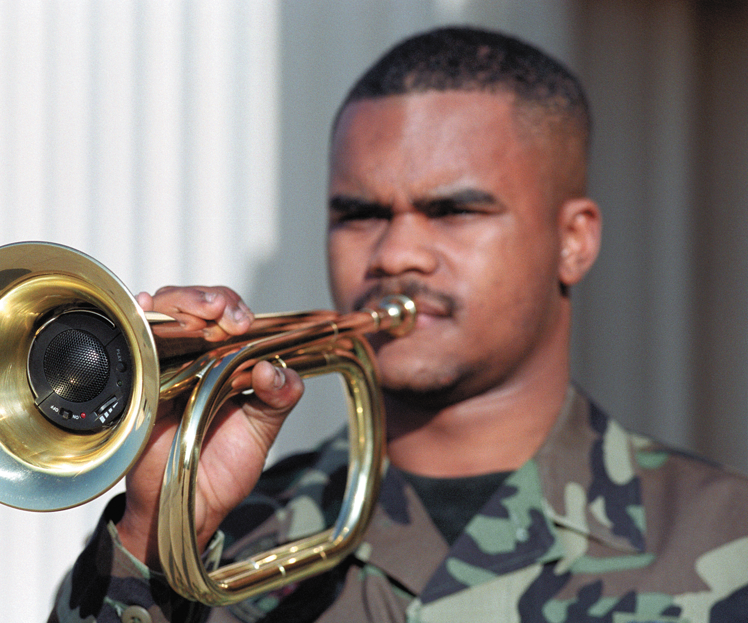

BIBLICAL EVIDENCE
MUSIC AS COMMUNICATION
SIGNALING
  Matt. 6:2
  1 Cor. 15:52
  1 Thess. 4:16
  Rev. 8-11
  Num. 10:2
Reveille

Slide 9

BIBLICAL EVIDENCE
MUSIC AS COMMUNICATION
EXPRESSING
  Mark 5:38-39
  Luke 8:52
  Luke 15:25
  Acts 16:25
  Rom. 15:9
  1 Chron. 25:1-3

Slide 10
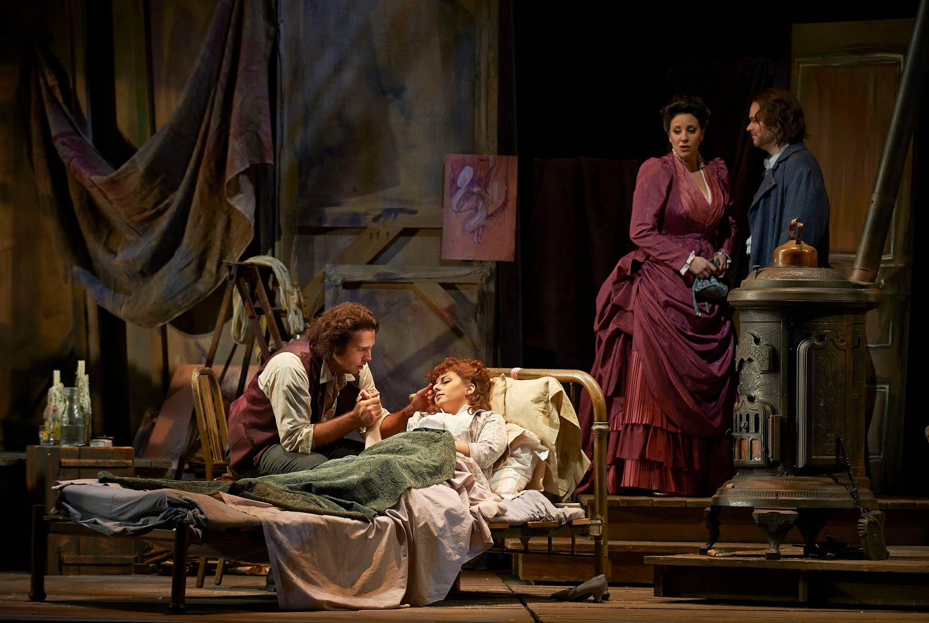
BIBLICAL EVIDENCE
MUSIC AS COMMUNICATION
EVOKING RESPONSE
  Luke 7:32
  1 Cor. 13:1
  Heb. 12:19

Slide 11
Not a single reference suggests music is neutral or non-communicative
Every single NT reference sees music as communication; nearly every OT reference does the same.

Slide 12
-Music is a form of communication
-Components of communication

Slide 13

HUMAN NATURE
PSYCHOSOMATIC UNITY
Music speaks to our emotions
Emotions are not separated from any other part of our being

Slide 14
Components of communication: mode
Sound or music alone
  Psa.43:4; 71:22; 150
  Isa. 16:11

Slide 15
-Music is a form of communication
-Components of communication
-Elements of reception

Slide 16
Take-aways
The idea that music is a means of communication is important for several reasons
  It is a fact clearly established in scriptures
  It means that sound is not neutral
  It means music-making is intentional: we are responsible for what we say through music
  As receivers, we need to be discerning about music is saying to us
    Fulfill Phil. 4:8
    Obey 1 John 4:1 and 1 Thess. 5:21-22

