Slide 1




Slide 2
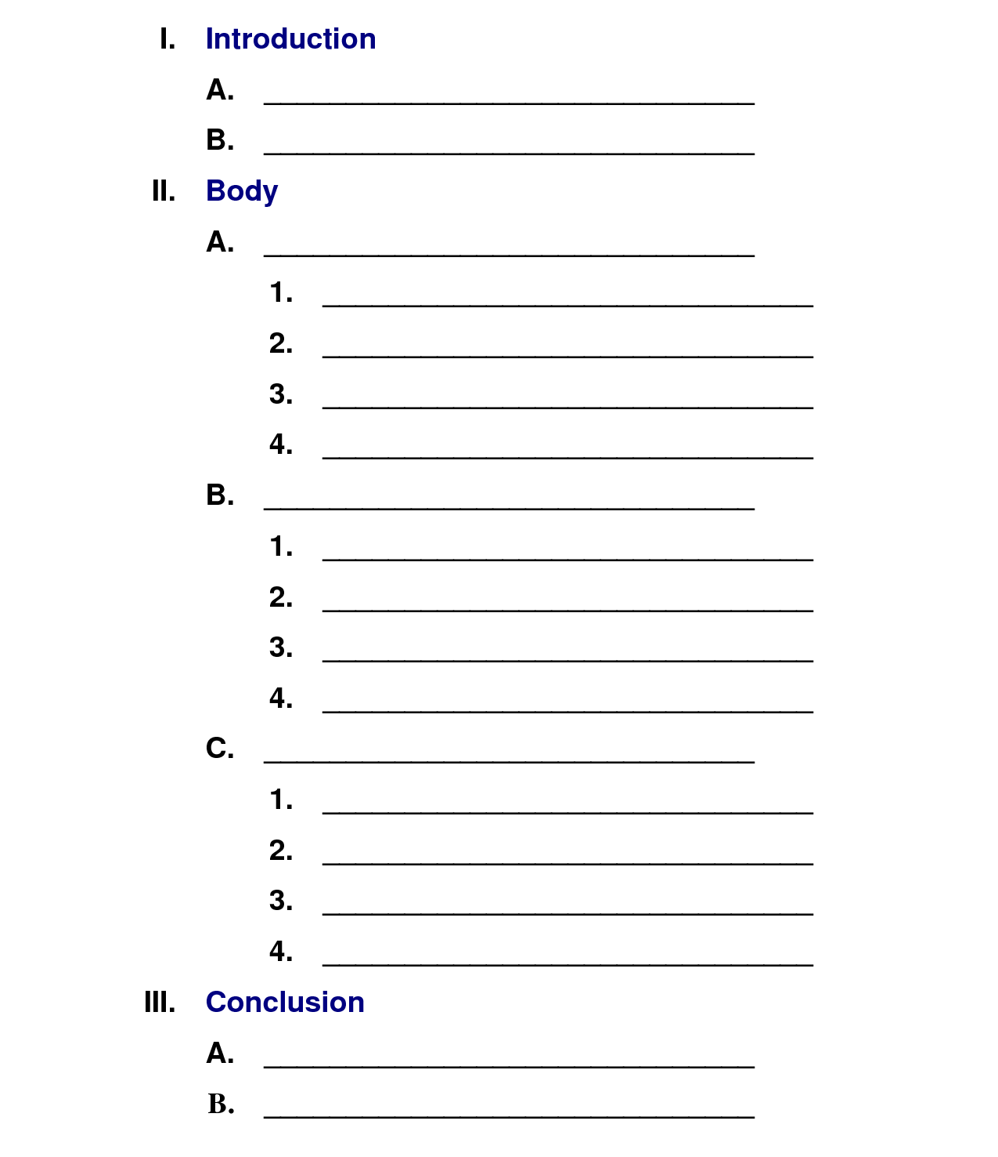

Slide 3
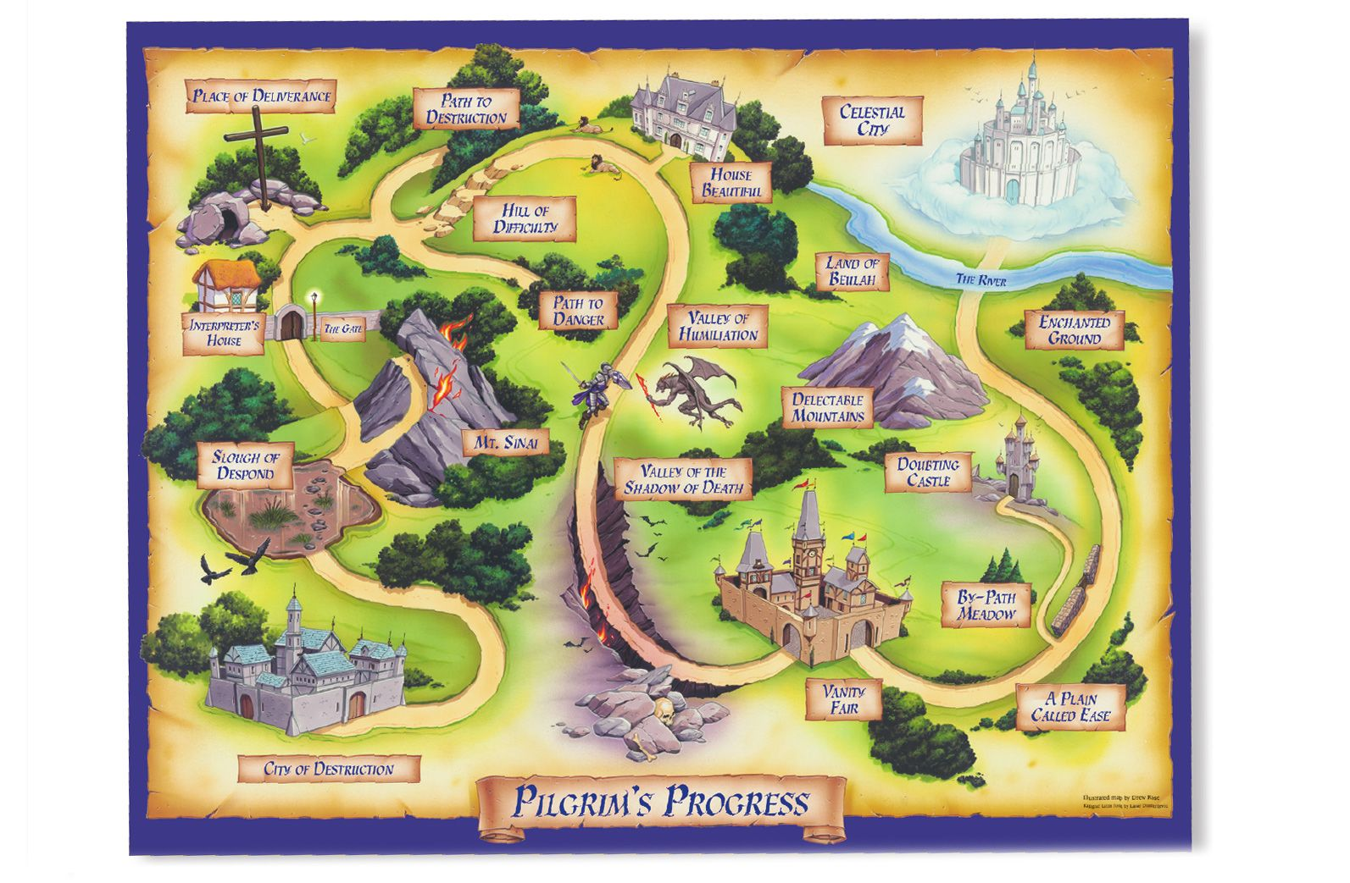

Slide 4
Psalms 1-2 At the Gateway

Slide 5
Psalms 1-2 At the Gateway
Psalms 3-5 On the Worst Possible Day

Slide 6
Psalms 1-2 At the Gateway
Psalms 3-5 On the Worst Possible Day
Psalms 6 In the Deepest Possible Anxiety

Slide 7
Psalms 1-2 At the Gateway
Psalms 3-5 On the Worst Possible Day
Psalms 6 In the Deepest Possible Anxiety
Psalms 7-9 When Taking Refuge in the
Righteous Judge

Slide 8
Psalms 1-2 At the Gateway
Psalms 3-5 On the Worst Possible Day
Psalms 6 In the Deepest Possible Anxiety
Psalms 7-9 When Taking Refuge in the
Righteous Judge
Psalms 10-14When Lamenting the Ways of the Wicked

Slide 9
Psalms 1-2 At the Gateway
Psalms 3-5 On the Worst Possible Day
Psalms 6 In the Deepest Possible Anxiety
Psalms 7-9 When Taking Refuge in the
Righteous Judge
Psalms 10-14When Lamenting the Ways of the Wicked
Psalms 15-18With Longing and Love for the LORD

Slide 10
Psalms 1-2 At the Gateway
Psalms 3-5 On the Worst Possible Day
Psalms 6 In the Deepest Possible Anxiety
Psalms 7-9 When Taking Refuge in the
Righteous Judge
Psalms 10-14 When Lamenting the Ways of the Wicked
Psalms 15-18 With Longing and Love for the LORD
Psalm 19 As the LORD’s Servant Responding
to Revelation

Slide 11
Psalms 1-2 At the Gateway
Psalms 3-5 On the Worst Possible Day
Psalms 6 In the Deepest Possible Anxiety
Psalms 7-9 When Taking Refuge in the
Righteous Judge
Psalms 10-14 When Lamenting the Ways of the Wicked
Psalms 15-18 With Longing and Love for the LORD
Psalm 19 As the LORD’s Servant Responding
to Revelation
Psalms 20-24 Concerning the King’s Victory!

Slide 12
Book 1: David Preserved
Psalms 1-2 At the Gateway
Psalms 3-5 On the Worst Possible Day
Psalms 6 In the Deepest Possible Anxiety
Psalms 7-9 When Taking Refuge in the
Righteous Judge
Psalms 10-14 When Lamenting the Ways of the Wicked
Psalms 15-18 With Longing and Love for the LORD
Psalm 19 As the LORD’s Servant Responding
to Revelation
Psalms 20-24 Concerning the King’s Victory!

Slide 14
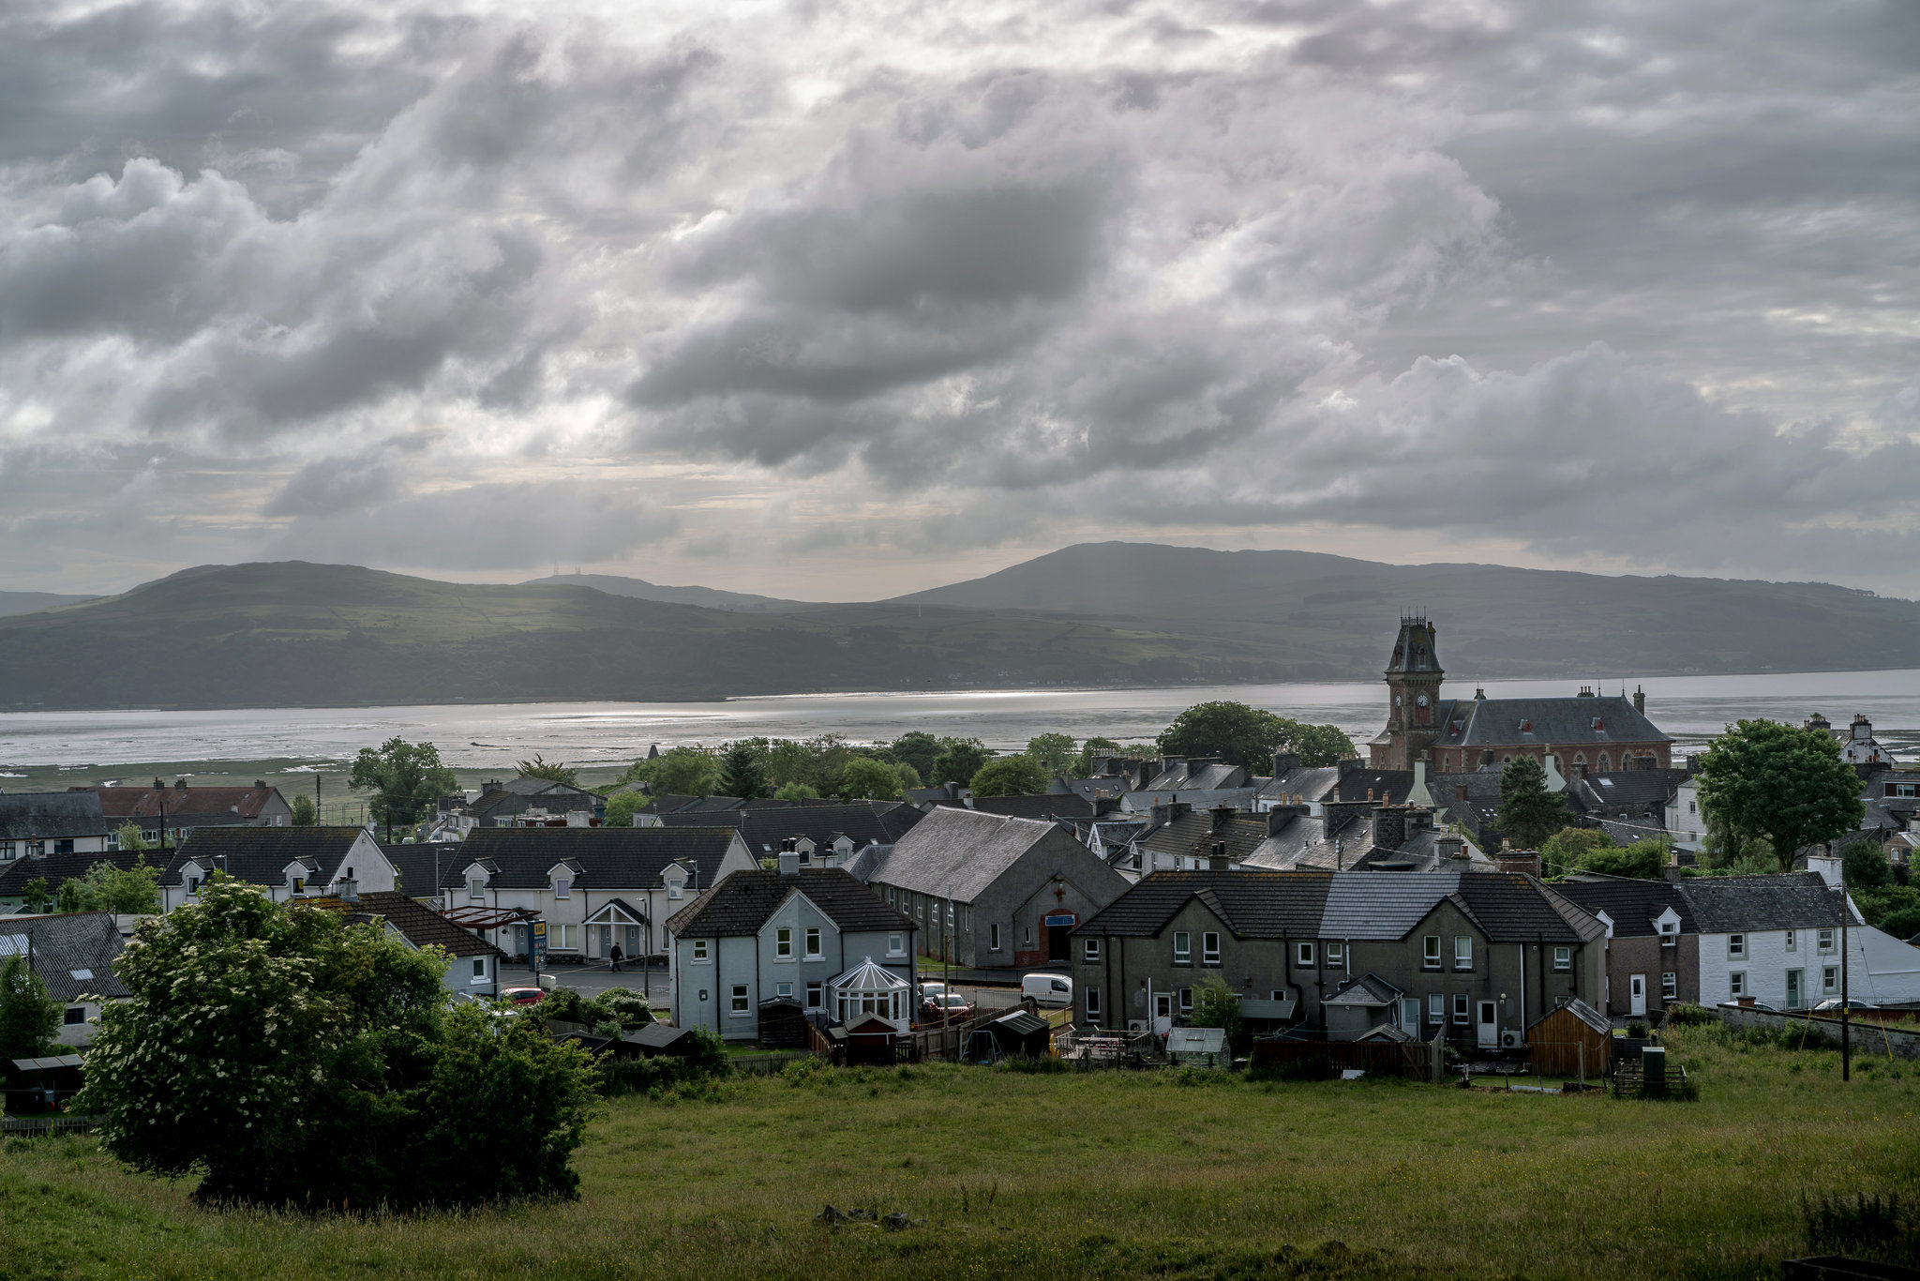

Slide 15
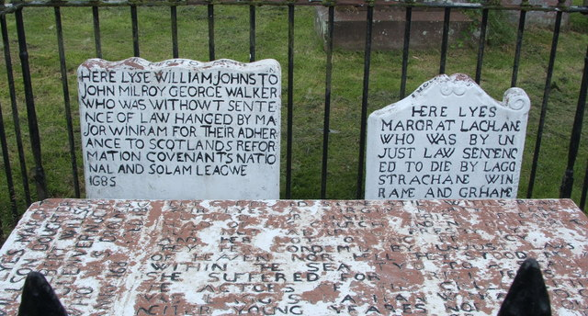

Slide 16
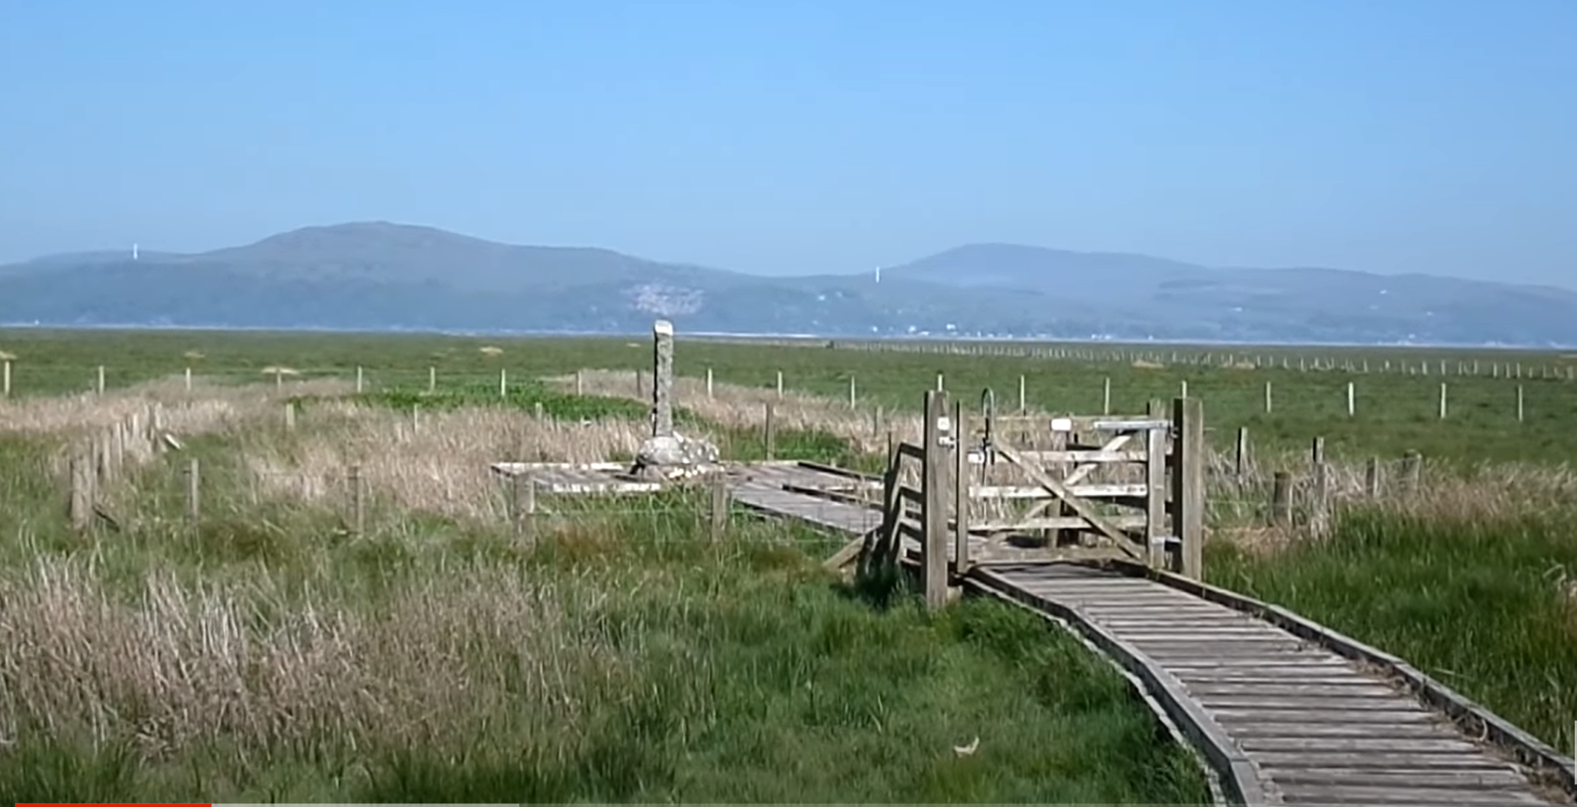

Slide 17
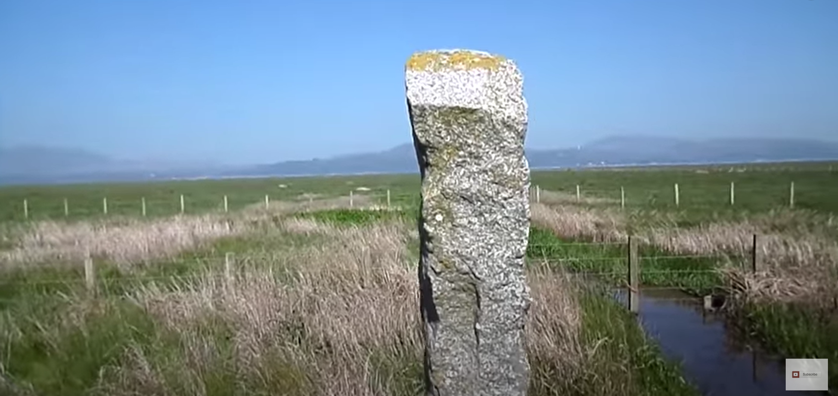

Slide 18
My sins and faults of youth
Do thou, O Lord, forget:
After thy mercy think on me,
And for thy goodness great (7)

Slide 19
O do thou keep my soul
Do thou deliver me:
And let me never be ashamed,
Because I trust in thee (20)

Slide 22



Slide 23
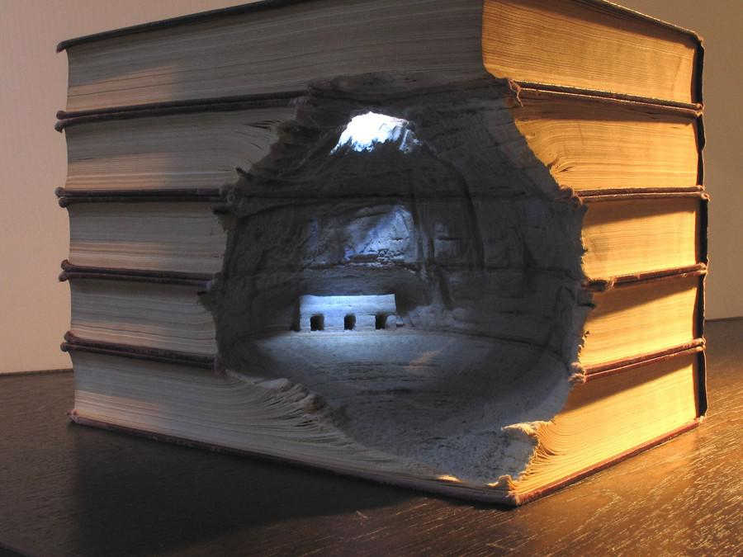

Slide 24


