Slide 1
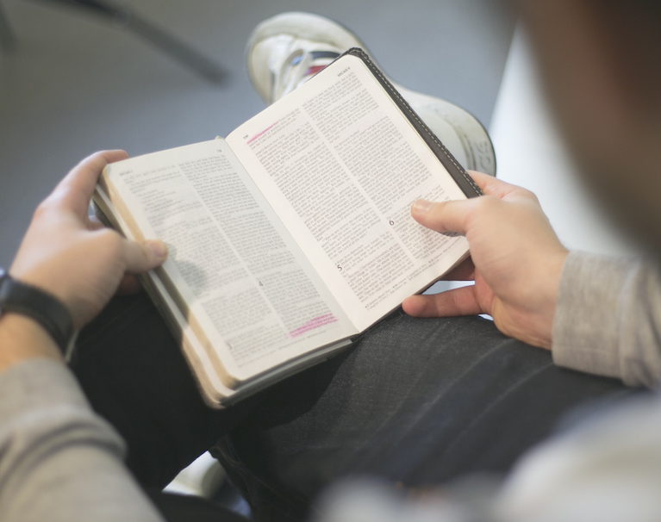
Daily Devotional
Life 2021
© [YEAR] Communicate Jesus. All rights reserved. Originally published at www.communicatejesus.com.”

Slide 2
Daily Devotional
Life 2021
Necessity: Luke 10:39-40
© [YEAR] Communicate Jesus. All rights reserved. Originally published at www.communicatejesus.com.”

Slide 3
Daily Devotional
Life 2021
Necessity: Giving God undivided attention
© [YEAR] Communicate Jesus. All rights reserved. Originally published at www.communicatejesus.com.”

Slide 4
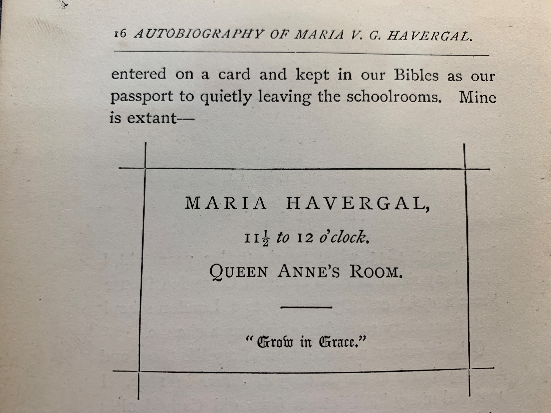

Slide 5
Daily Devotional
Life 2021
Activities:
© [YEAR] Communicate Jesus. All rights reserved. Originally published at www.communicatejesus.com.”

Slide 6
Daily Devotional
Life 2021
Activities:
Brief prayer
© [YEAR] Communicate Jesus. All rights reserved. Originally published at www.communicatejesus.com.”

Slide 7
Spirit of God, descend upon my heart.
Wean it from earth, through all is pulses move.
Stoop to my weakness, mighty as Thou art,
And make me love Thee as I ought to love.

Slide 8
I ask no dream, no prophet ecstasies,
No sudden rending of the veil of clay,
No angel visitant, no opening skies,
But take the dimness of my soul away.

Slide 9
Daily Devotional
Life 2021
Activities:
Brief prayer
Begin with whatever will best Spiritualize your heart
© [YEAR] Communicate Jesus. All rights reserved. Originally published at www.communicatejesus.com.”

Slide 10
Daily Devotional
Life 2021
Activities:
Brief prayer
Begin with whatever will best Spiritualize your heart
Bible Reading
© [YEAR] Communicate Jesus. All rights reserved. Originally published at www.communicatejesus.com.”

Slide 11
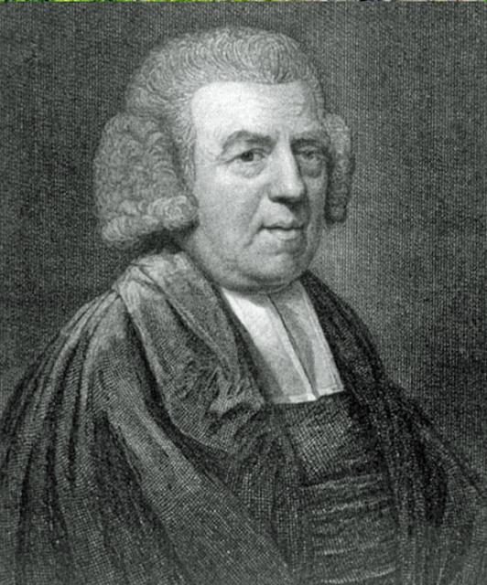
I know not a better rule of reading the scripture than to read it through from beginning to end and, when we have finished it once, to begin it again.

Slide 12
We shall meet with many passages which we can make little improvement of, but not so many in the second reading as in the first, and fewer in the third than in the second—provided we pray to him who has the keys to open our understandings, and to anoint our eyes with his spiritual ointment.

Slide 13
The course of reading today will prepare some lights for what we shall read tomorrow, and throw a farther light upon what we read yesterday. Experience only can prove the advantage of this method, if steadily persevered in.

Slide 14
To make a few efforts and then give over is like making a few steps and then standing still, which would do little towards completing a long journey. But though a person walked slowly, and but a little way in a day, if he walked every day, and with his face always in the same direction, year after year, he might in time encompass the globe.

Slide 15
By thus traveling patiently and steadily through the Scripture, and repeating our progress, we should increase in knowledge to the end of life. The Old and New Testament, the doctrines, precepts and promises, the
history, the examples, admonitions, and warnings, etc. would mutually illustrate and strengthen each other, and nothing that
is written for our instruction would be overlooked.

Slide 16
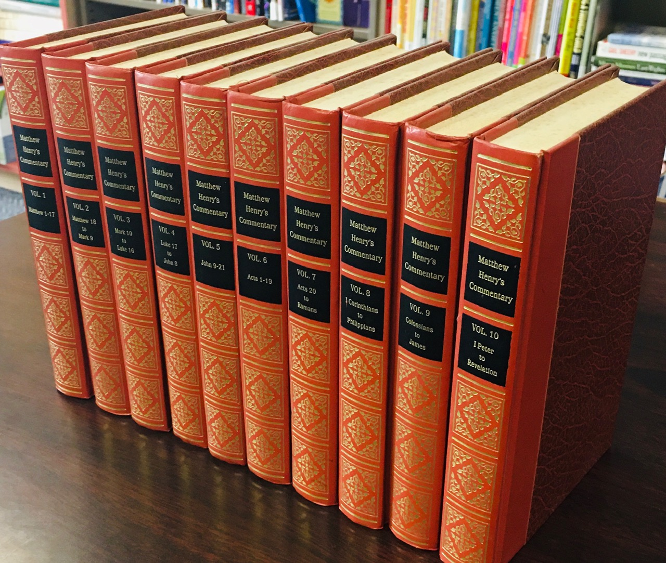

Slide 17
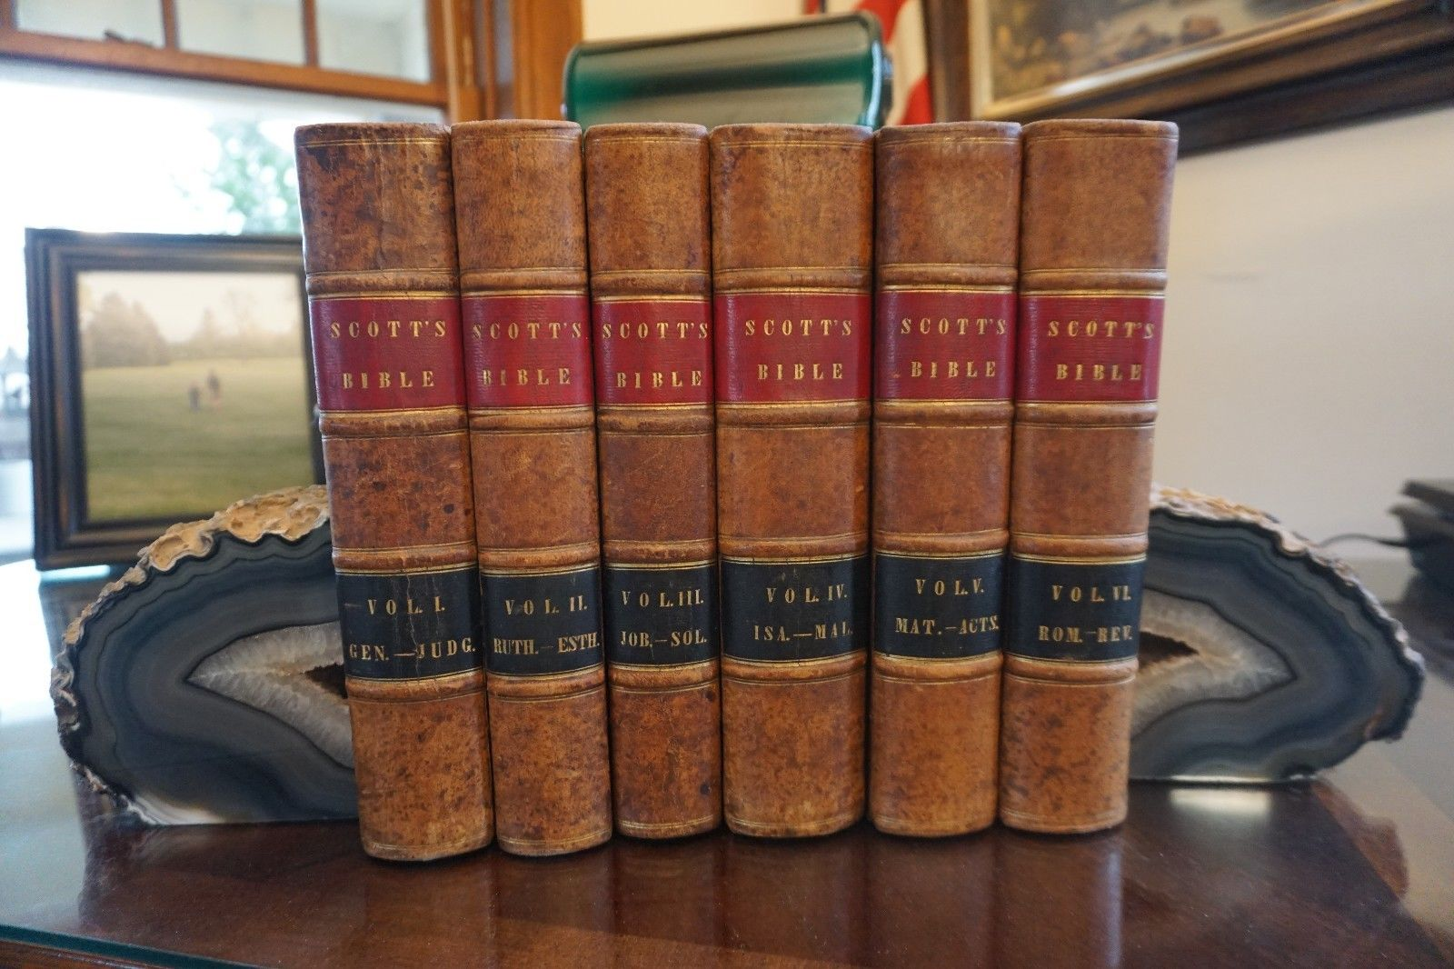

Slide 18
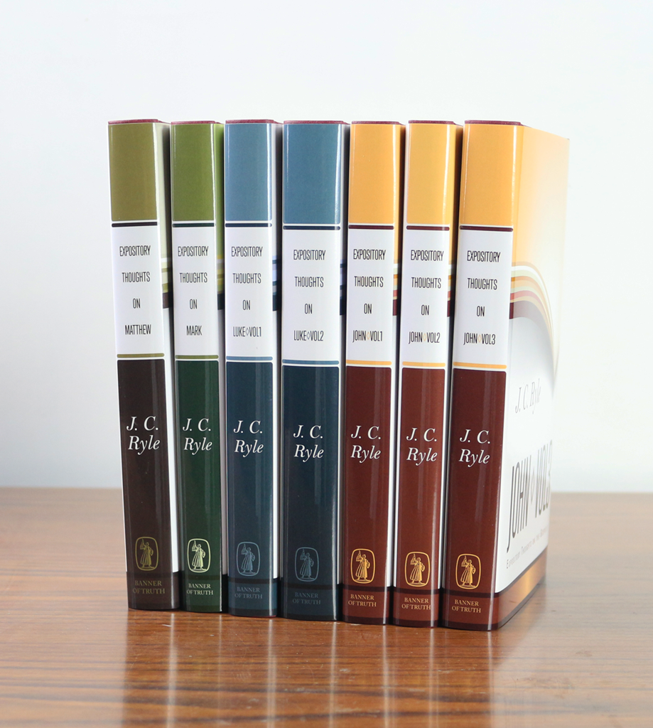

Slide 19
Daily Devotional
Life 2021
Activities:
Brief prayer
Begin with whatever will best Spiritualize your heart
Bible Reading
Prayers, intercessions, supplications, giving of thanks
© [YEAR] Communicate Jesus. All rights reserved. Originally published at www.communicatejesus.com.”

Slide 20
Daily Devotional
Life 2021
Activities:
Brief prayer
Begin with whatever will best Spiritualize your heart
Bible Reading
Prayers, intercessions, supplications, giving of thanks
Scripture memorization
© [YEAR] Communicate Jesus. All rights reserved. Originally published at www.communicatejesus.com.”

Slide 21
Daily Devotional
Life 2021
Activities:
Brief prayer
Begin with whatever will best Spiritualize your heart
Bible Reading
Prayers, intercessions, supplications, giving of thanks
Scripture memorization
Devotional Literature
© [YEAR] Communicate Jesus. All rights reserved. Originally published at www.communicatejesus.com.”

Slide 22
Daily Devotional
Life 2021
Activities:
Reviewing SS lessons and sermons
© [YEAR] Communicate Jesus. All rights reserved. Originally published at www.communicatejesus.com.”

Slide 23
Daily Devotional
Life 2021
Activities:
Reviewing SS lessons and sermons
Meditating
© [YEAR] Communicate Jesus. All rights reserved. Originally published at www.communicatejesus.com.”

Slide 24
Daily Devotional
Life 2021
Activities:
Reviewing SS lessons and sermons
Meditating
Singing
© [YEAR] Communicate Jesus. All rights reserved. Originally published at www.communicatejesus.com.”

Slide 25
Daily Devotional
Life 2021
Activities:
Reviewing SS lessons and sermons
Meditating
Singing
Journaling
© [YEAR] Communicate Jesus. All rights reserved. Originally published at www.communicatejesus.com.”

Slide 26
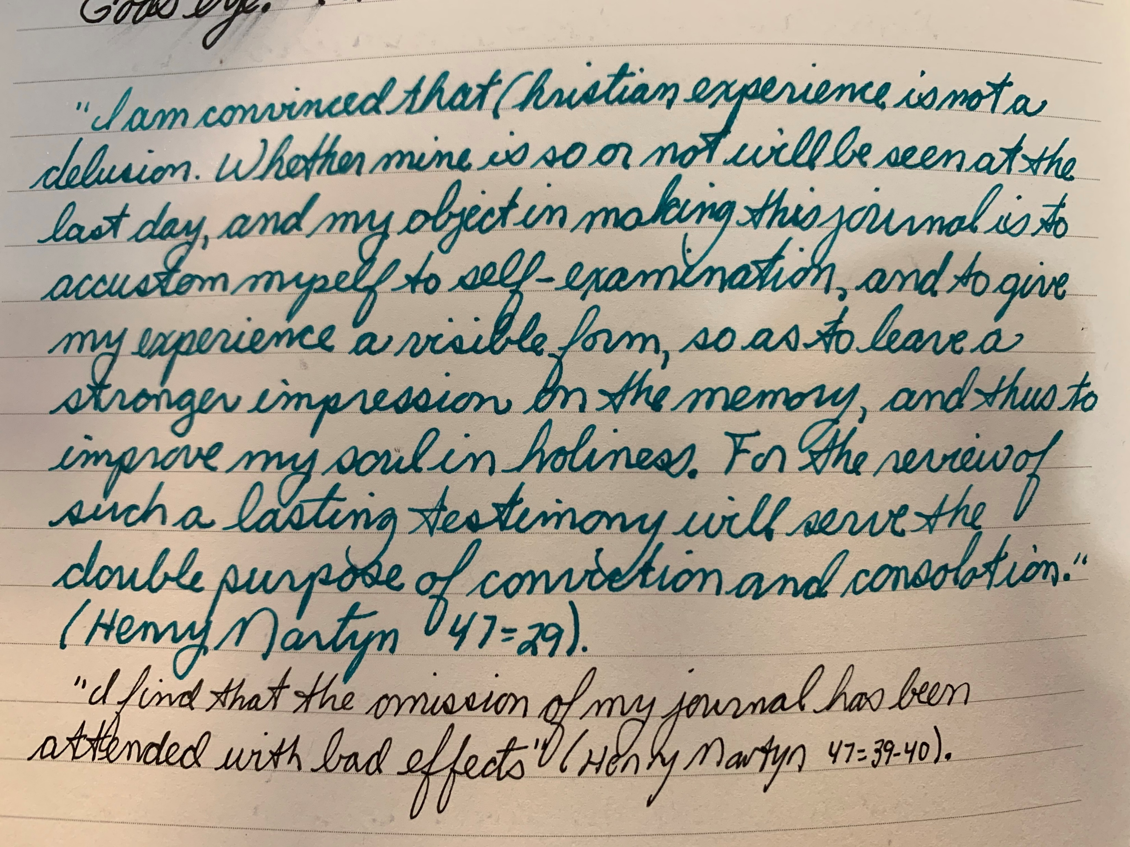

Slide 27
Daily Devotional
Life 2021
Activities:
Reviewing SS lessons and sermons
Meditating
Singing
Journaling
Planning the day
© [YEAR] Communicate Jesus. All rights reserved. Originally published at www.communicatejesus.com.”

Slide 28
Daily Devotional
Life 2021
What a daily devotional habit is.
© [YEAR] Communicate Jesus. All rights reserved. Originally published at www.communicatejesus.com.”

