Slide 1




Slide 2
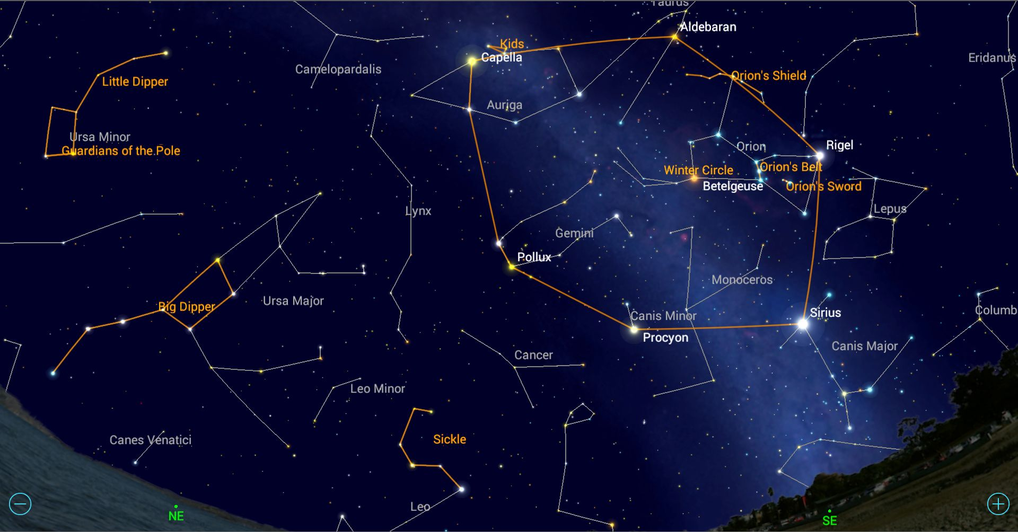

Slide 3
  Oh! That I knew how all thy lights combine,
  And the configuration of thy glory;
  Seeing not only how each verse doth shine,
  But all the constellations of the story.
  --George Herbert

Slide 4
Psalms 10-14

Slide 5
Psalms 10-14
Psalms 15 following. . .

Slide 6
Psalms 10-14
Psalms 15 following. . .
--longing for the LORD

Slide 7
Psalms 10-14
Psalms 15 following. . .
--longing for and loving the LORD

Slide 8
  Psalm 15 Righteous Requirements to Dwell with the LORD

Slide 9
  Psalm 15 Righteous Requirements to Dwell with the LORD
  (which only our Lord could meet)

Slide 10
  Psalm 15 Righteous Requirements to Dwell with the LORD
  (which only our Lord could meet)
  Psalm 16 Prayer for Preservation Incorruptible Into the LORD’s
  Presence

Slide 11
  Psalm 15 Righteous Requirements to Dwell with the LORD
  (which only our Lord could meet)
  Psalm 16 Prayer for Preservation Incorruptible Into the LORD’s
  Presence
  (which only our Lord could pray confidently)

Slide 12
  Psalm 15 Righteous Requirements to Dwell with the LORD
  (which only our Lord could meet)
  Psalm 16 Prayer for Preservation Incorruptible Into the LORD’s
  Presence
  (which only our Lord could pray confidently)
  Psalm 17 Prayer to Awake In Righteousness with His Likeness

Slide 13
  Psalm 15 Righteous Requirements to Dwell with the LORD
  (which only our Lord could meet)
  Psalm 16 Prayer for Preservation Incorruptible Into the LORD’s
  Presence
  (which only our Lord could pray confidently)
  Psalm 17 Prayer to Awake In Righteousness with His Likeness
  (which only our Lord could expect without imputation)

Slide 14
  Tonight: Psalm 18

Slide 15
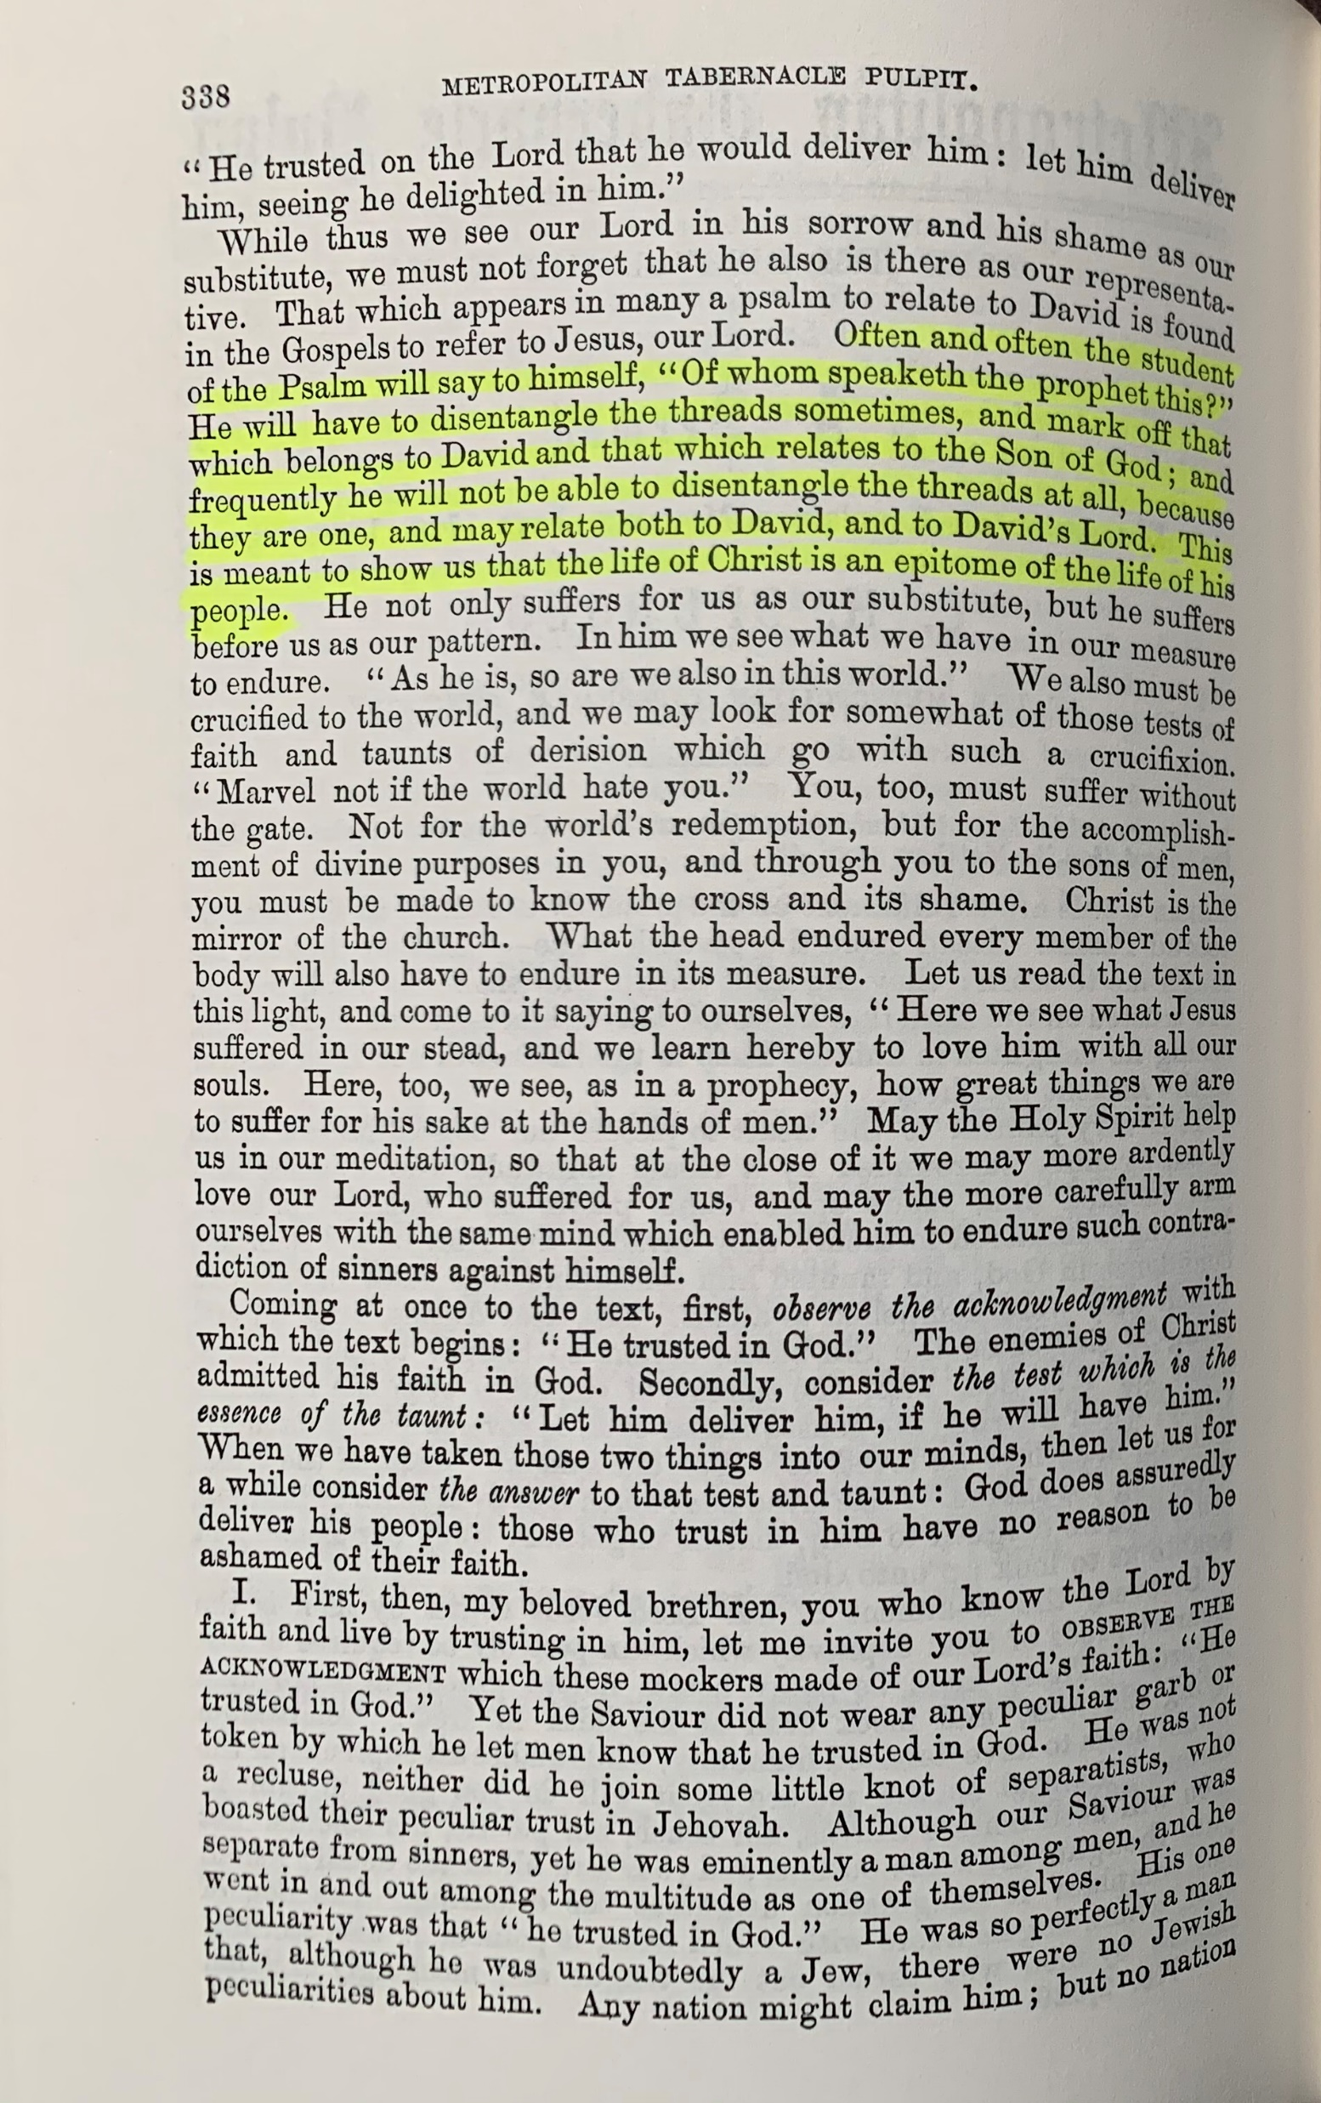
Often and often the student of the Psalm
will say to himself, Of whom speaketh the
prophet this?

Slide 16
Often and often the student of the Psalm
will say to himself, Of whom speaketh the
prophet this?
He will have to disentangle the threads
sometimes, and mark off that which belongs to David and that which relates to the Son of God;

Slide 17
Often and often the student of the Psalm
will say to himself, Of whom speaketh the
prophet this?
He will have to disentangle the threads
sometimes, and mark off that which belongs to David and that which relates to the Son of God; and frequently he will not be able to disentangle the threads at all, because they are one, and may relate both to David, and to David’s Lord.

Slide 18
  Tonight: Psalm 18

Slide 19
  Tonight: Psalm 18 Let’s Read. . .

Slide 20
Often and often the student of the Psalm
will say to himself, Of whom speaketh the
prophet this?

Slide 21
He will have to disentangle the threads sometimes, and mark off that which belongs to David and that which relates to the Son of God.

Slide 22
  Psalm 18

Slide 23
  Psalm 18
  I. CONSTRAINS US TO ATTEMPT TO DISENTANGLE THE THREADS.

Slide 24
  Psalm 18
  I. CONSTRAINS US TO ATTEMPT TO DISENTANGLE THE THREADS.
  A. The Superscript: Informs Us That David Is The One Speaking.

Slide 25
  Psalm 18
  I. CONSTRAINS US TO ATTEMPT TO DISENTANGLE THE THREADS.
  A. The Superscript: Informs Us That David Is The One Speaking.
  B. The 49th Verse

Slide 26
  Psalm 18
  I. CONSTRAINS US TO ATTEMPT TO DISENTANGLE THE THREADS.
  A. The Superscript: Informs Us That David Is The One Speaking.
  B. The 49th Verse (Romans 15:9)

Slide 27
  Psalm 18
  I. CONSTRAINS US TO ATTEMPT TO DISENTANGLE THE THREADS.
  A. The Superscript: Informs Us That David Is The One Speaking.
  B. The 49th Verse Is Quoted By Paul AS Being Of Our Lord.

Slide 28
  Psalm 18
  I. CONSTRAINS US TO ATTEMPT TO DISENTANGLE THE THREADS.
  A. The Superscript: Informs Us That David Is The One Speaking.
  B. The 49th Verse Is Quoted By Paul AS Being Of Our Lord.
  C. Sections We Might Be Able To Disentangle.

Slide 29
  Psalm 18
  I. CONSTRAINS US TO ATTEMPT TO DISENTANGLE THE THREADS.
  A. The Superscript: Informs Us That David Is The One Speaking.
  B. The 49th Verse Is Quoted By Paul AS Being Of Our Lord.
  C. Sections We Might Be Able To Disentangle.
  1. Vv. 37-42?

Slide 30
  Psalm 18
  I. CONSTRAINS US TO ATTEMPT TO DISENTANGLE THE THREADS.
  A. The Superscript: Informs Us That David Is The One Speaking.
  B. The 49th Verse Is Quoted By Paul AS Being Of Our Lord.
  C. Sections We Might Be Able To Disentangle.
  1. Vv. 37-42? David

Slide 31
  Psalm 18
  I. CONSTRAINS US TO ATTEMPT TO DISENTANGLE THE THREADS.
  A. The Superscript: Informs Us That David Is The One Speaking.
  B. The 49th Verse Is Quoted By Paul AS Being Of Our Lord.
  C. Sections We Might Be Able To Disentangle.
  1. Vv. 37-42? David
  2. Vv. 43-48?

Slide 32
  Psalm 18
  I. CONSTRAINS US TO ATTEMPT TO DISENTANGLE THE THREADS.
  A. The Superscript: Informs Us That David Is The One Speaking.
  B. The 49th Verse Is Quoted By Paul AS Being Of Our Lord.
  C. Sections We Might Be Able To Disentangle.
  1. Vv. 37-42? David
  2. Vv. 43-48? David?

Slide 33
  Psalm 18
  I. CONSTRAINS US TO ATTEMPT TO DISENTANGLE THE THREADS.
  A. The Superscript: Informs Us That David Is The One Speaking.
  B. The 49th Verse Is Quoted By Paul AS Being Of Our Lord.
  C. Sections We Might Be Able To Disentangle.
  1. Vv. 37-42? David
  2. Vv. 43-48? David? Our risen Lord?

Slide 34
He will have to disentangle the threads sometimes, and mark off that which belongs to David and that which relates to the Son of God.

Slide 35
  Frequently he will not be able to disentangle the threads
  at all, because they are one, and may relate both to
  David, and to David’s Lord.

Slide 36
  Psalm 18
  I. CONSTRAINS US TO ATTEMPT TO DISENTANGLE THE THREADS.

Slide 37
  Psalm 18
  CONSTRAINS US TO ATTEMPT TO DISENTANGLE THE THREADS.
  II. CONTAINS SECTIONS WE CANNOT DISENTANGLE (50).

Slide 38
  Psalm 18
  CONSTRAINS US TO ATTEMPT TO DISENTANGLE THE THREADS.
  II. CONTAINS SECTIONS WE CANNOT DISENTANGLE (50).
  A. His anointed

Slide 39
  Psalm 18
  CONSTRAINS US TO ATTEMPT TO DISENTANGLE THE THREADS.
  II. CONTAINS SECTIONS WE CANNOT DISENTANGLE (50).
  A. His anointed (Psalm 2:2).

Slide 40
  Psalm 18
  CONSTRAINS US TO ATTEMPT TO DISENTANGLE THE THREADS.
  II. CONTAINS SECTIONS WE CANNOT DISENTANGLE (50).
  A. His anointed (Psalm 2:2).
  B. David and his descendants

Slide 41
  Psalm 18
  CONSTRAINS US TO ATTEMPT TO DISENTANGLE THE THREADS.
  II. CONTAINS SECTIONS WE CANNOT DISENTANGLE (50).
  A. His anointed (Psalm 2:2).
  B. David and his descendants (זֶרָע )

Slide 42
  Psalm 18
  CONSTRAINS US TO ATTEMPT TO DISENTANGLE THE THREADS.
  II. CONTAINS SECTIONS WE CANNOT DISENTANGLE (50).
  A. His anointed (Psalm 2:2).
  B. David and his descendants (זֶרָע seed )

Slide 43
  Psalm 18
  CONSTRAINS US TO ATTEMPT TO DISENTANGLE THE THREADS.
  II. CONTAINS SECTIONS WE CANNOT DISENTANGLE (50).
  A. His anointed (Psalm 2:2).
  B. David and his descendants (זֶרָע seed )
  Now the promises were spoken to Abraham and to his seed. He does not say, "And to seeds," as referring to many, but rather to one, "And to your seed," that is, Christ (Gal. 3:16).

Slide 44
  Psalm 18
  CONSTRAINS US TO ATTEMPT TO DISENTANGLE THE THREADS.
  II. CONTAINS SECTIONS WE CANNOT DISENTANGLE (50).
  A. His anointed (Psalm 2:2).
  B. David and his descendants (זֶרָע seed )
  Vv 4-6

Slide 45
He will have to disentangle the threads sometimes, and mark off that which belongs to David and that which relates to the Son of God.

Slide 46
  Frequently he will not be able to disentangle the threads
  at all, because they are one, and may relate both to
  David, and to David’s Lord.

Slide 47
  This is meant to show us that the life of Christ is an epitome of the life of his people.

Slide 48
  Psalm 18
  CONSTRAINS US TO ATTEMPT TO DISENTANGLE THE THREADS.
  II. CONTAINS SECTIONS WE CANNOT DISENTANGLE (50).

Slide 49
  Psalm 18
  CONSTRAINS US TO ATTEMPT TO DISENTANGLE THE THREADS.
  II. CONTAINS SECTIONS WE CANNOT DISENTANGLE (50).
  III. REVEALS WAYS IN WHICH HIS LIFE EPITOMIZES OURS.

Slide 50
  Psalm 18
  CONSTRAINS US TO ATTEMPT TO DISENTANGLE THE THREADS.
  II. CONTAINS SECTIONS WE CANNOT DISENTANGLE (50).
  REVEALS WAYS IN WHICH HIS LIFE EPITOMIZES OURS.
  Vv 1-3

Slide 51
  Psalm 18
  CONSTRAINS US TO ATTEMPT TO DISENTANGLE THE THREADS.
  II. CONTAINS SECTIONS WE CANNOT DISENTANGLE (50).
  REVEALS WAYS IN WHICH HIS LIFE EPITOMIZES OURS.
  Vv 1-3 I love You, O LORD. . .

Slide 52
  Psalm 18
  CONSTRAINS US TO ATTEMPT TO DISENTANGLE THE THREADS.
  II. CONTAINS SECTIONS WE CANNOT DISENTANGLE (50).
  REVEALS WAYS IN WHICH HIS LIFE EPITOMIZES OURS.
  Vv 1-3 I love You, O LORD. . . in Whom I take refuge

Slide 53
  How much of Psalm 18 concerns our Lord?

Slide 54
  How much of Psalm 18 concerns our Lord?
  I. OUR LORD’S CONCEPTION?

Slide 55
  How much of Psalm 18 concerns our Lord?
  I. OUR LORD’S CONCEPTION?
  II. THE APOSTLES’ CONCEPTION (Romans 15:9).

Slide 56
  How much of Psalm 18 concerns our Lord?
  I. OUR LORD’S CONCEPTION?
  II. THE APOSTLES’ CONCEPTION (Romans 15:9).
  III. OUR CONCEPTION?

Slide 57
  How much of Psalm 18 concerns our Lord?
  I. OUR LORD’S CONCEPTION?
  II. THE APOSTLES’ CONCEPTION (Romans 15:9).
  III. OUR CONCEPTION?
  A. Occasionally A Verse Is Messianic?

Slide 58
  How much of Psalm 18 concerns our Lord?
  I. OUR LORD’S CONCEPTION?
  II. THE APOSTLES’ CONCEPTION (Romans 15:9).
  III. OUR CONCEPTION?
  A. Occasionally A Verse Is Messianic?
  B. Pervasively Messianic?

Slide 59
  How much of Psalm 18 concerns our Lord?
  I. OUR LORD’S CONCEPTION?
  II. THE APOSTLES’ CONCEPTION (Romans 15:9).
  III. OUR CONCEPTION?
  A. Occasionally A Verse Is Messianic?
  B. Pervasively Messianic?
  We tend to read entire Book in terms of Psalm 1
  and only occasionally find Him (Psalm 2).

Slide 60
  How much of Psalm 18 concerns our Lord?
  I. OUR LORD’S CONCEPTION?
  II. THE APOSTLES’ CONCEPTION (Romans 15:9).
  III. OUR CONCEPTION?
  A. Occasionally A Verse Is Messianic?
  B. Pervasively Messianic?
  He taught to read in terms of Psalm 2,

Slide 61
  How much of Psalm 18 concerns our Lord?
  I. OUR LORD’S CONCEPTION?
  II. THE APOSTLES’ CONCEPTION (Romans 15:9).
  III. OUR CONCEPTION?
  A. Occasionally A Verse Is Messianic?
  B. Pervasively Messianic?
  He taught to read in terms of Psalm 2, and then
  to find ourselves (Psalm 1).

Slide 62
  How much of Psalm 18 concerns our Lord?
  I. OUR LORD’S CONCEPTION?
  II. THE APOSTLES’ CONCEPTION (Romans 15:9).
  III. OUR CONCEPTION?
  A. Occasionally A Verse Is Messianic?
  B. Pervasively Messianic?
  Keep your left eye on David, and your right eye
  full of Christ.

