Slide 1
Imagine Fox Cities
Living Vision Presentation
Notes:
INTRO (1-minute)
Narrator – Please note this is your presentation to scale as needed per audience. Please feel free to save the presentation and utilize all of it or some of it. You can also print the “What we heard” and ”Living Vision” documents from the website for correlating material to act as handouts for the group. For questions, please fill out the contact us page on the Imagine Fox Cities website. Thank you for your support!
- Welcome - Narrator’s job title / roles and responsibilities within Imagine Fox Cities or company/group (if applicable)

Slide 2
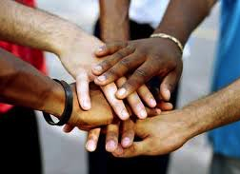
Today’s Agenda
What is Imagine Fox Cities?
What does “well-being” mean?
Imagine Fox Cities findings
Bringing the Living Vision to life!
Notes:
AGENDA (1-minute)
Narrator - Summarize what will be covered in the Imagine Fox Cities Living Vision presentation, which includes the following pieces:
What is Imagine Fox Cities? Overall goals of the Imagine Fox Cities initiative.
What defines well-being?
Imagine Fox Cities findings (Grouped into themes)
What is the Imagine Fox Cities living vision? (Based on community input)
How can we bring the vision to life, together?

Slide 3
To bring the Living Vision to life, we imagine a place where …
Kids get off to a strong start and onto a positive pathway
We have an economy that works for everyone
Shared spaces and a rich cultural environment connect us
We ALL belong!
Notes:
So what is the Living Vision? (2-minutes) - Today we are going to discuss how Imagine Fox Cities, with help from the community, developed a Living Vision for the future of the Fox Cities. - We’ll also discuss ways in which you can help move the Living Vision forward! - Keep this Living Vision in mind today as we discuss our Imagine Fox Cities findings and commitments for the future.
Through our shared living vision, we imagine a place where:
Kids get off to a strong start and onto a positive life pathway
A place where parents and families of all forms feel supported and equipped to fulfill their essential role.
All kids in the Fox Cities have access to quality schools that foster their intellectual, emotional, and social skills.
Young people who grow up here know what it is like to be raised and cared for by the village.
We have an economy that works for everyone
A place with a strong and diverse economic environment.
Traditional industries, small businesses and entrepreneurs benefit from a strong and well-prepared workforce.
They reciprocate by providing healthy work environments and livable wages—ensuring all community members can afford basic needs, including humane housing, healthy food, and insurance.
Strong regional collaboration across municipalities, villages, and counties ensures a physical infrastructure and essential services to bolster sustainable economic growth.
Shared spaces and a rich cultural environment connect us
A place where we feel a strong sense of community and deep connection.
It is a hallmark of life here, why people come and stay.
We have a smaller town feel with the openness and cultural amenities that rival those of larger metropolitan areas; the variety of cultural attractions reflects the diversity and diverse interests of the population.
Our widely used and strongly supported trails, parks and civic spaces bring our distinctive towns and villages together.
We all belong
A place with a visible culture of caring, generosity and compassion.
Ours is a community where helping each other is habitual—as mentors, as neighbors, as volunteers.
When in need, there are support systems and people eager to help.
Newcomers feel welcome here.
In fact, people from all walks, races, gender identities, and ages feel respected and included here.
Ours is a place where people who never leave have no regrets and those who do are constantly tempted to come home!

Slide 4
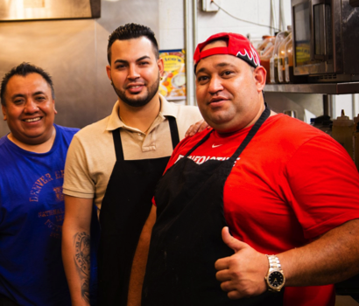
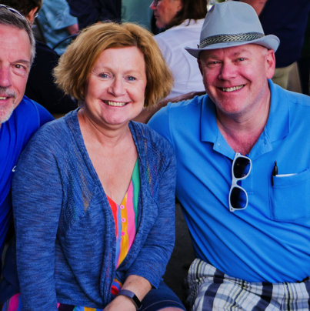
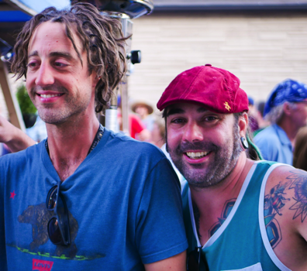
Our hope for today …
How can YOU help the community move the Living Vision forward?
Notes:
OUR HOPE FOR TODAY (1-minute)
Narrator – Use this slide to clearly outline the goals of the presentation. Show your enthusiasm. Encourage participants to take notes and gather their thoughts (on how they can help move the vision forward) throughout the length of the presentation. Welcome questions. Make sure the participants understand the value they bring. Add in personal stories whenever possible and applicable. Keep future generations and quality of life at the forefront of presentation. - Today we’re going to discuss concepts such as “what does well-being mean?” It’s our hope that you leave here with an understanding of how Imagine Fox Cities defines well-being and why it’s a good measure of how we’re doing as a region - As we work through our workshop today, think about the research findings and how they are similar or different for your own experience - Lastly, we want to know, how can YOU help the community move the Imagine Fox Cities Living Vision forward?

Slide 5
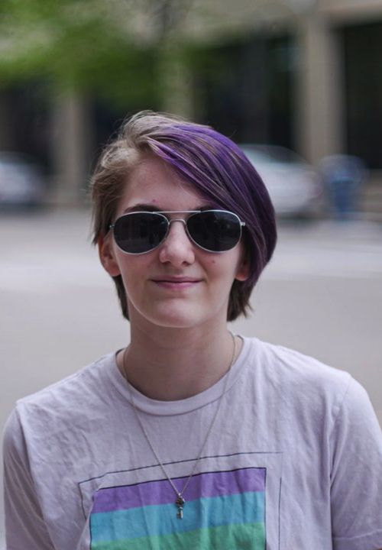
What is Imagine Fox Cities?
Initiative involving close to 20 municipalities that make up the Fox Cities
Aim is to advance the well-being of our people and community to support all those who call this place home … now and for generations to come.
Notes:
DEFINITION (1-minute) Narrator – Use this slide to discuss the goals for Imagine Fox Cities. - Imagine Fox Cities is a regional-wide initiative created to be more intentional about shaping the future of the Fox Cities to improve individual and collective well-being.
- Imagine Fox Cities was initiated in late 2017 by a diverse array of community members (now called the Coordinating Committee) with the purpose of looking ahead a generation or two and imagining what the Fox Cities could ideally look like in the future
- The Coordinating Committee wanted to develop a Living Vision (that can change over time) which would provide a path forward to create a better sense of well-being for future generations. In order to do that, input was needed from as many people as possible who live and/or work in the Fox Cities. - The Coordinating Committee spent most of 2018 focused on surveying more than 3,000 diverse people throughout the region and hosting community conversations to discover how people feel they are doing personally, financially, socially, physically and mentally as well as how they feel about the future for themselves and their children, what they desire for the future and what’s needed to achieve it. - Input was meticulously collected and analyzed and shared at the first-ever Imagine Fox Cities summit where more than 300 diverse community members gathered to discuss the findings and outline next steps.

Slide 6
What is well-being?
Imagine Fox Cities defines well-being as how people feel about their lives
Notes:
WELL-BEING (1-minute)
Imagine Fox Cities uses the word well-being quite a lot. Ask the group to consider what well-being means to them personally. - It’s important to define what well-being means to Imagine Fox Cities because so often it is viewed as a term used for health and wellness, but it is so much more than just eating right and exercising. It is inclusive to all aspects of life that contribute to a person’s or community’s quality of life. Well-being is a person’s perception of how they are doing – physically, mentally, socially, financially and overall having hope and purpose in life and feeling a sense of social connection and belonging.
- There is now a well-studied compilation of vital conditions that contribute to community well-being and allow us to thrive, flourish and become our best selves. These conditions include having adequate and affordable housing, access to basic needs such as healthcare and safety, meaningful work and wealth, the chance for lifelong learning, a healthy environment and a sense of social connection and belonging.
- Furthermore, well-being of people is both how people feel about their lives and how long they are likely to live. Health, security, prosperity, sense of connection, and purpose all play a role in well-being. - Definitions of Thriving, Struggling and Suffering: Thriving = growing or developing well or vigorously / to prosper or flourish
Struggling = striving to achieve or attain something in the face of difficulty or resistance Suffering = the state of undergoing pain, distress, or hardship

Slide 7
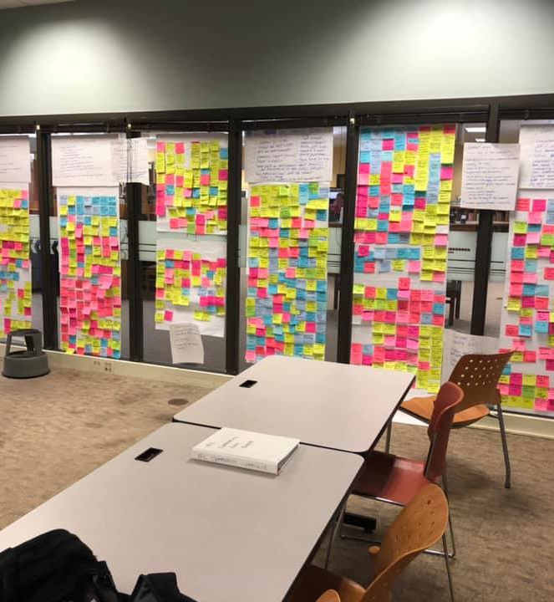
Community Conversations
80 conversations including 800 individuals
Demographics mirrored geographic, racial/ethnic and gender profile of the Fox Cities
Comments were analyzed over the span of three months to identify trends.
Notes:
COMMUNITY CONVERSATIONS: (1-minute) Narrator – A group of volunteers spent countless hours sorting through feedback from more than 80 Community Conversations, including 800 individuals whose collective demographics mirrored the geographic, racial/ethnic and gender profile of the Fox Cities. Every sticky note showcases one comment that filled an entire room. This information was tabulated (along with the 3,000 community surveys) analyzed for key themes and served as the foundation for the Living Vision.

Slide 8
Survey Demographics Snapshot
Gender
67.3% female | 28.8% male | 0.4% non-binary | 3.5% no answer
Ages 1.1% ages 17 and under | 3.9% ages 18-23 36.8% ages 24-42 | 27.6% ages 43-54 21.7% ages 55-66 | 5.1 % ages 67–73 1.3% ages 74 and older | 2.5% no answer
Notes:
SURVEY DEMOGRAPHICS (1-minute)
Narrator – The survey was completed by nearly 3,000 people. Be sure to relay the weight of that number. It was the goal of Imagine Fox Cities to be as inclusive as possible. More women completed the Imagine Fox Cities survey than men.
The age breakdown shows:
The largest age bracket to complete the survey were those ages 24-42 followed by ages 43-54
There was also a separate adolescent survey available to those under 18

Slide 9
Survey Demographics Snapshot Cont.
Communities
Appleton Neenah Greenville Little Chute
Grand Chute Menasha Fox Crossing Harrison
Kimberly Kaukauna Other
Notes:
SURVEY DEMOGRAPHICS (1-minute)
Every city, town and village was represented in good proportion to their size relative to the whole Fox Valley area.

Slide 10
Survey Results on Well-Being
Notes:
SURVEY RESULTS (1-minute)
Definitions of Thriving, Struggling and Suffering: Thriving = growing or developing well or vigorously / to prosper or flourish
Struggling = striving to achieve or attain something in the face of difficulty or resistance Suffering = the state of undergoing pain, distress, or hardship
Through the well-being survey, Imagine Fox Cities tabulated and analyzed the following data from a diverse group of people from differing backgrounds in regards to their age, race, gender and geographic location. It’s important to note that well-being is one’s self-perception. Per the Imagine Fox Cities, it was asked how people feel about their well-being in regards to a sliding 1 to 10 scale with 10 representing the best one could feel. 9% of the individuals who responded to our well-being survey indicated they are currently suffering. This is more than twice the national average. Does this surprise anyone? We usually consider the Fox Cities “Happy Valley” and it’s important to note that not everyone feels this way. Also, please note that more drilled down information on the survey responses and demographics can be found at imaginefoxcities.com.

Slide 11
Survey Results on Future Outlook
Notes:
SURVEY RESULTS (1-minute) - However, in this same survey - 64% of the individuals who responded say they look to the future with optimism. - Also, please note that more data can be found on the Imagine Fox Cities website at imaginefoxcities.com

Slide 12
Imagine Fox Cities Findings
Strong sense of community
Cultural and natural assets
Meaningful employment and livable wages
Education is critical
Mental health
New ways of thinking and future collaborations
Notes:
THEMES (2-minutes) Narrator – It’s important that participants understand the themes below because this information helped craft the Living Vision. See the next few slides for further details.
Six themes were identified in the research about life in the Fox Cities.
We have a strong sense of community, but not all are feeling it
We prize our cultural and natural assets
There is a will and we are looking for ways to ensure meaningful employment and livable wages for all
Education is a critical bridge to our shared future
Our mental health is clearly on the collective radar
The future will require new ways of thinking, learning and working together
It’s also important to note that Coordinating Committee members are working on weaving a Sense of Belonging through each theme identified. Through the Coordinating Committee, members are identifying areas of opportunity and growth. If you have ideas, we want to hear them! Please fill out the Contact Us card on the Imagine Fox Cities website.

Slide 13
Strong Sense of Community
Hallmark of living in the Fox Cities
Supporting family is BIG for us but families are changing
Societal changes posing a threat to sense of community (growth, technology, etc.)
Maintaining local institutions and neighborhoods is more important than ever
Time to advance equity and inclusion
Notes:
THEMES (1-minute)
Theme: We Have a Strong Sense of Community, But Not All Are Feeling It
The desire to live in a community where people feel as if they belong and are supported was a common sentiment.
Overall, people see the strong sense of community as one of the hallmarks of living in the Fox Cities.
Many people expressed how they feel supported and cared about by fellow community members.
However, there were also many who felt or experienced the Fox Cities as not welcoming to all community members.
Some of us worry that growth, technology and societal changes are posing a threat to this key community attribute. This theme also identified a need to maintain community organizations and spaces that connect us…
We have many local institutions in place to support our sense of community, such as strong local neighborhoods, community-based organizations like the YMCA, places of worship, libraries, and farmers’ markets.
All of these are critical for connecting us, and we do not want to lose them. We also have room for real growth, to create places, spaces, and events that encourage the participation of our diverse community.
This is critical “social infrastructure” that helps us maintain real relationships when the digital age sometimes divides us and undermines our empathy and sense of humanity. Next, supporting family is big for us, and it’s changing…
Our community has always put a strong value on family.
We think that strong families are as important as ever.
We want to expand opportunities to prepare and support parents as they guide children across the developmental phases, ensuring that all families can thrive. Last, we recognize it’s time to advance equity and inclusion…
Our community has a more diverse population than it did a generation ago.
While many long-time residents and the white population consider the Fox Cities to be an open and accepting place, racial and ethnic minorities, as well as members of the LGBTQ community, don’t always experience it this way.
We need to create more physical and organizational “spaces” that reflect our diversity and where everyone belongs.
There is a real opportunity to be inclusive and to advance equitable prosperity.

Slide 14
Cultural and Natural Assets
Growing appetite for more and different cultural outlets
Maintaining cultural experiences as a source of pride
Engaging in outdoor activities is a big part of who we are
Notes:
THEMES (1-minute)
We prize our cultural and natural assets
Our community has an abundance of cultural and natural physical assets.
It’s what distinguishes us from other regions, and many of us take full advantage.
We recognize that these assets will not automatically maintain themselves; we need to support and fund them.
We need to be mindful to ensure cultural venues and outdoor opportunities meet the needs of an increasingly diverse community.
This theme identified:
Providing many, different cultural experiences as a source of pride…
We value our arts institutions such as the PAC and Bergstrom Mahler Museum, as well as other cultural offerings such as Mile of Music, Octoberfest, Bazaar After Dark, food truck rallies, and concerts, such as PorchaPalooza in Menasha.
We want to build on this culture, which is such a big part of our quality of life—and a real plus for attracting and retaining talent.
A growing appetite for more and different cultural outlets…
We are interested in continuing to expand and diversify opportunities and places to connect, find entertainment, and learn
—from new eateries, art of all kinds, repurposing of underutilized real estate and vacant store fronts, intergenerational and youth led activities, celebrating Pride, enhanced multicultural programming at schools, community gardens, and activities to include options for persons of differing abilities.
Engaging in outdoor activities is a big part of who we are…
The Fox Cities are surrounded by natural beauty and opportunities for relaxation and outdoor activity.
From the Fox River itself to the many parks and growing number of bike trails to Lake Winnebago and nature preserves, there is plenty for the outdoor sports enthusiast, for families, for anyone to spend time outside.

Slide 15
Meaningful Employment and Livable Wages
Planning for future workforces / innovation
Attracting employers to the area that can offer stable and rewarding jobs
Meeting the holistic needs of employees
Notes:
THEMES (1-minute)
There is a will and we are looking for ways to ensure meaningful employment and livable wages for all
While our community sees the current employment environment as an asset, we acknowledge that it is important to continuously diversify employment opportunities and strengthen wages.
Our future generations will only be able to flourish if they can access good jobs, across the community, with healthy work environments—and our businesses must thrive in order to provide them.
This theme looks at:
Attracting employers to enliven and invigorate traditional industries…
While we have a strong foundation of employers, we need to continue to attract businesses that will increase the number of stable and rewarding jobs for high school and college graduates.
Meeting the needs of the whole employee…
Many businesses in the Fox Cities provide well-paying jobs that support our community members in providing for themselves and their families and help set the stage to enjoy a strong quality of life.
Our employers increasingly recognize the needs of the whole employee and are offering workplaces that are healthy, safe, and supportive.
Planning for the jobs of the future….
Our communities must deepen our commitment to training/re-training the existing workforce to prepare for greater automation.
We need to expand our approaches to on-the-job training, mentorship and partnerships with educational and vocational institutions.
Increased support for entrepreneurship and growth of tech jobs could help diversify the types of companies and positions available.
Our region can innovate to provide more benefits such as a Fox Cities Retirement Plan, a living wage and 30-hour workweeks to help combat part-time employment and low/stagnant wages.

Slide 16
Education is Critical
Prioritizing early childhood education is essential
Recognizing the need for inclusion and innovation
Supporting the holistic needs of children so they can thrive in our ever-changing world
Notes:
THEMES (1-minute)
Education as a critical bridge to our shared future
Our many educational institutions are some of our community’s greatest strengths.
Our local schools are a draw for businesses recruiting new employees.
Many families have choices for enrolling their children in the type of school they feel will be the best fit.
There also exist disparities across school districts around funding, arts and other enrichment activities, as well as student supports.
Key attributes to this theme include
Engaging the family and early childhood education are essential…
We want to support parents in preparing children to be lifelong learners.
Our families’ work schedules, competing priorities and understanding of what practices can be most impactful influence student readiness.
We want all children in the Fox Cities to have access to high quality early childhood education.
To achieve this we recognize resources will be needed to improve access opportunities and more adequately compensate early childhood educators.
Prioritizing inclusion and innovation…
We recognize education as fundamental to experiencing high levels of health and well-being and want to meet different types of learners where they are to help ensure all children can thrive.
Our online classrooms, vocational tracks, expanded language options and access to technology provide a good start.
Focusing on student strengths, using multi-culturally representative curricula and expanding supports for first generation college applicants and those poised to pursue employment immediately after high school graduation are among the bold ideas for the future.
Supporting the whole child to thrive in a changing world…
Our students arrive at school as more than just learners.
We want to support the whole child by providing a well-rounded education that fosters a culture of respect, prepares them for the activities of daily living and develops values-driven citizens.
We endeavor to celebrate every child’s uniqueness and support children in matching their gifts to a purpose-filled life.
There are pockets of effective programs and student resources, and we need to lift up the best of these and launch others.

Slide 17
Mental Health
Realizing it’s time to talk about mental health
Improving access to mental health services
Boosting resiliency
Notes:
THEMES (1-minute)
Our mental health is clearly on the collective radar
We have a concern about the decline in mental health across the nation and our region.
We are also concerned with how it has been stigmatized.
We recognize that mental health is more than an issue or a disease—mental illness is part of being human, and we can be proactive about boosting mental well-being.
Our community is starting to take some important steps to better understand mental health and address some of the contributing factors such as trauma, anxiety, financial or physical insecurity, and isolation.
Key factors in this area include:
Realizing it’s time to talk about mental health…
Many in our community named the need to broaden the conversations about mental health.
It is a topic that is difficult because of longstanding stigmas associated with individuals suffering from mental health challenges.
Not talking about mental health merely perpetuates and escalates the challenges for those suffering in silence.
Improving access to various mental health services…
Many people reported that health care in the Fox Cities is easy to access and of excellent quality.
Mental health care was another story.
Even those who have access to good physical care find somewhat limited resources for behavioral health services, and what is available may well be unaffordable.
The most vulnerable among us are most likely to experience less affordability and access to sustainable, quality care.
There is strong support for early identification and a network of services to help manage the impacts of poor mental health.
Boosting mental health and resilience…
We recognize there are many drivers of our mental health.
One challenge that cuts across all groups—a real sense of connection and belonging—is especially challenging for our marginalized populations.
We’re interested in being proactive in promoting good mental health and growing resiliency skills for people at all ages/stages and through the engagement of our schools, places of worship, and employers.
We are also interested in finding ways to connect vulnerable or isolated people to the larger community.

Slide 18
New ways of thinking and future collaborations
Maximizing regional collaboration and maintaining local autonomy
Growing culture of people helping people
Sharing a stake in our desired future
Notes:
THEMES (1-minute)
A future that will require new ways of thinking, learning and working together
Many of us consider the Fox Cities region to be a very collaborative place.
We have plenty of examples of projects that demonstrate our ability to come together and get results.
The big challenges and opportunities we are sure to face in the future will demand new and deeper forms of collaboration—across institutions, geographies, and between people.
This theme will require
Maximizing regional collaboration and maintaining local autonomy…
We are a community that encompasses multiple smaller governmental units.
There is a strong identity and history with each of our communities, which serves us well and creates real and perceived barriers around turf.
It can sometimes feel as if the bigger communities, particularly Appleton, are where all the interest and power rest.
Wrestling with regional tensions is not new.
Many feel it’s time to find new mechanisms or processes to effectively solve problems and plan for future generations together—including considering ways to moderate redundancies in services.
Growing the culture of people helping people…
Institutions can provide essential services, but people can care for each other.
In other words, we can’t just rely on our institutions, with limited budgets, to do the work that members of our community can do: for example, raising our kids into caring neighbors and citizens, supporting new parents, and engaging isolated seniors.
These behaviors are part of a culture.
Sharing a stake in our desired future…
While this region has benefited from strong civic leadership, including business, nonprofit, and governmental leaders, it is usually the same actors who are shaping decisions.
We need and can share leadership with the next generation and groups of people who have not had a strong say or felt a stake in the future.
We have a lot of untapped leadership capacity here that we should make space for and help to cultivate.

Slide 19
To bring this Living Vision to life, we imagine a place where …
Kids get off to a strong start and onto a positive pathway
We have an economy that works for everyone
Shared spaces and a rich cultural environment connect us
We ALL belong!
Notes:
Revisit the Living Vision (2-minutes) Narrator – This is THE most important slide of this presentation. This summarizes all the findings and a clear direction forward. Please elaborate and allow time for discussion and questions. Be engaging and energetic as you run through each part. Provide personal examples of ways it resonates with you on a personal level and how it has you personally thinking about ways you can help.
Through our shared living vision, we imagine a place where:
Kids get off to a strong start and onto a positive life pathway
A place where parents and families of all forms feel supported and equipped to fulfill their essential role.
All kids in the Fox Cities have access to quality schools that foster their intellectual, emotional, and social skills.
Young people who grow up here know what it is like to be raised and cared for by the village.
We have an economy that works for everyone
A place with a strong and diverse economic environment.
Traditional industries, small businesses and entrepreneurs benefit from a strong and well-prepared workforce.
They reciprocate by providing healthy work environments and livable wages—ensuring all community members can afford basic needs, including humane housing, healthy food, and insurance.
Strong regional collaboration across municipalities, villages, and counties ensures a physical infrastructure and essential services to bolster sustainable economic growth.
Shared spaces and a rich cultural environment connect us
A place where we feel a strong sense of community and deep connection.
It is a hallmark of life here, why people come and stay.
We have a smaller town feel with the openness and cultural amenities that rival those of larger metropolitan areas; the variety of cultural attractions reflects the diversity and diverse interests of the population.
Our widely used and strongly supported trails, parks and civic spaces bring our distinctive towns and villages together.
We all belong
A place with a visible culture of caring, generosity and compassion.
Ours is a community where helping each other is habitual—as mentors, as neighbors, as volunteers.
When in need, there are support systems and people eager to help.
Newcomers feel welcome here.
In fact, people from all walks, races, gender identities, and ages feel respected and included here.
Ours is a place where people who never leave have no regrets and those who do are constantly tempted to come home!

Slide 20
Are there things you are already doing today that excite you and align with the Imagine Fox Cities Living Vision?
At home and with your family
At work or at school
Within your neighborhood
Through your volunteer efforts
With your friends and networks
Notes:
WHAT ARE PARTICIPANTS ALREADY DOING?: (1-minute)
Encourage participants to think through things that they are already doing. Can they share those things with Imagine Fox Cities via the contact page on the website?
- What types of things are participants already doing? (Whether in a group or on an individual basis) - Are there things you know of that are already taking place in the community? - What parts of the Living Vision most resonated with you? - What are you personally passionate about?

Slide 21
How can you help bring the Imagine Fox Cities Living Vision to life?
Talk with your neighbor about IFC or host a civic dinner
Start a program or initiative with your employer
Invest in educational opportunities
Support diversity and cultural assets in our community
Prioritize the well-being of your family
Notes:
DISCUSSION: (5-minutes)
- There are thousands of ways to advance the ideas of the IFC Living Vision with our own influence - Everyone has a role to play in making the Fox Cities a great place to live, work and play for future generations - What you do after today can be as big or as small as you want to make it
Take the next few minutes to brainstorm a few ways you can make the Living Vision come to life in your circle of influence. It’s brainstorming sessions like this where great ideas come to light.

Slide 22
Together, we can bring the Living Vision to life!
Please help Imagine Fox Cities today by pledging the following commitments:
Sustaining what makes this place special
Fostering innovation
Being inclusive
Measuring what matters
Building on and aligning efforts
Offering gracious space
Acting with the next generation in mind
Notes:
BRINGING THE LIVING VISION TO LIFE (1-minute)
The ownership falls on all of us collectively to make this Living Vision come to life in our community.
So what’s next? How can you help?
To bring this vision to life, commit to:
Sustaining and preserving what makes our area special
Fostering an environment that supports innovation
Being inclusive of all
Measuring what matters to our area
Building on and finding ways to align efforts
Offering gracious space to members and visitors of our communities
Acting with the next generation, and the one after that, in mind
Some examples of how groups and individuals are bringing this living vision to life include:
The Leadership Fox Cities program (as part of the Fox Cities Chamber) is hosting a number of Civic Dinners to continue discussions on how to move the Living Vison forward.
Common Ground, an interdenominational faith-based group, is working belonging and inclusivity into its strategic plan.
The Well Being in the Nation (WIN) Network highlighting Imagine Fox Cities as a community taking an innovative approach.
Neighbors talking to neighbors and hosting block parties.
Book clubs diving into the Living Vision and inspiring new ways of thinking.
Volunteer Fox Cities highlighting Imagine Fox Cities on their videos by showcasing neat ways volunteers are impacting the community (See video on next slide.)

Slide 23
Support Imagine Fox Cities
Utilize the Imagine Fox Cities website to access a promotional tool kit. On the website, you’ll find:
Logos
Video examples
Social media posts
Print collateral
Presentations
And more! www.imaginefoxcities.com
Notes:
TOOL KIT (1-minute) - The Imagine Fox Cities website is the central location for all things resources - On the website, you’ll find a tool kit which will help you brand your current programs and initiatives with Imagine Fox Cities - You’ll also find ways to promote Imagine Fox Cities to your own circle of influence - For questions, you can also reach out to Imagine Fox Cities through an easy contact form

Slide 24
Share your Imagine Fox Cities stories
We want to hear from you!
Show us the ways you are moving the Living vision forward
Submit your stories, photos or videos online at www.imaginefoxcities.com
Notes:
SHARE YOUR STORY (1-minute) - For those of you who are already bringing the vision to life or have plans to do so, please share what you’re doing.
- For those of you who plan to do things in the future, again, please share your stories back with us. - This could include starting a business, implementing a neighborhood block party, taking the Living Vision to your employer and creating a new program, etc. The sky is the limit. - To share what you’re doing or if you’re ready to take action, please visit imaginefoxcities.com and fill out the contact us page.
- You can also follow Imagine Fox Cities on Facebook and share more information with us there - Please note, by sharing your story, an Imagine Fox Cities Coordinating Committee member may contact you for more information

Slide 25
Thank You
ImagineFoxCities.com
Imagine Fox Cities
Notes:
WRAP-UP (1-minute)
- Thank you for engaging in this presentation.
- As a reminder, on the Imagine Fox Cities website at imaginefoxcities.com, you’ll find detailed information on the initiative’s findings, summit, Living Vision, commitments and more - We encourage you to share this presentation with your friends, family members, colleagues and beyond
- On the website, you’ll also find a commitment form, a place where you can further indicate how you want to be involved
- Do you have any questions?

